Slide 1

Project Kickoff
August 15, 2023
Sales Enablement and Webinar
Marketing Program

Slide 2

Agenda
Campaign Overview
Objectives
Deliverables
Methodology
Project Portal
Timeline
Q & A

Slide 3

Objectives
Drive engagement through compelling workshop value proposition, messaging and call-to-action
Engage prospects through a demand generation campaign that includes social media, email marketing, sales tools, and multi-step sales process
Generate excitement and capture mindshare of engineering directors, architects and influencers
Connect Telefónica and NetApp sales teams for current and future opportunities

Slide 4


Program KPIs
Increase leads to sale conversion rate
Shorten sales cycles
Drive a better ROI by producing measurable outcomes and faster short-term results
Door-opener for net-new accounts
Identify & qualify prospects early in the process
Facilitate engagement between NetApp and Telefónica teams to drive solution sales

Slide 5

Deliverables
Custom campaign and webinar assets
Co-branded NetApp/Telefónica webinar presentation - design and create a professional and engaging presentation to showcase the benefits and features of NetApp solutions.
Co-branded NetApp/Telefónica solution brief - Develop marketing briefs that highlight and promote the campaign's goals, target audience, key messaging, and tactics.
Landing page: Design and develop a visually appealing and user-friendly landing page for the event, including information about the roadshow, registration forms, and a discovery questionnaire.
Discovery questionnaire: Create a questionnaire to gather relevant information from prospective attendees and tailor the event experience to their interests.
Event registration: Set up a secure and efficient event registration system, integrated with the landing page.
Automatic email notifications: Implement a system for sending automated email notifications for event registration, reminders, and updates.
Social media posts: Create and schedule social media posts for Telefónica/NetApp across various platforms to promote webinar events and to engage potential attendees.
Email communications: Develop targeted email communications with a clear call to action, encouraging registration and attendance. Thank you email –develop a personalized thank you email to be sent to attendees after the event.

Slide 6

Event Management
Pre-Event Preparation
  Provide access to Telefónica | NetApp team members to program and campaign assets, including the presentations, brief, and other tools
  Socialize event details, agenda, and key messaging points with sales teams and stakeholders
  XL to facilitate collaboration with Telefónica/NetApp marketing and sales team members through portal platform to address any questions or concerns and ensure alignment on event goals and objectives.
Event Promotion and Registration
  Utilize the pre-developed social media posts and email communications to enable Telefónica/NetApp to promote webinar event within their professional networks.
  Monitor registration numbers and attendee engagement for Telefónica/NetApp to indentify potential leads and opportunities.
  XL to coordinate with Telefónica/NetApp marketing team to adjust messaging and execution efforts as needed.
Event Logistics and Execution
  Facilitate delivery team preparation for event presentations and product demonstrations.
  Provide scheduling information, attendee lists, registrations and follow-up meeting scheduling for Telefónica/NetApp teams.
  Coordinate communication across teams tools to ensure successful event execution.

Slide 7
Event Management (continued)
Post-Event Engagement and Follow-up
  Access attendee information and identify key prospects for post-event engagement.
  Use thank-you email template for Telefónica/NetApp sales teams to send personalized messages to attendees, thanking them for their participation and providing additional resources and suggested next steps.
  Facilitate Telefónica/NetApp follow up with identified leads to schedule meetings, product demonstrations, or other sales engagement activities.
Performance Tracking and Reporting
  Facilitate monitor and analyze event metrics to support evaluation of of results against the pre-defined KPIs.

Slide 8


Online Registration Pages and Management
Create value prop, messaging and call to action for new Telefónica | NetApp registration page
Registration page development and production - design and layout
Design, test, implement registration form with email invitations and landing page
HTML code and graphics development
Registration management and administration
Use of Telefónica | NetApp brand guidelines
Delivery and integration support for Telefónica | NetApp email invitations and landing pages
3 reminder emails (1 week prior, 1 day prior, morning of event)
Create registration confirmation email
Two review cycles with SMEs

Slide 9


Invitations
Create value prop, messaging and call to action for email invitations
Email invitation development and production - design, graphics and layout (Outlook OFT format)
Invitation to be sent by Telefónica/NetApp acct execs via OFT file
Design, test, implement email invitations with registration form and landing page
HTML code and graphics development
Incorporate registration form in the email invitation
Include hyperlinks to registration landing page and other assets as required
Two review cycles with SMEs

Slide 10

Workshop Brief
Create value prop, messaging and call to action for email invitations
Brief development and production - design, graphics and layout
Curate photos and images that meet Telefónica and NetApp guidelines
Link to registration form and landing page
Use of Telefónica and NetApp brand guidelines
Two review cycles with SMEs

Slide 11



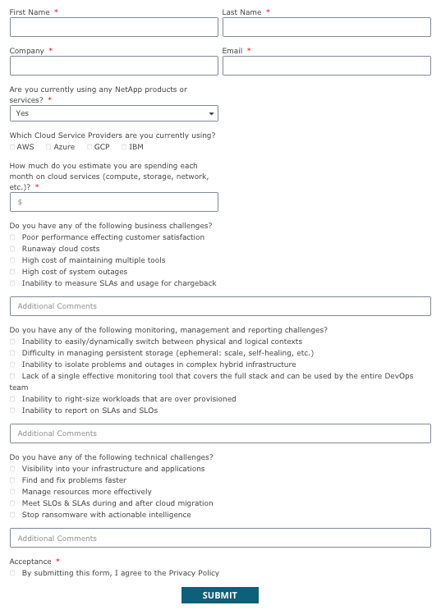
Discovery Questionnaire
Enhanced and proactive customer engagement
Customer assessment and qualification
Increased strategic alignment
Higher conversion rates
Tailored selling approach

Slide 12


Metrics and Reporting
Project portal setup and access for Telefónica and NetApp marketing and sales teams
Manage and administer process of qualifying, tracking and reporting customer registrations and attendance
Provide reporting and metrics to key stakeholders
Develop and design workshop surveys
Manage attendee feedback and survey process

Slide 13

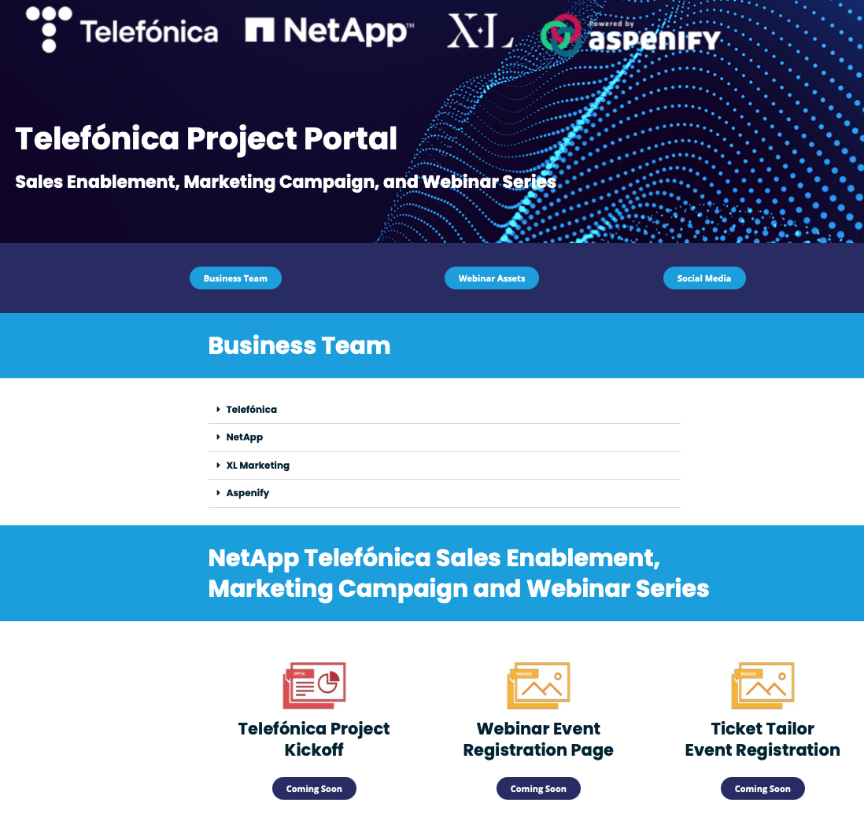

Telefónica | NetApp Project Portal
Convenient and quick access to sales tools, marketing campaign and workshop assets, social media, and templates
Metrics and reporting for net-new customer opportunities, deal status, sales inhibitors, deal size, estimated close date, and next steps.
Sales enablement tools including battlecards, ROI calculators, customer workshop registration, marketing campaign assets, POC Sign-up, social media and tools
Metrics and reporting to include Informative campaign reports and metrics to help drive sales
Key benefits - Faster time to quote, faster time to close, higher POC/Close conversion rates.
https://pmopanda.com/project-center/telefonica-project-center/

Slide 14
Project Schedule
Asset and Program Development – Aug 15th – Aug 28th
1st Draft Asset Review – Aug 29th
Telefónica Project Portal Complete – Sep 5th
Telefónica | NetApp Customer Outreach – Sep 5th– Sep 20th
2nd Draft Workshop Asset Review – Sep 7th
Final Draft Workshop Asset Review and Signoff – Sep 12th
1st Dry Run – Sep 14th (Thu)
2nd Dry Run (if required) – Sep 19th (Tue)
Telefónica Webinar Event – Sep 21st (Thu)

Slide 15

Q & A

