Slide 1

Miami-Dade
Beacon Council

Slide 2



Economic Development Organization Challenges
Municipalities have an imperative to assist the financial inclusion of affinity groups while facing intense competition to support the growth of main street businesses.
Projects seeking investment are often not properly structured for investor mandates or grants
Investors devote excessive levels of effort and time to identify and qualify projects that are the best candidates for deal flow
Notes:
Determining and reporting the impact of economic initiatives on business recruitment, expansion and retention
More detailed mainstreet business metrics
White label technology for an ecosystem platform
Matching system for investors and investments
Ecosystem mapping and navigation
Some kind of revenue share
Capital advisement of mainstreet firms with an emphasis on affinity groups

Slide 3


The Opportunity
There are 58,000+ main street businesses with 5 to 49 employees in the Miami-Dade area.
The LIH target is to economically map and navigate 1,450 (2.5%) companies in the 1st year and 7,830 (13.5%) in the 2nd year.
Notes:
https://www.beaconcouncil.com/solutions/small-business/market-research/
1400 is 2.5% of TAM from diffusion of innovation curve
https://floridajobs.org/FloridaSSBCI

Slide 4



Local Investment Hub (LIH) Platform and Infrastructure
The Local Investment Hub offers a scalable white label solution that is customized for Miami Dade Beacon to provide main street business data and metrics to map, navigate and match the ecosystem participants.
Enables ecosystem mapping, navigation and aggregates financial data of stakeholders to maximize ROI of economic initiatives
Provides exclusive virtual and in-person deal room to match investors and projects through Reg D deal flow
Capital advisory services to help ensure project initiators and issuers meet investment and grant requirement
Notes:
The Local Investment Hub is an operational, purpose-built and customized platform that provides an end-to-end investment management solution for economic development organizations

Slide 5
Platform Features
Local Investment Hub Platform Features
Features | LIH Essentials | LIH Premium
Tradex Transaction Engine and SaaS Platform | ✓ | ✓
Intuitive Investor and Issuer GUI and UX | ✓ | ✓
Administrative Control and Investment Management Panel | ✓ | ✓
Secure and Credentialed System Access – Roles and Permissions | ✓ | ✓
Amazon EC2 infrastructure and Secure S3 Cloud Object Storage | ✓ | ✓
AWS Security and Compliance Protocols | ✓ | ✓
Secure Private Deal Room | ✓ | ✓
Investor and Issuer Transaction Reporting and Analytics | ✓ | ✓
Investor and Issuer Portal and Admin Panel | ✓ | ✓
Investor Credentialed Login and Security | ✓ | ✓
Advanced Issuer Mapping and Navigation Features | ✓ | ✓
Support for Reg. D Reg A and Red CF Compliance | ✓ | ✓
Institutional Investor Assessment and Scorecard | ✓ | ✓
KYC Document Management | ✓ | ✓
Education and Enablement Tools Portal for Issuers and Investors | ✓ | ✓
CRM configuration, deployment, and integration | - | ✓
Escrow Integration and Support | - | ✓
LIH white label branding and customization | - | ✓
Customizable Issuer and Investor Forms and Workflows | - | ✓
Payment Platform Integration | - | ✓
Data Backup and Ransomware Prevention | - | ✓

Slide 6

Why Now?
Local Investment Hub today provides the technology platform and processes that give EDOs a first mover advantage to fuel economic growth
Issuer education and enablement platform available to ensure issuers to do not miss out on grant and capital raise opportunities
Investment opportunities are missed due to rapid growth and an inefficient marketplace and investment infrastructure
Notes:
growth within the community by facilitating capital investments that can be directed towards promising projects

Slide 7

Traction
LIH has a node in the Bahamas operating under the brand of ArawakX. We have raised capital on average $614K per company.
Currently LIH has a pipeline of $82 million across several industries in 4 countries
ArawakX has been featured on Fintech TV and Yahoo Finance
Notes:
LIH is about to set up nodes in 11 eastern Caribbean countries
LIH was feature on Fintech TV which shoots from the floor of the NYSE

Slide 8

Ecosystem
Miami Dade Beacon will generate revenue for each company successfully capital advised and funded
LIH business model builds an ecosystem that is underpinned with grant & fund procurement and business services fees
LIH will offer additional business and consultings services to stakeholders, companies and partners
The LIH platform fee is a flat fee $180,000 per year plus customization
Notes:
We estimate about $1,000 per business out of the $5,000 grant, fund and fee structure.
Other services offered of LIH independent of Miami Beacon include Capital Advisement, investor matching, Legal and regulatory forms, debt matching
LIH needs access to the ecosystem

Slide 9
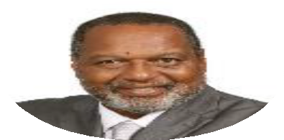
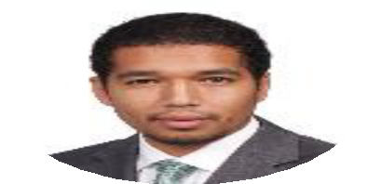

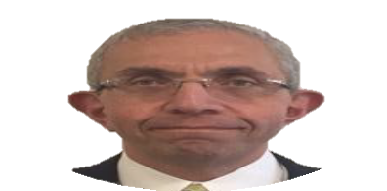

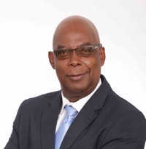



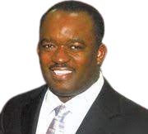
A diverse international team with tons of experience expertise in Legal, Compliance, Internet Sales, Operations, Internet Technology, Engineering and Economics.
Key Executives and Advisors
D’Arcy Rahming Sr, MBA
Chief Executive Officer
Former COO Bahamas International
Securities Exchange (BISX)
D’Arcy Rahming Jr., LLB
Chief Technology Officer
SME Management Consultant
Electrical Engineer – Securities Lawyer
Bob Hablutzel , MBA
Director - Technical Advisor
Former Pay Pal Chief Architect
Dick Kazarian, PhD
Chief Economic Advisor
Former Managing Director of
Lehman Brothers
V Nadia Butler
Chief Risk Officer
Certified Compliance Officer
Winston Rolle, PMP
Chief of Equities
Former CEO of the
Chamber of Commerce
Benita Rahming, MBA
Director – Operations Consultant
Former Operations Manager
Walk-In Clinics Bahamas
Doug Kryzan
Director - Technology Consultant
CEO CloudPro
Robertson Dieudonne
Chief Relationship Officer
Businessman
Mark Finlayson
Business & Legal Advisor
Businessman

Slide 10
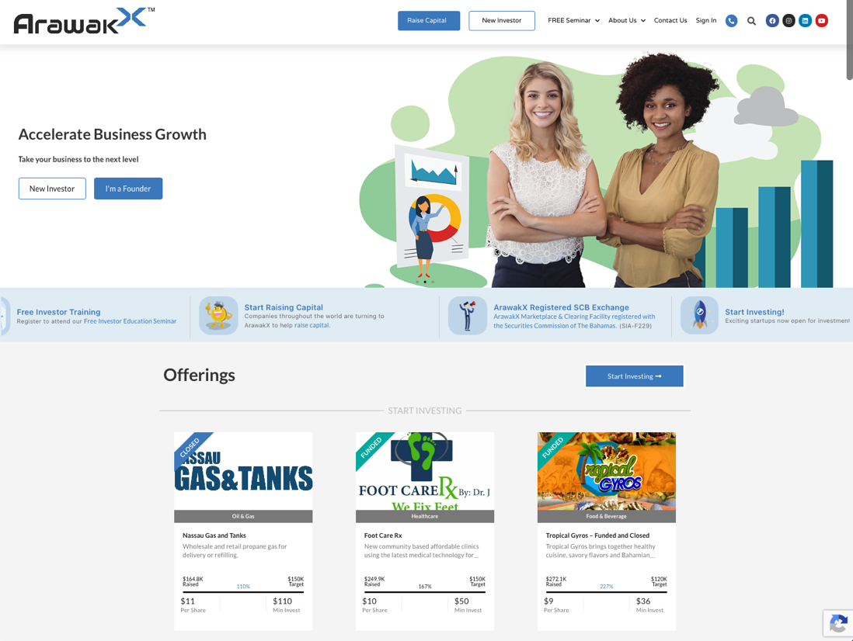
Local Investment Hub Demo
Investor and Issuer GUI and UX
Tradex Transaction Engine
Administrative Control and Investment Management Panel
Credentialed System Access
Education and Issuer Enablement Portal
Amazon EC2 infrastructure and Secure S3 Cloud Object Storage
Investor Credentialed Login and Security
Secure Private Deal Room
Investor and Issuer Transaction Reporting and Analytics

Slide 11

Next Steps
Miami-Dade Beacon Council Project Proposal
LIH Deployment scope, budget and timeline
Notes:
Facilitation of project assessment and institutional investor identification, recruitment and qualification

