Slide 1

New Product Introduction
PowerCore™ DPA-220
Webinar
Tue May 30, 2023 11:00 AM EDT
S

Slide 2




Today’s Presenters
Brian McCormick
Stewart Audio
CEO
Stephen Thomas
Stewart Audio and SP Controls
Director of Sales
Cody Dowling
Stewart Audio
VP of Engineering
Doug Kryzan
XL Marketing
CEO
S

Slide 3

Sound for Every Space
Agenda
  Our Mission
  PowerCore™ Series Overview
  DPA-220 Product Introduction
  Use Cases and Market Opportunity
  New Sales Portal
  InfoComm 2023
  Q & A
  Next Steps
S

Slide 4



Our Mission
Our mission is to elevate every sound experience through our innovative and superior audio product solutions.
We are dedicated to pushing the boundaries of audio technology, providing reliable and high-quality audio products that elevate our customers sound experiences.
We are committed to enabling our manufacturer reps and their resellers grow their business by achieving excellence in performance, quality, reliability, and customer satisfaction.
B

Slide 5

New PowerCore™ Technology
Smart. Durable. Versatile.
Sets new standard for performance, size, durability and features
Embedded Linux platform running on advanced dual-core ARM processors
Wide range of input power supply options to include DC and AC input voltages, and latest generation PoE supporting up to 90W
Uncompromising focus on design- longer life, more reliable components, updated technology blocks, improved design architectures
Advanced network and audio protocol support (Dante Embedded Platform, AES67, USB, Bluetooth) and advanced Digital Signal Processing
API support for custom integrations and integrated webserver for ease of use during deployment
Innovative “Integrator-friendly” features from real-time system/load monitoring/reporting, plenum rating, Over-the-Air (OTA) updates, and more
Rugged, Compact Design and innovative installation accessories allow products to be installed faster, in more places, with less call-backs
2-year replacement and 5-year parts & labor warranty
Made in the U.S.A.
C

Slide 6
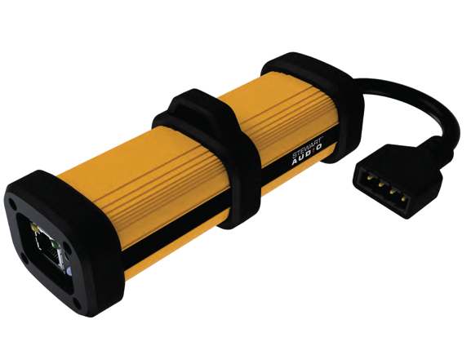
New PowerCore™
DPA-220 Audio Amplifier
Sensational Sound
Everywhere
Features & Performance | DPA-220
2x20W, 1x 40W(20-20kHz, 4/8Ω, ≤0.1% Distortion) | ✓
PoE support (802.3bt, ≤ Type 3, Negotiated) | ✓
Integrated Web Server for Set-Up & Configuration | ✓
Auto-Load Sensing & Gain Scaling at Start-up | ✓
Over-the-Air (OTA) Firmware Updates | ✓
Advanced PoE Power Negotiation at Startup | ✓
Rich Suite of Protection Features | ✓
Beacon/Identifying Strobe for Easy Identification | ✓
Multi-color LED Patterns for Status Reporting | ✓
Plenum Rated, with Hanger Wire Strap | ✓
C

Slide 7

New PowerCore™
DPA-220+ Audio Amplifier
Sensational Sound
Everywhere
All DPA-220 Features/Performance, plus… | DPA-220+
Auxiliary DC Power Supply Support (18VDC to 48VDC) | ✓
Application Programming Interface (API) Support | ✓
Real-time reporting/monitoring of system status, including…
MAC ID, Firmware ID, Dante ID | ✓
Speaker Health via Voltage/Current Monitoring | ✓
System Voltage, Temperature, PoE Status | ✓
Feature rich DSP algorithms and controls, including…
Input Scaling, Output Volume Control | ✓
Graphic or Parametric Audio Equalization | ✓
Dynamic Range Compression & Power Limiting | ✓
Auto-Ducking | ✓
Mixing/Muxing of Input Signals | ✓
Beep, Tone, Comfort/Masking Noise Generation | ✓
Symetrix Intelligent Module Support | ✓
C

Slide 8
New PowerCore™
DPA-220 vs. DPA-220+
Product Comparison
Features & Performance | DPA-220 | DPA-220+
2x20W,1x40W (20-20kHz, 4/8Ω, ≤0.1% Distortion) | ✓ | ✓
PoE Support with External DC Supply Support | ✓ | ✓
Integrated Web Server for Set-Up & Configuration | ✓ | ✓
Auto-Load Sensing & Gain Scaling at Start-up | ✓ | ✓
Over-the-Air (OTA) Firmware Updates | ✓ | ✓
Advanced PoE Power Negotiation at Startup | ✓ | ✓
Rich Suite of Protection Features | ✓ | ✓
Beacon/Identifying Strobe for Easy Identification | ✓ | ✓
Multi-color LED Patterns for Status Reporting | ✓ | ✓
Plenum Rated, with Hanger Wire Strap | ✓ | ✓
Symetrix Intelligent Module Support |  | ✓
Application Programming Interface (API) Support |  | ✓
Real-time Monitoring & Reporting of System Status, Output Voltage, Output Current, Load Impedance, Temperature |  | ✓
Digital Signal Processing (DSP) of Audio Signals |  | ✓
Integrated Beep, Tone, Noise Masking Signal Generators |  | ✓
C

Slide 9





Premium Sound for Every Space
Public and government buildings
Sound masking and background music for coworking spaces
Classrooms and higher educational institutions
Paging and background music in food-services and entertainment venues
Schools, coffee shops and houses of worship
S

Slide 10
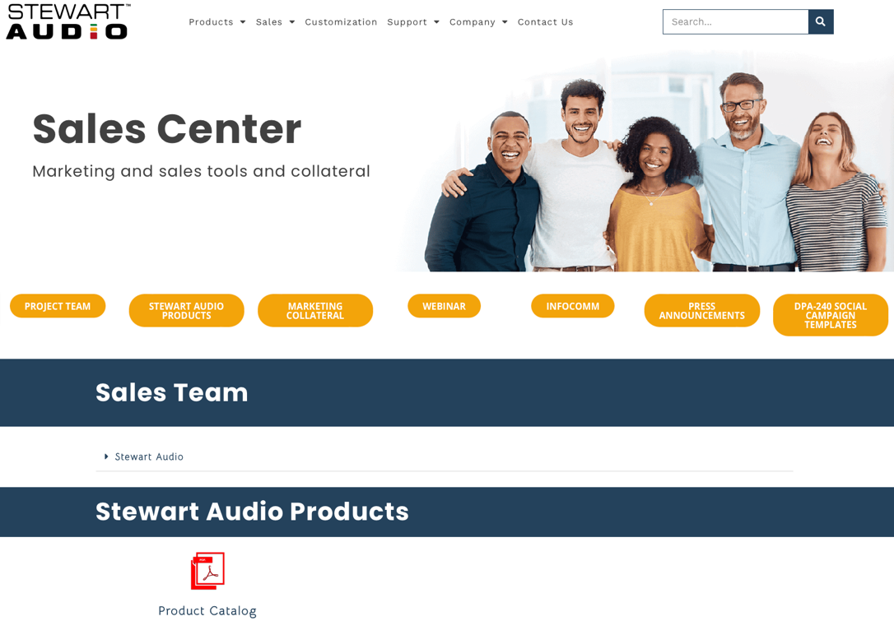
Stewart Audio Sales Portal
The Stewart Audio Sales Portal provides manufacturer reps and resellers with everything you need to know about Stewart Audio products one convenient place.
Sales Tools
Battlecards
Product Literature
Social Media Templates
Marketing Campaign Assets
Resource Directory
Email Templates
Events Calendar
Tips and Tricks
Image Library
And More!
https://stewartaudio.com/stewart-audio-manufacturer-reps-sales/ PW: SA2023AMPCON
D

Slide 11

&
A
S

Slide 12

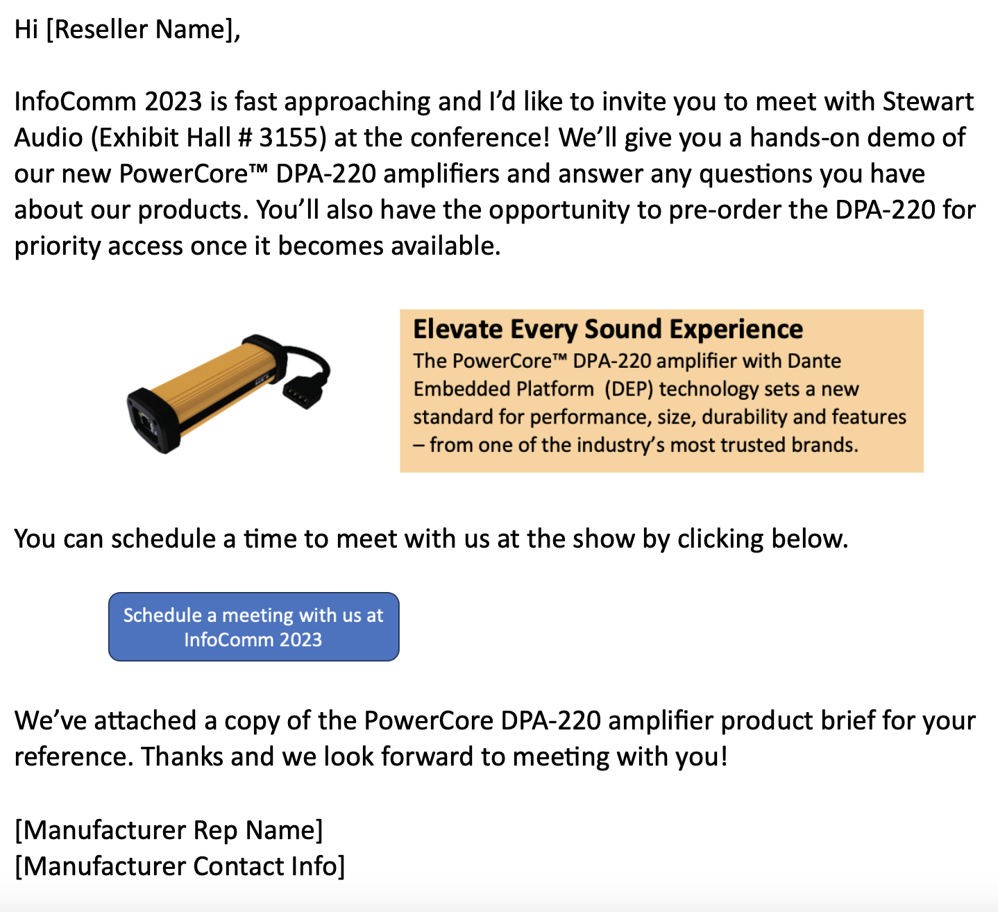
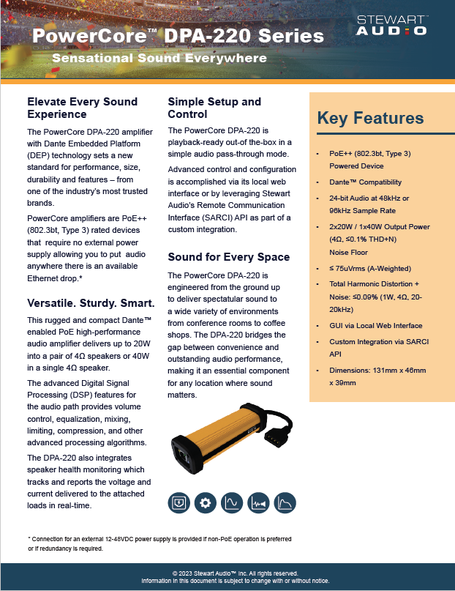
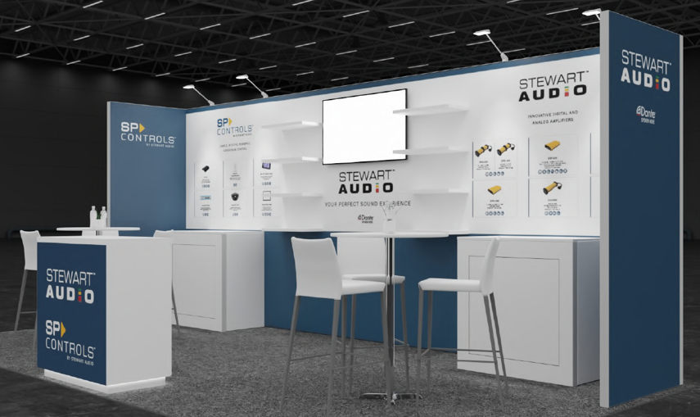
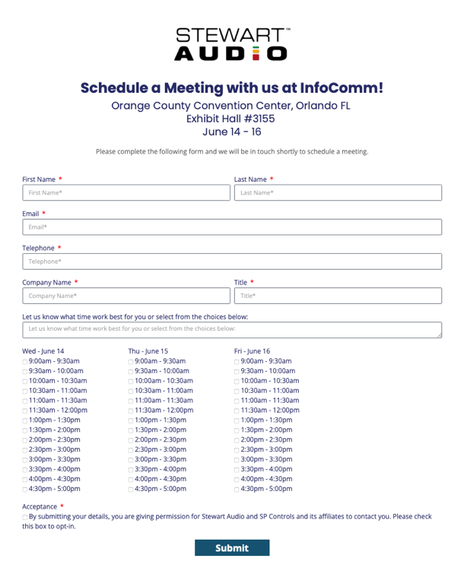
Invite your Resellers to schedule a meeting with us at InfoComm!
Email Invitation Template
PowerCore™
DPA-220 Brief
InfoComm Meeting Scheduler
Booth # 3155
S

Slide 13
Thank You!

