Slide 1
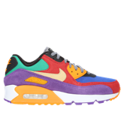

Ensure Resiliency Against
Cyber Threats
Webinar and Live Demo
June 1, 2023
E

Slide 2

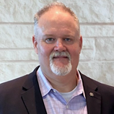
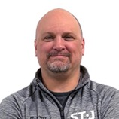
Today’s Presenters
Eric Haya
CloudPro
VP of Solutions
Greg Hooper
Rubrik
MSP Solutions Architect
Brian Dutton
Assured
Director, US Sales and Client Services
E

Slide 3

Agenda
Welcome
Introductions – CloudPro, Rubrik & Assured
Workshop Objectives
Data and organizational resiliency
Continuous data protection
Secure data backup
Recovery from ransomware attacks
Your data protection plan
Next steps and actions
Nike By You
Q & A
E

Slide 4

Poll Question:
How would you rate your organization's ability to respond to a ransomware attack?
E

Slide 5

Businesses are Under Attack
“Assume Breach”
Data and Backup are the Targets
Data
Backup Copies
Data
G
Notes:
Problem statement:
Layers of security, breaches every day.
Data is the target, they get in, they get the data, they got you.
They get the backup too, your toast.
----
1 in 3 organizations were popped last year.
75% of them had the backups targeted.

Slide 6
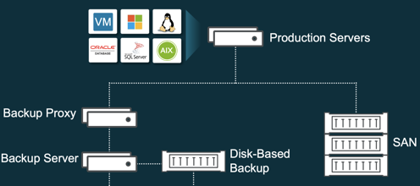
Is Your Data an Easy Target?
Your Data Center
Not designed for adversary behind the firewall
    Are the network protocols open?
    What is running windows?
    Is MFA and TOTP deployed and enforced?
G
Notes:
Drag through Glass
Now, is your data an easy target?
Consider the data center. You may have an aging infrastructure that looks like this.
Generally disdained, complicated, expensive and most concerning – insecure
-Open protocols
-Misconfigurations
-Windows OS
Not designed for bad guys behind the firewall.
Shoot, you might have multipe of these around the globe you have to keep running.
Make things more fun, you have cloud(s)
-Is everything protected in a consistent way
-Do we have visibility into what is going on?
-Immutability? Air Gap?
Then when it hits the fan, you have to recover, you have to CYBER RECOVER.
How is Cyber Recovery different than backup and recovery?

Slide 7
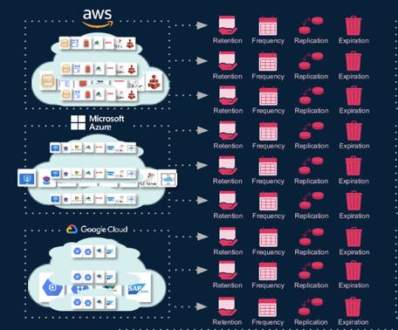
Is Your Data an Easy Target?
Your Data Center
Your Cloud
G
Notes:
Drag through Glass
Now, is your data an easy target?
Consider the data center. You may have an aging infrastructure that looks like this.
Generally disdained, complicated, expensive and most concerning – insecure
-Open protocols
-Misconfigurations
-Windows OS
Not designed for bad guys behind the firewall.
Shoot, you might have multipe of these around the globe you have to keep running.
Make things more fun, you have cloud(s)
-Is everything protected in a consistent way
-Do we have visibility into what is going on?
-Immutability? Air Gap?
Then when it hits the fan, you have to recover, you have to CYBER RECOVER.
How is Cyber Recovery different than backup and recovery?

Slide 8

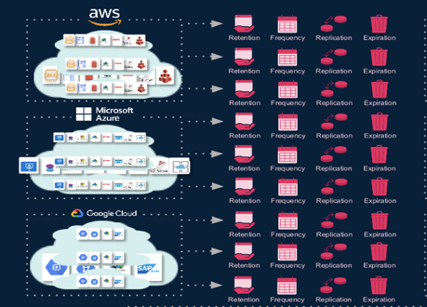
Backup and Recovery ≠ Cyber Recovery
New Questions
What exactly do I recover?
Was sensitive data in scope?
How do I ensure I don’t restore the malware?
Now Board / C-Suite Priority
Are we good?
Can you prove it?
How long will it take?
G
Notes:
Drag through Glass
Now, is your data an easy target?
Consider the data center. You may have an aging infrastructure that looks like this.
Generally disdained, complicated, expensive and most concerning – insecure
-Open protocols
-Misconfigurations
-Windows OS
Not designed for bad guys behind the firewall.
Shoot, you might have multipe of these around the globe you have to keep running.
Make things more fun, you have cloud(s)
-Is everything protected in a consistent way
-Do we have visibility into what is going on?
-Immutability? Air Gap?
Then when it hits the fan, you have to recover, you have to CYBER RECOVER.
How is Cyber Recovery different than backup and recovery?

Slide 9
Introducing the
Rubrik Security Cloud
    Benefits
    Guaranteed ability to recover data
    Native immutability to stop cyber attacks affecting the data
    A single platform to protect on-prem, in cloud, and SaaS
    Testable resiliency to reduce risk
    Practical data visibility to drive better decision making
    Consolidation and repurposing of existing budget
G
Notes:
Drag through Glass
Now, is your data an easy target?
Consider the data center. You may have an aging infrastructure that looks like this.
Generally disdained, complicated, expensive and most concerning – insecure
-Open protocols
-Misconfigurations
-Windows OS
Not designed for bad guys behind the firewall.
Shoot, you might have multipe of these around the globe you have to keep running.
Make things more fun, you have cloud(s)
-Is everything protected in a consistent way
-Do we have visibility into what is going on?
-Immutability? Air Gap?
Then when it hits the fan, you have to recover, you have to CYBER RECOVER.
How is Cyber Recovery different than backup and recovery?

Slide 10




Rubrik Zero Trust Data Security
Data Resilience
Data Observability
Data Recovery
Data Security Command Center
Enterprise Data Protection
Sensitive Data Discovery
Threat Containment
Cloud Data Protection
Ransomware Investigation
Mass Recovery
M365 Protection
Threat Hunting
Orchestrated App Recovery
NIST Security Standards
Preparation
Detection and Analysis
Containment Eradication
and Recovery
B
Notes:
Rubrik’s solutions keep your data safe and easy to recover in the face of cyber attacks and operational failures. Now you can recover the data you need, however and whenever you need it to keep your business running.
Our solution is organized into 3 key pillars that are mapped to the United States NIST Standard
Data Resilience – Safeguard your data with secure backups so it can’t be deleted, compromised, or encrypted; and is always available for recover
Data Observability - Identify when, where, and how attacks have impacted systems by continuously scanning data over time so compromises can be remediated quickly
Data Recovery - Quarantine malware, avoid reinfection, and recover data quickly with guided file-level, object-level, application-level, and system-wide operations so business operations can be restored quickly

Slide 11
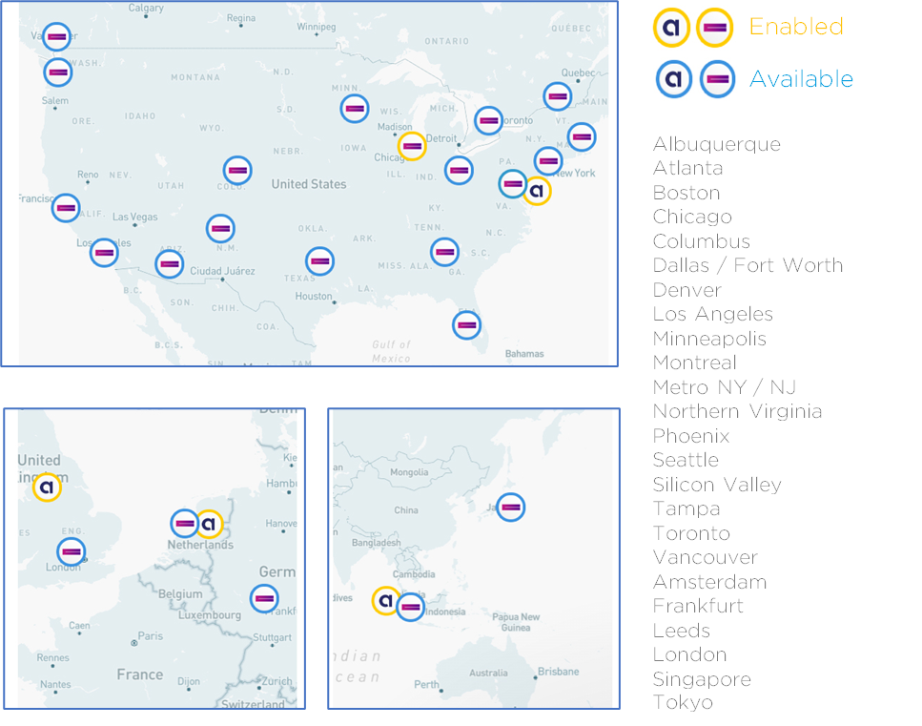
SERVICE TIERS
GLOBAL COMPANY
Servicing EMEA and the Americas
Over 100 years combined Data Protection as a Service experience.
Manage 400+ customer sites in more than 40 countries.
We are first and largest MSP to be RASP (Rubrik Authorized Support Partner) accredited.
DATA MANAGEMENT
Managed backups
Business Continuity / Disaster Recovery
Location agnostic data protection
Enhanced compliance reporting
Security
Data analytics
B

Slide 12



ASSURED MANAGED SERVICES
MANAGED
BACKUP
BUSINESS
CONTINUITY
DISASTER
RECOVERY
THREAT
DETECTION
Backup, archive and recover data across private, public & hybrid cloud environments.
Replicate critical data to a secure, off-site location to keep operations running.
Recover all your critical IT systems in minutes and hours, not days or weeks.
Monitor production and backup data to prevent data loss and cyber attacks.
B

Slide 13
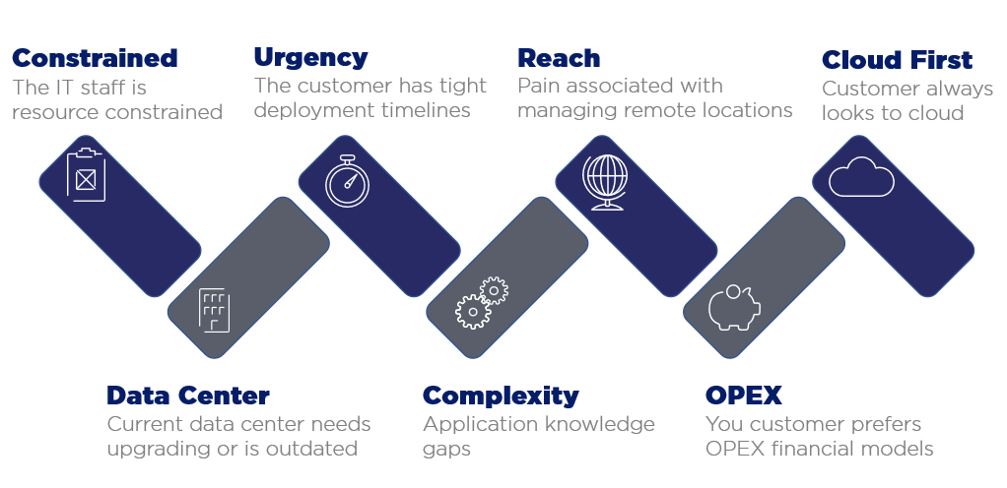
PROBLEMS WE SOLVE
B

Slide 14
Rubrik as a Service – OPTIONS
CapEx Rubrik (Customer buys Brik from partner)
  Client owns and depreciates Rubrik appliance on premises
  Assured charges per TB for the replica data pushed to Assured’s second site Rubrik instance
Operationalize Rubrik (Assured buys Brik from partner)
  Assured owns the Rubrik appliance on premises
  Client is assessed monthly charge for utilizing the Rubrik on premises
  36-month minimum term
HP Build
  Medium to large production environments (40+ TB)
  Assured owns the Rubrik appliance on premises
  Rubrik software built into 2U HPE appliance
  Easily scales up and down – consumption-based model
Rubrik AIR/EDGE Appliance
  Rubrik on Assured owned appliance in customer environment
  Available for smaller data footprints of 2TB – 40TB
B

Slide 15

Poll Question:
Have you conducted a disaster recovery test in the last 6 months?
B

Slide 16
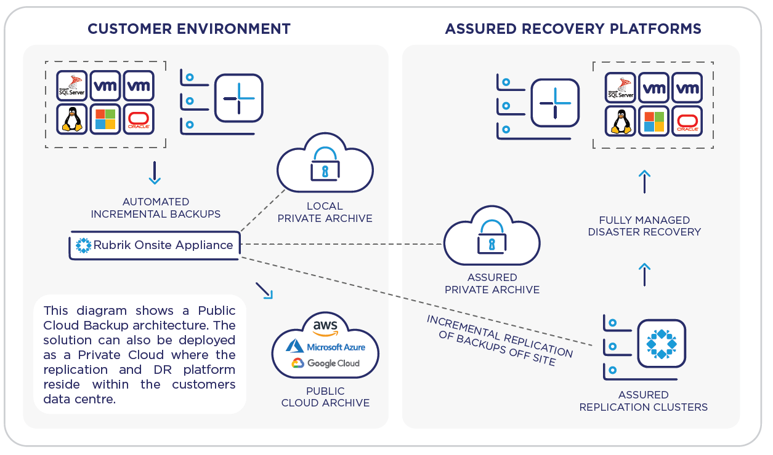
SOLUTION TOPOLOGY
Assured’s Ransomware Defense Solution
Rubrik Instance on premises replicating critical data to dedicated environment within Assured data center
Ransomware remediation with industry leading technology - Rubrik
24/7 Monitoring, support and daily reporting
Fully managed service – no touch needed
Immutable data protection
Disaster Recovery
Virtual infrastructure for recovery
Private firewall for network isolation
Low RTO recovery from Rubrik
Recover to cloud for extended use
B

Slide 17




WHAT YOU GET WITH DISASTER RECOVERY
Custom runbook & automated boot order scripting
Dedicated firewall instance per customer
Two DR Test per year
DR resources included (4 VPU/32 GB RAM) – support AD, other “table stakes” applications
24/7 on-call support with IT experts for DR declaration and response
On Demand Resources
Priced and metered hourly
Consumption based
Waived during included tests
Reserved Resources
Piece of mind – no competition for resources
Ensure resources for critical systems
Leverage for live systems
B

Slide 18
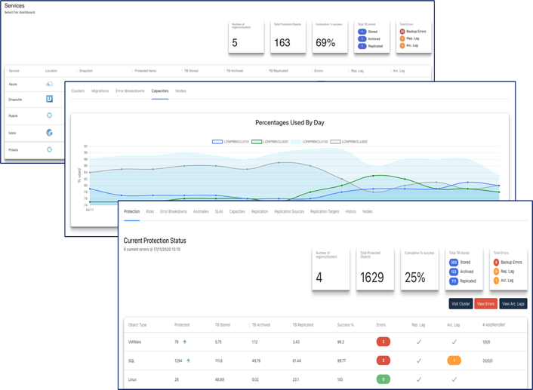
ASSURED MANAGEMENT
CENTRAL DATA PROTECTION MANAGEMENT
Consolidated view across deployments
Role Based Access and Controls#
Delegate authority
Limit visibility
Resource consumption for charge back
PROTECTION DATA ANALYTICS
Capacity management through growth trends
Predict missed backup windows
Pinpoint bottlenecks visually
B

Slide 19

Poll Question:
Does your team have the technical expertise to manage a data protection solution?
B

Slide 20
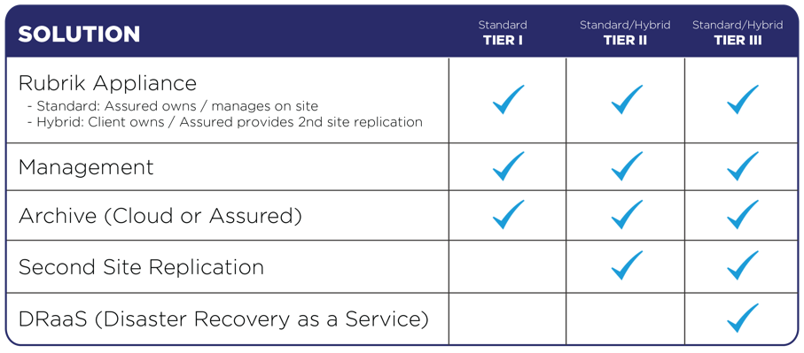
SERVICE TIERS
Turn-key Backup and DR as a Service
Physical Rubrik On Premises
Archive to Cloud or ADP
24/7 Monitoring & Help Desk
Enterprise Grade DRaaS
36 Month Term
B

Slide 21

SERVICE TIERS - HYBRID
Turn-key Backup and DR as a Service
Physical Rubrik On Premises
Archive to Cloud or ADP
24/7 Monitoring & Help Desk
Enterprise Grade DRaaS
36 Month Term
SOLUTION | TIER II | TIER III
Customer Owned Rubrik
Management
Archive (Cloud or Assured)
Second Site Replication
DRaaS (Disaster Recovery as a Service)
B

Slide 22




















CUSTOMERS IN 40+ COUNTRIES WORLDWIDE
B

Slide 23
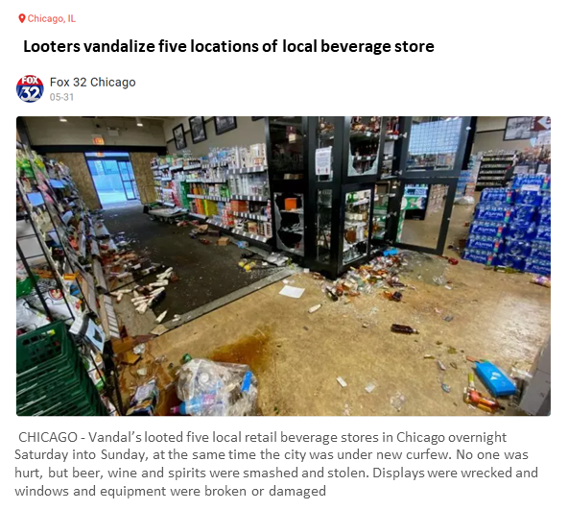

CUSTOMER SUCCESS STORY
Existing Rubrik Customer
Struggling to DR to public cloud
Assured “hybrid” Solution positioned
Rubrik replication w/DRaaS
DR Success Story
B

Slide 24
?
&
A
E

Slide 25

Thank you
for attending
our Webinar!
E

Slide 26
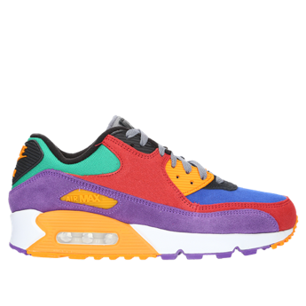

NIKE shoes
customized
by you
Receive a free pair of Nike shoes designed by you when you sign up and qualify for a free Assured Data Protection trial.
Click here to schedule your Free Trial!
E

Slide 27
Thank You
E

