Slide 1
The Future Starts Now
[12/09/2022]

Slide 2


SA|Core
New Digital Core Platform
API/Web Server
Embedded Linux
Dual Core Processor

Slide 3


















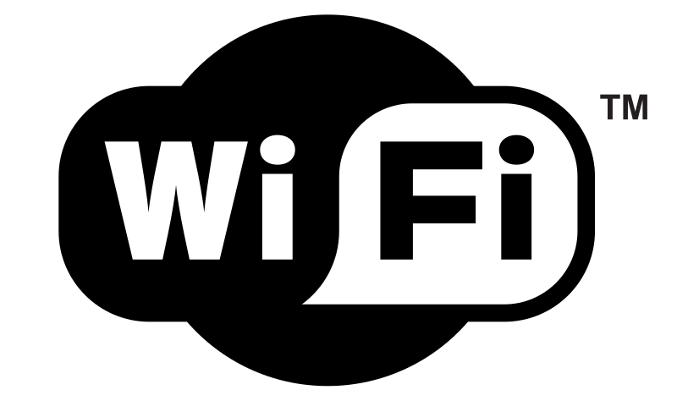






Modular and Scalable Design
Embedded Networked Audio Protocols
Isolated PoE 802.3bt Standard
AES
67
API / Server
Embedded Linux
Dual Core Processor
System Management SAPB Network Control
Speaker Health Monitoring
Environmental Monitoring
Robust, Expandable API
DSP Enabled I/O Modules, Amps, Soundbars
Advanced Audio Protocols

Slide 4








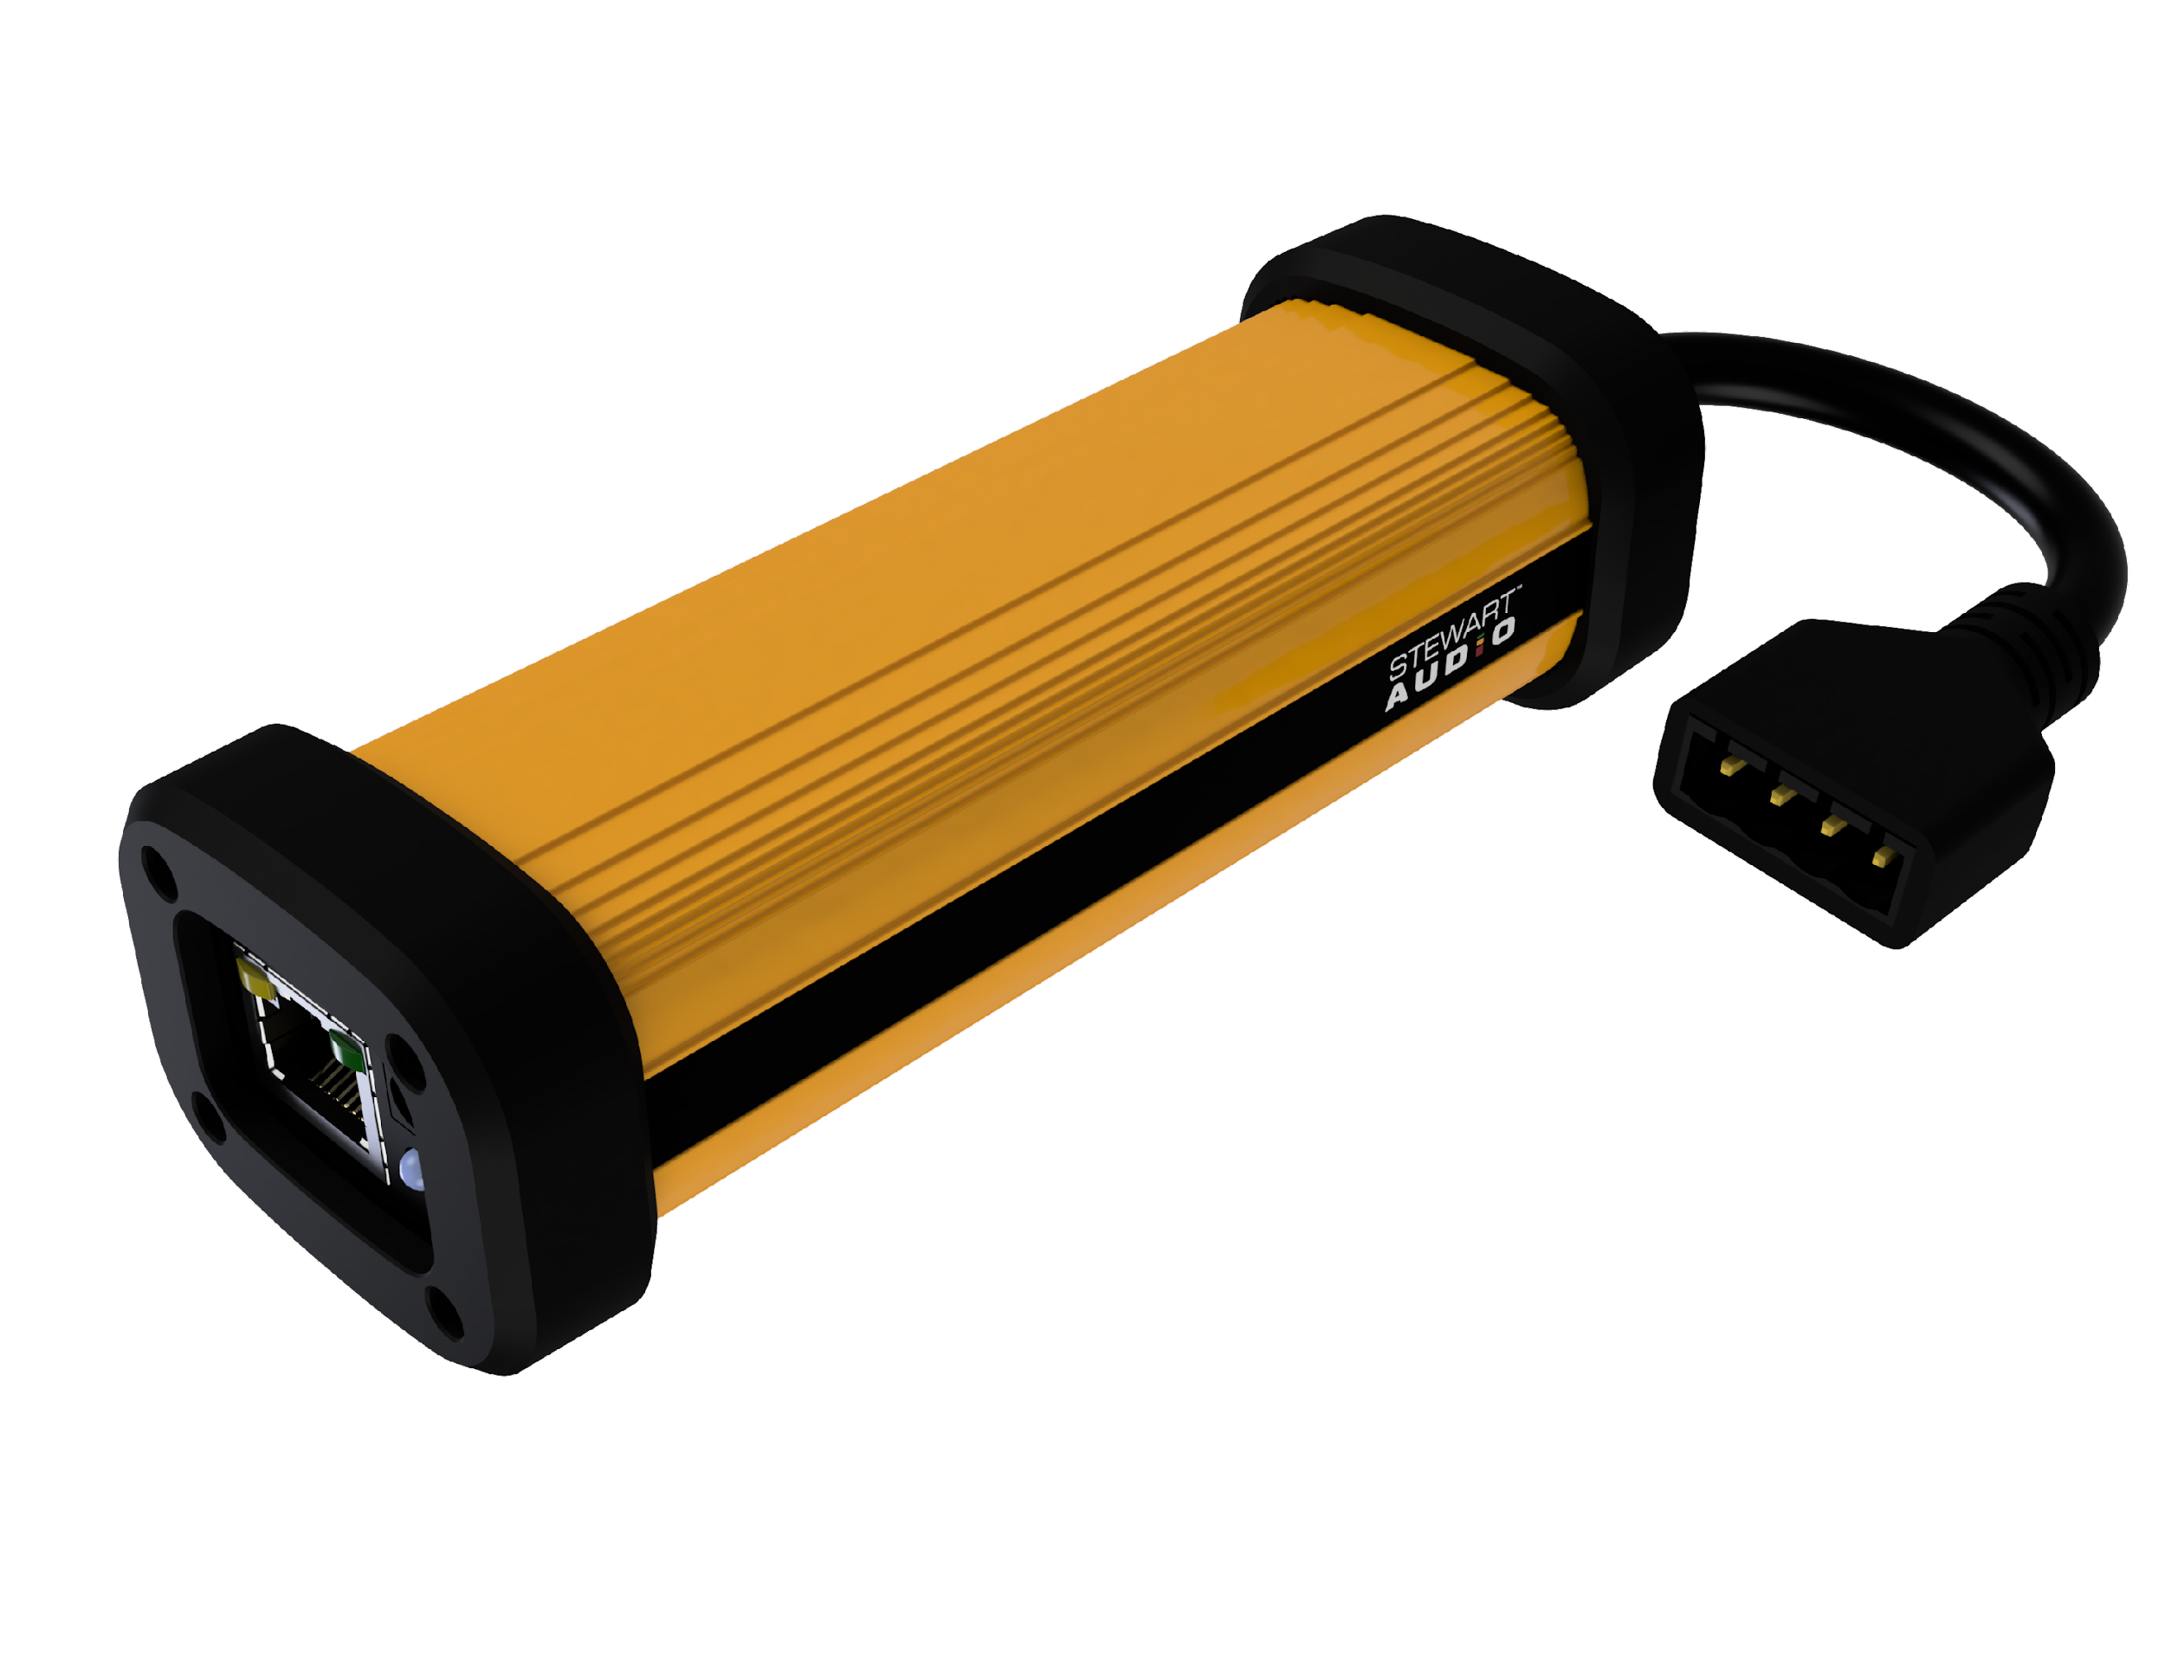
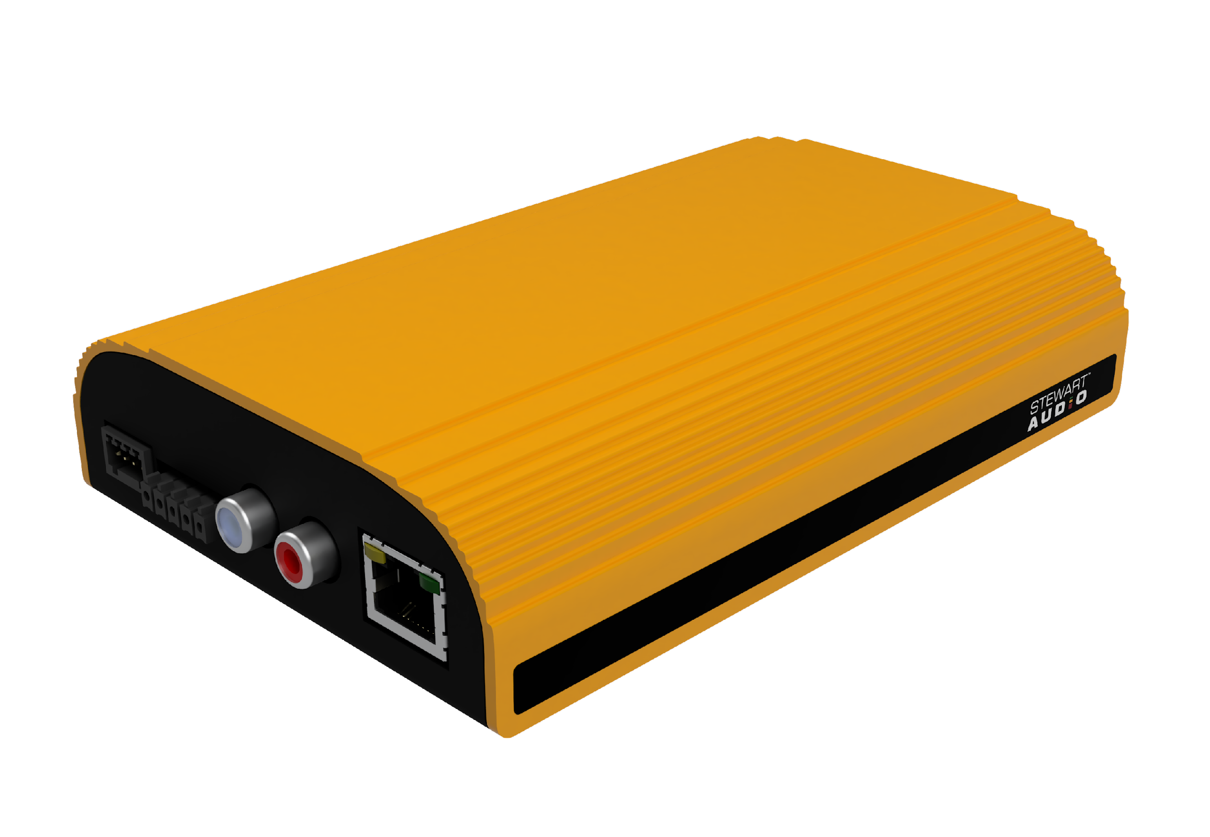
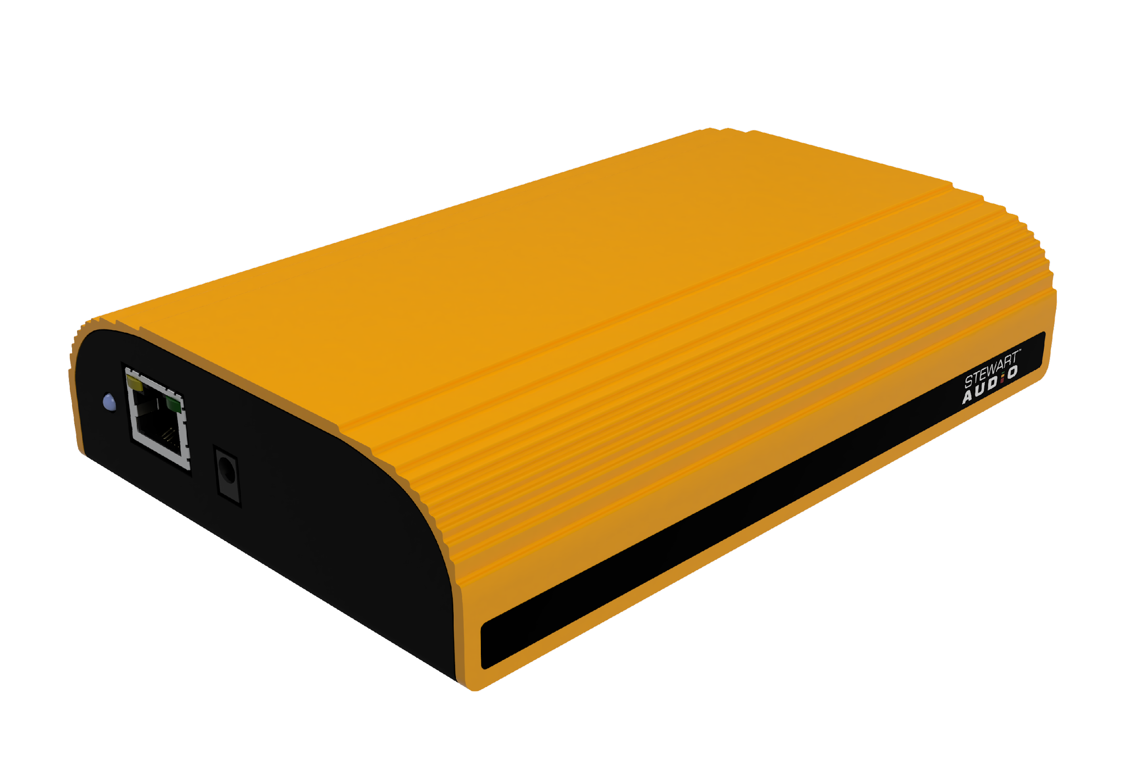
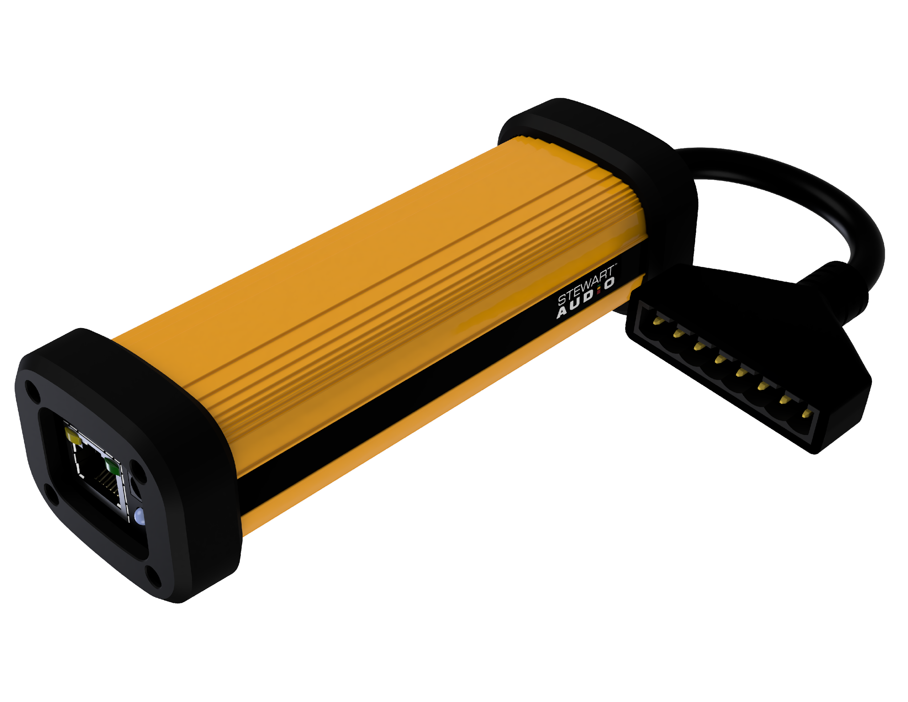
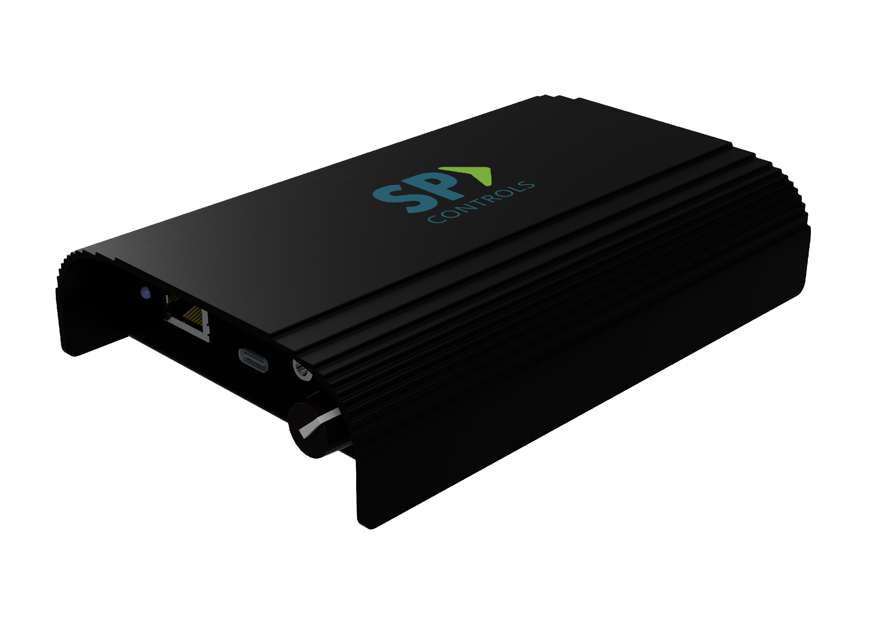
Product Roadmap
DPA-240
1 x 40W, 2 x 20W
PoE/AUX Power
DSP-200
1 x 100W LZ/CV
2 x 200W LZ/CV
Hi-Efficiency GaN
Transformerless 70/100V
DIO-440
4x0, 0x4, 2x2
Configurable Dante™ I/O
PoE/AUX Power
Q3-2023
Q1-2024
SA|Core™
SA|Core™
SA|Core™
SA|Core™
Q1-2023
HF-210
HiFlex Audio Bridge
Front-end Mic-mixer for
Zoom, Teams, Meet Rooms
Q4-2023
Q1-2024
DPA-880
2 x 40W, 4 x 20W, 8 x 10W
PoE/AUX Power

Slide 5

SA | Core
Platform
DPA-240
Power: PoE 802.3BT T3
Aux PS
Inputs: Dante
Outputs : 2 x 20W or 1x40W LZ
Monitoring: Real-time speaker health
DSP: Yes
Control: SAPB
(API or Web Server)
Form Factor: Power Dongle

Slide 6
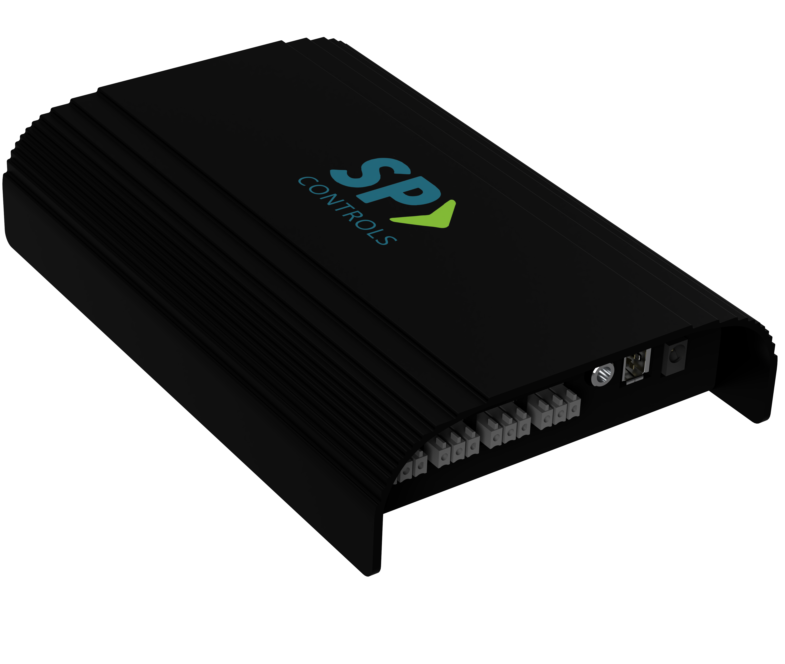
SA | Core
Platform
HF-210
SP Controls- HiFlex Audio Bridge
Inputs: (4) Balanced Mic Inputs
(1) USB-A Microphone
(1) PC Audio via USB-C
(1) Dante™ (optional)
Outputs : USB-C
Line-Level
Headphone
DSP: Yes
Auto-mixing: Yes
Control: SAPB API
Headphone Volume Knob
Package: Gen2 Sub-Compact
Power: External

Slide 7
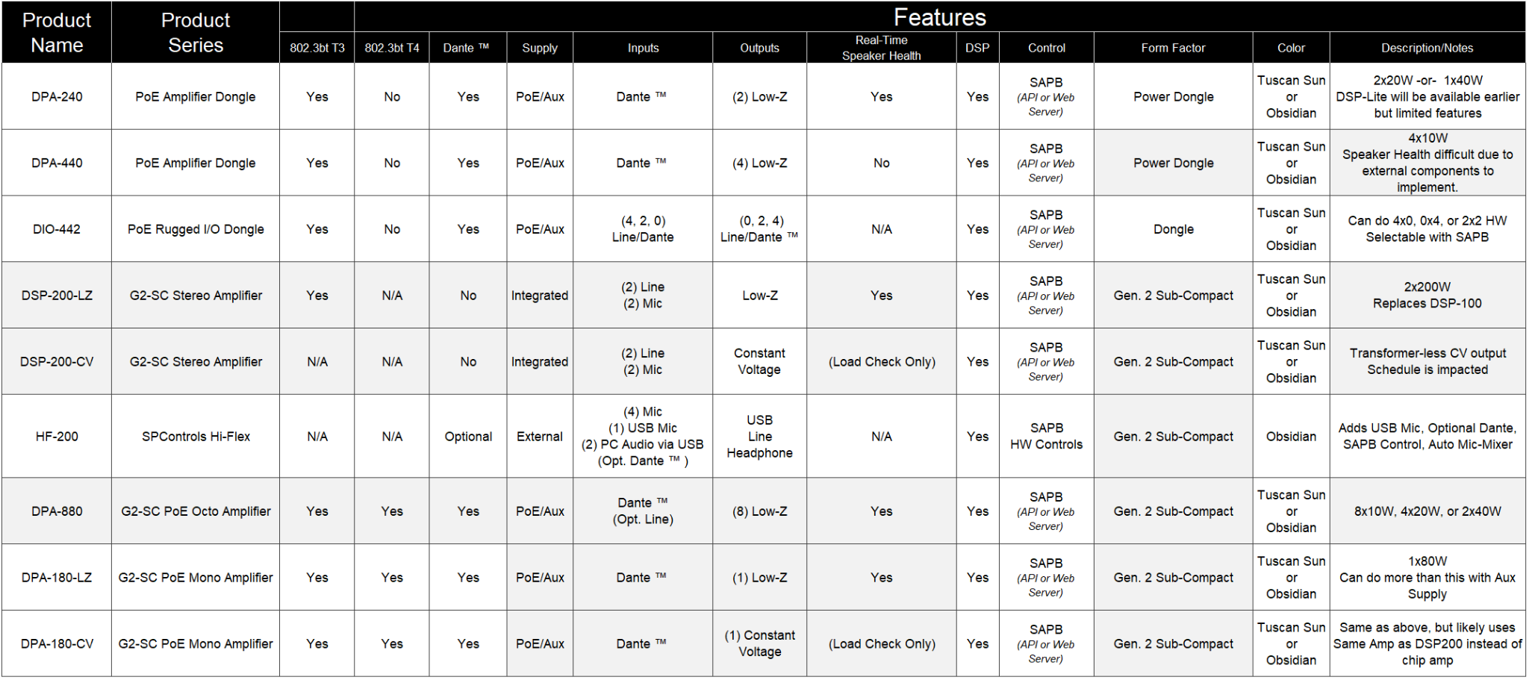
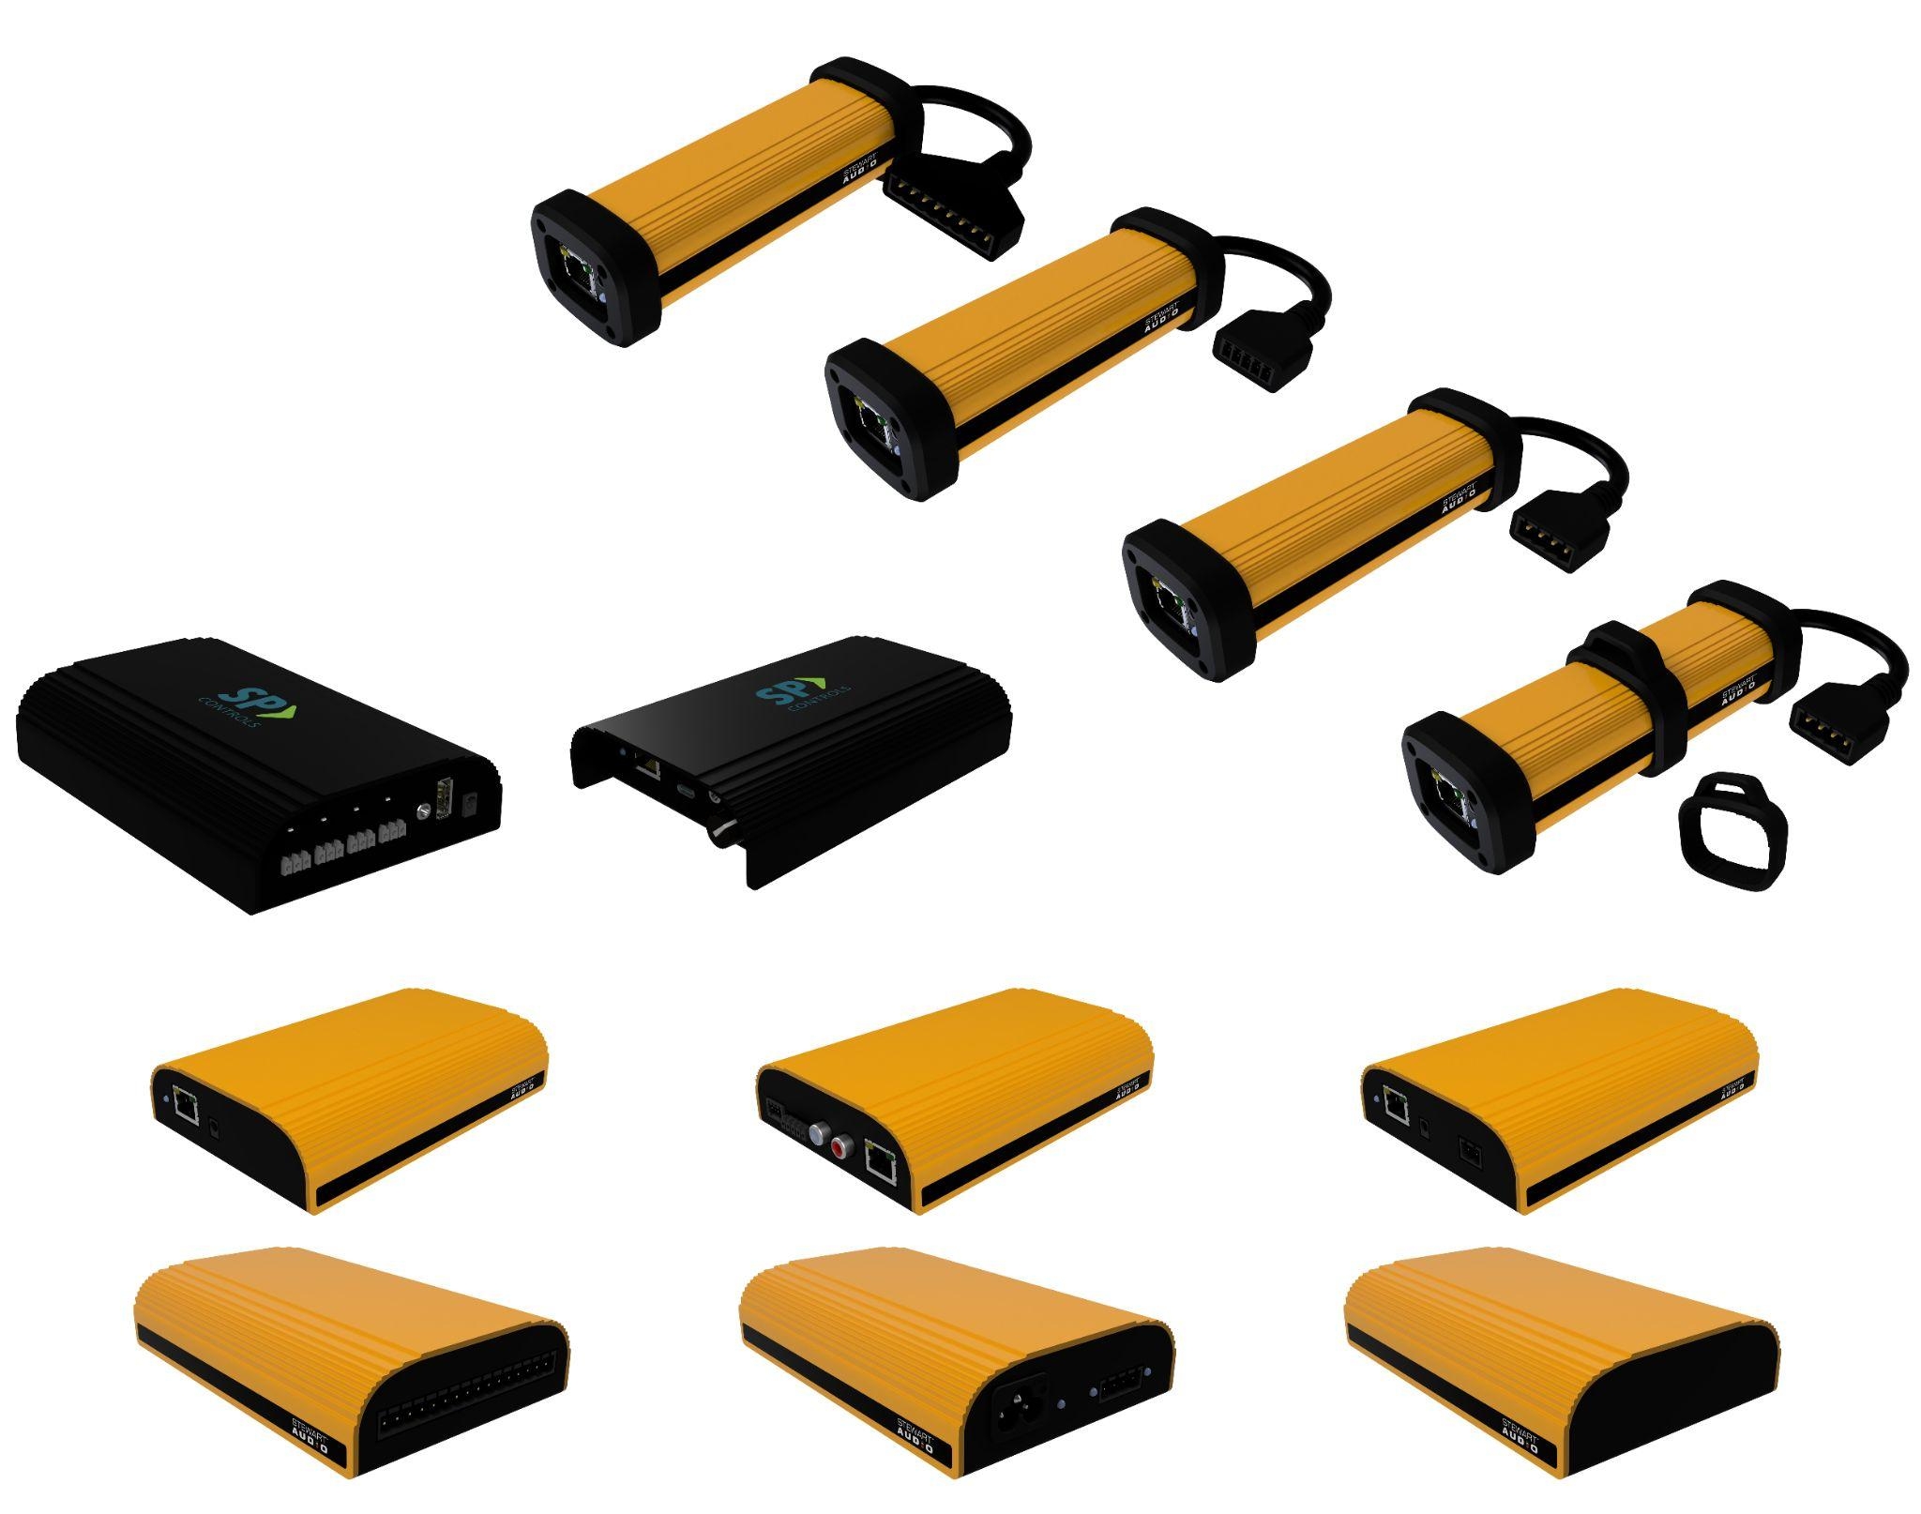
SA | Core
Platform

Slide 8
Thank You

