Slide 1

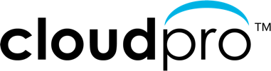

Cloud Optimization Sales Workshop
Optimize your Cloud
Accelerate your business with
Cloud Insights from NetApp
F

Slide 2

Workshop Agenda
Topic
Welcome Introductions – LinkSource & NetApp Sales Workshop Objectives
Why optimize your cloud? Performance, cost savings & security
Taking control of your cloud NetApp Cloud Insights Monitoring & Optimization
Selling Cloud Insights Target Customers Cloud Optimization Workshop POCs
Nike By You
Q & A
F

Slide 3



Your Business Accelerated
Comprehensive portfolio of cloud consulting and engineering services
Full spectrum of cloud expertise, skills, and certifications to quickly fill knowledge and resource gaps
High-quality cloud best practices and methodologies for your cloud optimization, integration, migration and assessment projects
D

Slide 4





Industry-leading cloud services
NetApp is a global cloud-led, data-centric software company that gives organizations everywhere the freedom to put data to work in the applications that elevate their business.
Global cloud-led, data-centric software company
Industry-leading software, systems, and cloud services
Founded in 1992, headquartered in San Jose, California
$5.74B FY21 revenue
11,000+ employees and 4,000+ partners helping organizations thrive in a hybrid multi-cloud world
Fortune 500 company (NASDAQ: NTAP)
Cloud
Storage
Compute
Operations
Cloud
Controls
Cloud Services
and Analytics
D

Slide 5

Understanding your Cloud
  Are you able to quickly identify runaway costs in your cloud infrastructure?
  Are you able to identify unused or orphaned infrastructure in your cloud environment?
  Are you able to monitor all your IT infrastructure on-premises and in the cloud?
  Are you able to detect ransomware attacks before they impact your business?
P

Slide 6



Getting the most out of your Cloud
Manage resources to do more with less
Dramatically reduce cloud spend
Detect ransomware before it impacts your business
D
Notes:
Danny
By 2025, Gartner estimates that over 95% of new digital workloads will be deployed on cloud-native platforms, up from 30% in 2021
https://www.ciodive.com/news/cloud-iaas-trends-2022/616860/
https://www.gartner.com/en/newsroom/press-releases/2022-02-09-gartner-says-more-than-half-of-enterprise-it-spending#:~:text=In%202022%2C%20more%20than%20%241.3,new%20technologies%2C%20including%20distributed%20cloud.

Slide 7





Cloud Insights Benefits Across the Organization
What inefficient use of resources means to:
CEO
CFO
CTO
IT MANAGER
PROCUREMENT MGR
Lower profit
Reduced cash flow
Inefficient use of resources
Fewer projects and smaller team
Best pricing, expense visibility
D
Notes:
Danny

Slide 8





LinkSource and DirectRFP
DirectRFP is an industry-leading RFP Procurement Automation Platform
70% AWS cloud cost reduction through cloud assessment
Plan to evaluate Cloud Insights from NetApp to help monitor and optimize cloud utilization
C

Slide 9

Nike – Cloud as a Strategic Priority
Speed
Agility
Build vs. buy
Cloud native
Micro-service architecture
Manageability
Security
Availability
Performance
D

Slide 10






a massive digital advantage”
“Nike is building
D

Slide 11
Control the performance and cost of your cloud workloads
Find performance issues faster and optimize cloud usage to do more with your limited budget.
NetApp Cloud Insights is a SaaS based monitoring tool that helps you quickly find performance problems and optimize usage of your cloud workloads.
B
Notes:
Paul

Slide 12



Outcomes Delivered
– Why Do You Need Cloud Insights
Monitor shared resources across any infrastructure;
On-premised, Cloud and Kubernetes
Analyze relationships between shared resources and how they impact each other
Modernize and Analyze
Optimize and Control Usage
Optimize by identifying waste, increasing utilization and density of compute and storage
Control usage with Show-back / Chargeback showing who is using what and how much
Guarantee Availability
Determine the available headroom to prevent infrastructure saturation
Right size application resources to prevent performance problems and downtime
Key Differentiators
Multi-Vendor Infrastructure
Shared Infrastructure
Full Stack Visibility
Ransomware Protection
B

Slide 13


Operational Pain Points
– Reasons to invest in Infrastructure Monitoring
  Business Challenges
  Poor performance effecting customer satisfaction
  Runaway cloud costs
  High cost of maintaining multiple tools
  High cost of system outages
  Inability to measure SLAs and usage for optimization
  Protection against Ransomware
  Technical Challenges
  Difficulty isolating problems and outages in complex hybrid infrastructure in a timely manner
  Lacking a single effective view of the full-service path
  Difficulty identifying workloads for right-sizing or optimization
  Inability to report on SLAs and SLOs
  Accurately provisioning cloud resources for cloud migrations
B

Slide 14
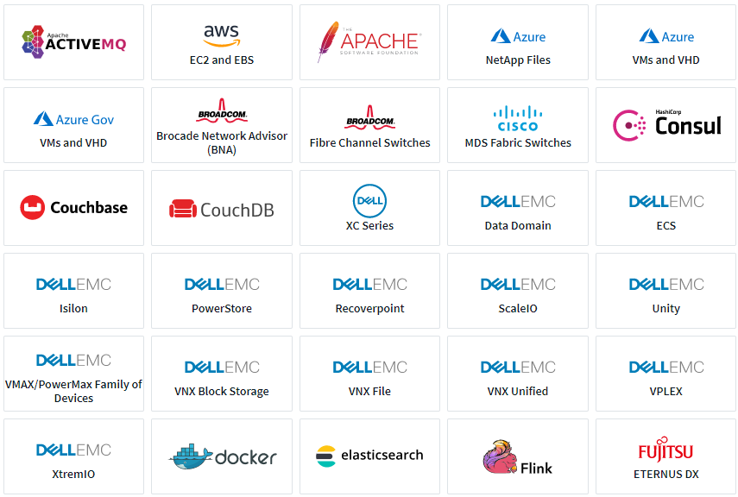
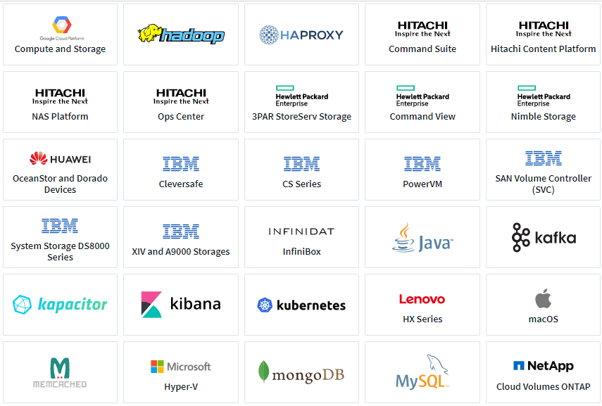
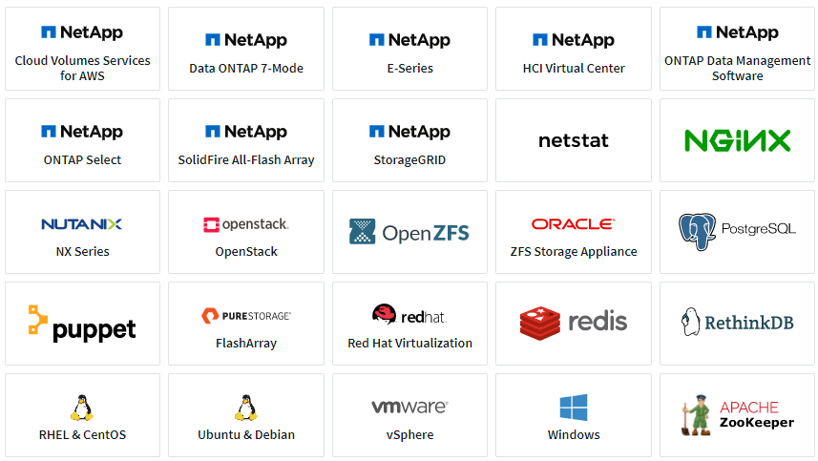
Heterogeneous Support
– Operating systems, infrastructure devices, and services
B

Slide 15

Cloud Insights
Common Use Cases
Cloud Visibility / Cloud Migration
Troubleshooting and Operational Efficiency
Forecasting and Trend Analysis
Security
B

Slide 16
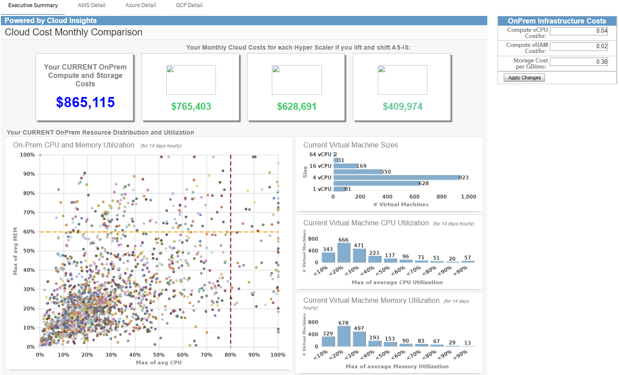

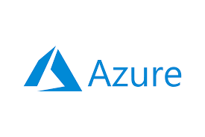
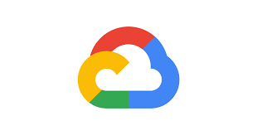
Cloud Visibility / Cloud Migration
– Optimize costs and run efficiently
Model on-prem versus cloud costs (these are fictitious values)
B

Slide 17
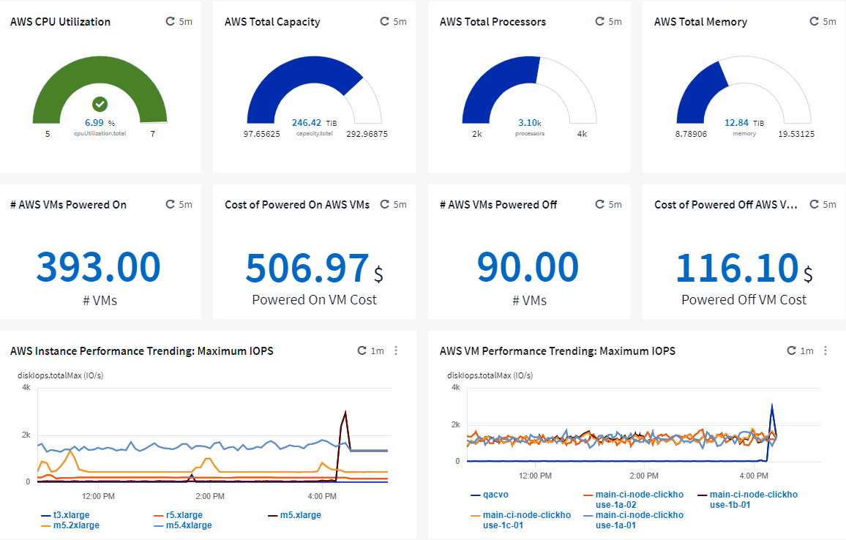
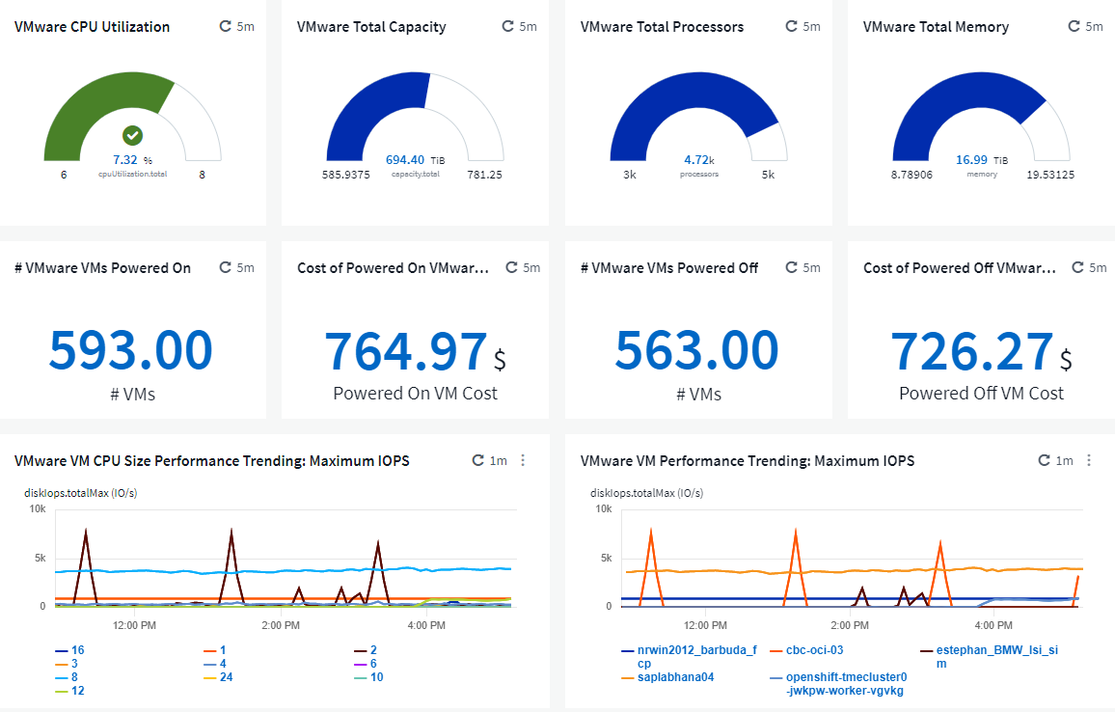
Cloud Visibility / Cloud Migration
– Managing hybrid-cloud assets: Side-by-side utilization and cost comparison
Cloud resources
On-prem resources
B

Slide 18
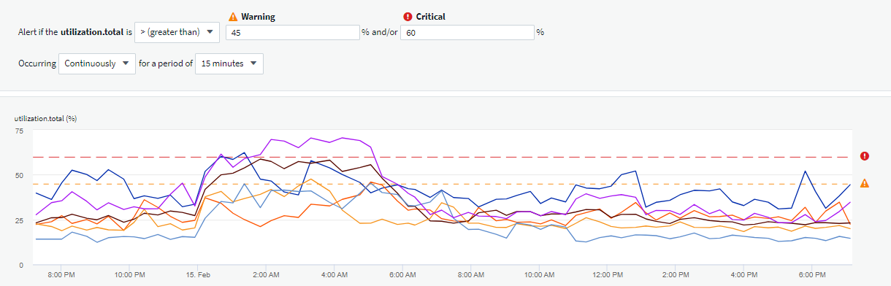
Troubleshooting and Operational Efficiency
– Reduce potential future application outages with proactive alerting
Thresholds determined by application owners, IT staff, etc…
Storage nodes consistently over-utilized, potentially leading to application interruption or outage
B

Slide 19
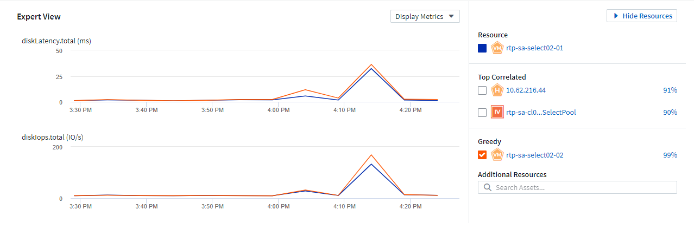
Troubleshooting and Operational Efficiency
– End-to-end visibility of application infrastructure resources, whether they’re in the cloud or on-prem
Identify resources having an impact on the base resource
IOPs of greedy resource (orange) impacts latency of base resource (blue)
Identify greedy or degraded workloads
B

Slide 20
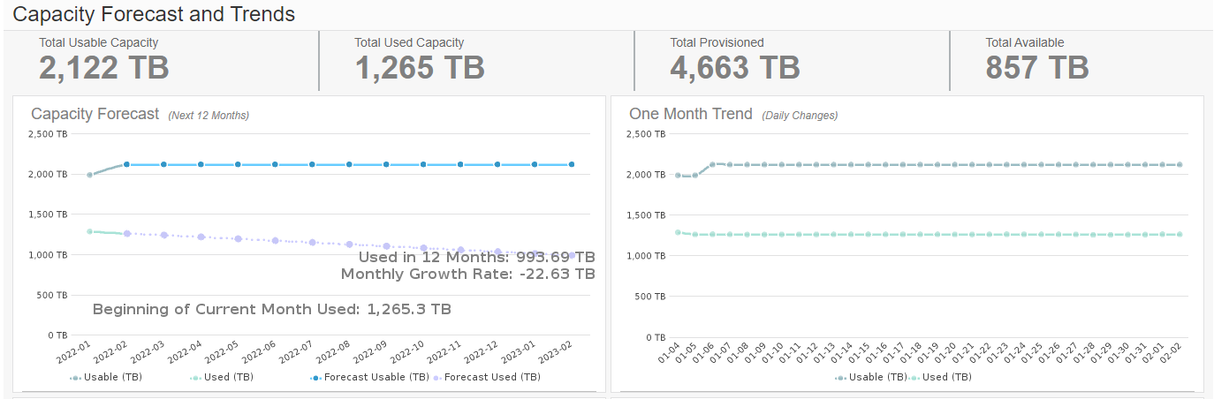
Forecasting and Trending Analysis
– Optimize usage and achieve more with a limited budget
Forecasted used capacity on a downward trend
B

Slide 21
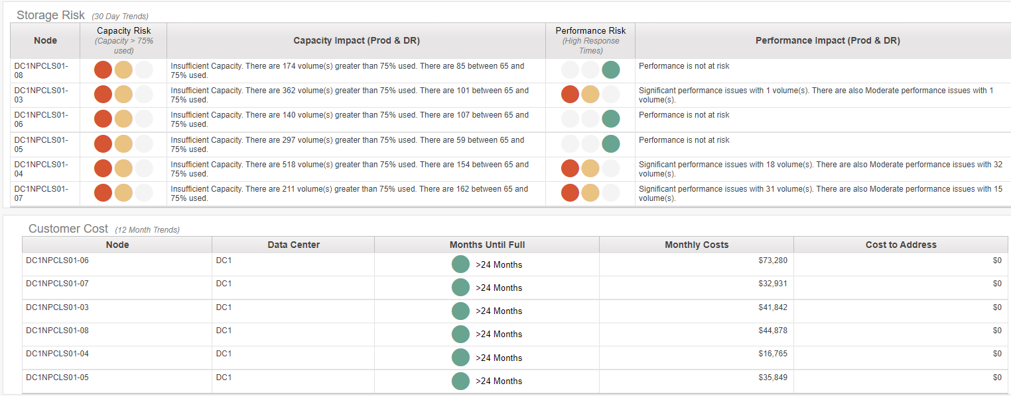

Forecasting & Trending Analysis
– Understand where storage capacity and performance may be at risk
Volume-level capacity and performance risk with easy-to-understand red, yellow, and green indicators
Anticipated capacity full timeframe based on current consumption
B

Slide 22
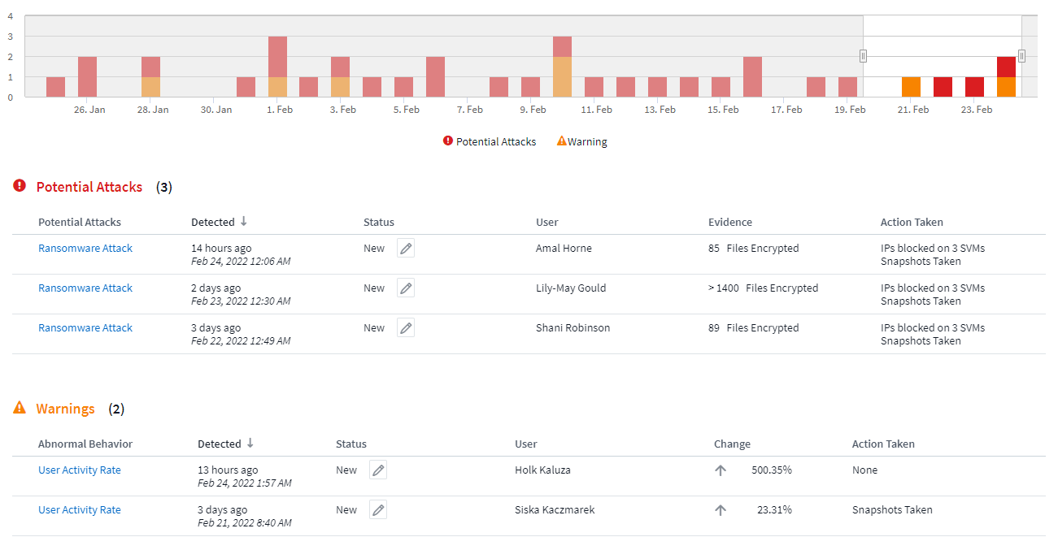
Security
– Cloud Secure: A feature of Cloud Insights
Detect anomalies & identify potential attacks
  Advanced machine learning algorithms uncover unusual data activity and detect a potential attack
Monitor User Activity
  All user activity across on-premises and hybrid cloud environments is captured and analyzed
Automated Response Policies
  Alerting and automatic data snapshot response make sure you are notified, data is backed-up and you can recover quickly
Forensics and User Audit Reporting
  Graphical interface for activity data analysis, data breach investigations and User Data Access Audit reporting generating
B

Slide 23

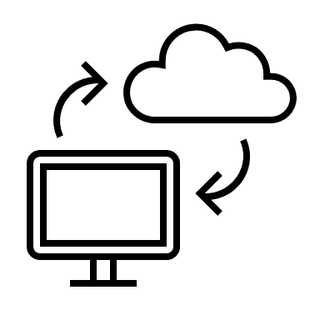

Summary
– Value and Benefits
Make intelligent decisions before, during, and after hybrid cloud migrations
Avoid potentially costly initial over-provisioning of cloud resources before migrating.
Analyze and control cloud costs before they get out of hand.
End-to-end visibility of application infrastructure resources, whether they’re in the cloud or on-prem
Reduce the time to find and resolve infrastructure issues and identify areas of potential risk before they become an issue.
Improve application availability and application user / owner satisfaction.
Integrate optimization and cost management into a daily process
REST APIs for CMDB integration enables true cost of infrastructure or application ownership analysis with chargeback reporting.
Provide infrastructure or application owners with performance and capacity information to make intelligent requirements decisions.
B

Slide 24

Summary
– Value and Benefits
Optimize usage and achieve more with a limited budget
Avoid over-provisioning hybrid cloud infrastructure resources.
Forecast infrastructure requirements based on historical trend analysis.
Protect organizational data from ransomware or being misused by malicious/compromised users
Limit critical data loss by detecting and stopping malicious activities.
Ensure corporate compliance by auditing user data access to NetApp data stored on-prem or in the cloud.
Avoid loss of business, damage to brand, loss of trust, fines, etc…
B

Slide 25





Cloud Insights Clients
Major healthcare insurer and managed care provider
Heterogeneous infrastructure monitoring, existing and via acquisitions
Ransomware and malicious activity detection
Global computer security company
Cloud migration
Cloud-based application chargeback
Global mortgage lending company
Monitor and administer their cloud-based VDI and database environment to ensure content creators have the necessary resources
Global provider of outsourced services to the pharmaceutical, biotechnology, and medical device industries
Heterogeneous infrastructure monitoring, capacity planning, and ransomware detection on a 20PB sprawling storage estate
Globally-known companies in the consumer electronics, entertainment, pharmaceutical oil & gas industries
Heterogeneous infrastructure monitoring
Cloud infrastructure monitoring: AWS, Google Cloud, Azure
B

Slide 26
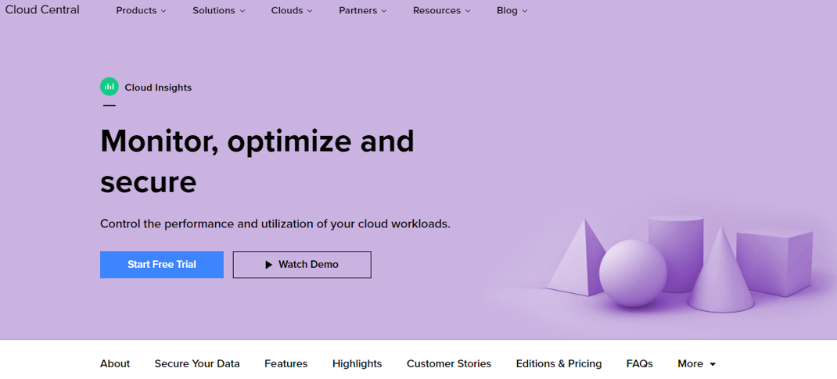
Next Steps
  Start a free Cloud Insights Trial in your environment!
B

Slide 27
What we learned from our customers
Who we talked to
Dev / Ops Director
Kubernetes Admin
Network Analyst
Head of Solution Delivery
IT Administrator
Cloud Operations Manager
Cloud Architect
Security Operations Director
Infrastructure and Security
Technical
CEOs, CFOs COOs
VP IT Operations
Development / Enterprise Architecture
Chief Security Officer (CSO)
SVP or Director
Infrastructure / Operations Directors
Department Managers
Business
D

Slide 28
What we learned from our customers
Survey results
Business Challenges
  Runaway cloud costs
  Inability to measure SLAs and usage for chargeback
  High cost of maintaining multiple tools
  Poor performance effecting customer satisfaction
  High cost of system outages
Technical Challenges
  Inability to right-size workloads that are over provisioned
  Find and fix problems faster
  Lack of a single effective monitoring tool that covers the full stack and can be used by the entire DevOps team
  Meet SLOs & SLAs during and after cloud migration
  Visibility into infrastructure and applications
D

Slide 29

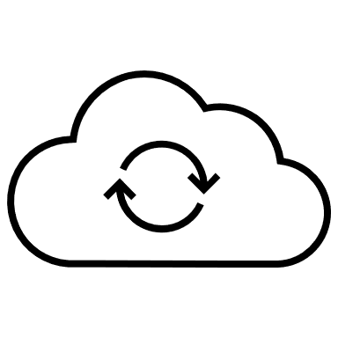

Action Plans and Next Steps
Monitor the health of your cloud environment
Correlate storage utilization to workloads
Optimize your cloud spend by understanding unused infrastructure and overprovisioned workloads
Monitor all your IT infrastructure on-premises and in the cloud
D
D

Slide 30


Custom Nikes and
Free Cloud Insights Trial
https://www.nike.com/nike-by-you
F

Slide 31

Q&A Discussion
Any Questions?
F

Slide 32
F

Slide 33
Backup

Slide 34
Workshop Poll Questions
Poll 1
  Q: Are you able to quickly identify runaway costs in your cloud infrastructure?
  A1:Yes A2: No A3: Not sure
Poll 2
  Q: Are you able to identify unused or orphaned infrastructure in your cloud environment?
  A1:Yes A2: No A3: Not sure
Poll 3
  Q: Are you able to monitor all your IT infrastructure on-premises and in the cloud?
  A1:Yes A2: No A3: Not sure
Poll 4
  Q: Are you able to detect ransomware attacks before they impact your business?
  A1:Yes A2: No A3: Not sure
P

Slide 35
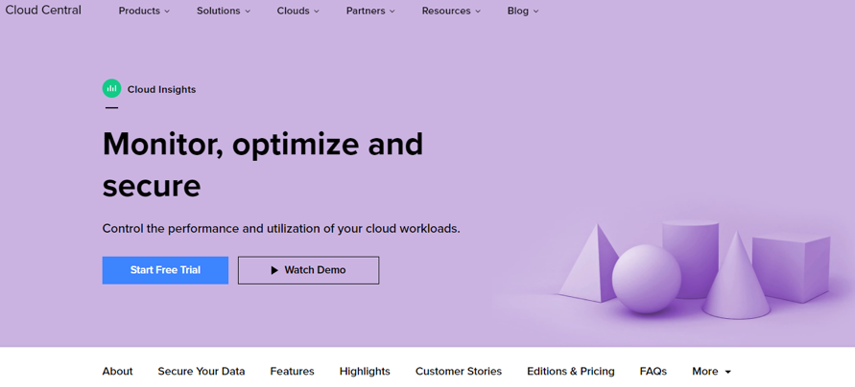
Cloud Insights
– Heterogeneous hybrid-cloud SaaS monitoring platform
Visibility into your infrastructure and applications
Find and fix problems faster
Manage resources more effectively
Meet SLOs & SLAs during and after cloud migration
Stop ransomware with actionable intelligence
https://cloud.netapp.com/cloud-insights
P

Slide 36



Cloud Insights Use Case Categories
Monitoring
Cost Control & Optimization
Secure
Centralize Monitoring Across Your Growing Hybrid IT Infrastructure
Reduce Cost Across Your Hybrid Environment
Reduce Exposure to Insider Threats
Reduce mean time to resolution by 90% and prevent 80% of cloud issues from impacting end users
Reduce cloud infrastructure costs by an average of 33%
Reduce your exposure to insider threats by protecting your data with actionable intelligence.
P

Slide 37
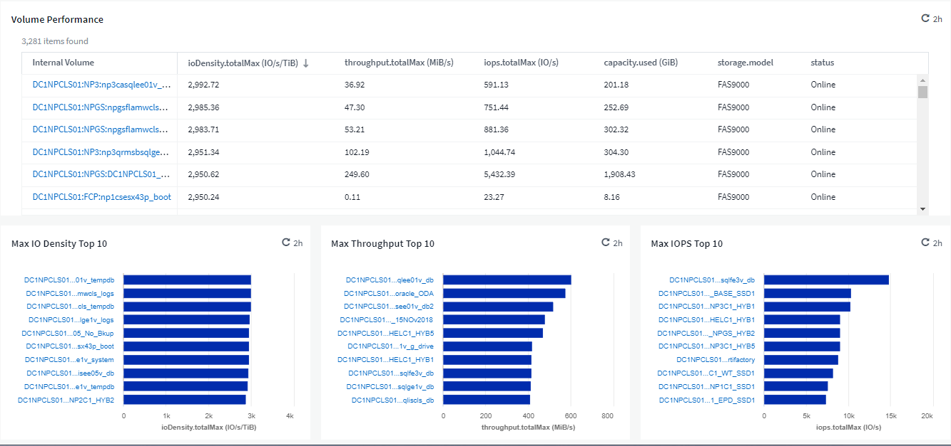
Cloud Visibility / Cloud Migration
– Make intelligent decisions before, during, and after hybrid cloud migrations
Provision cloud storage based on metrics used by cloud providers
P

Slide 38
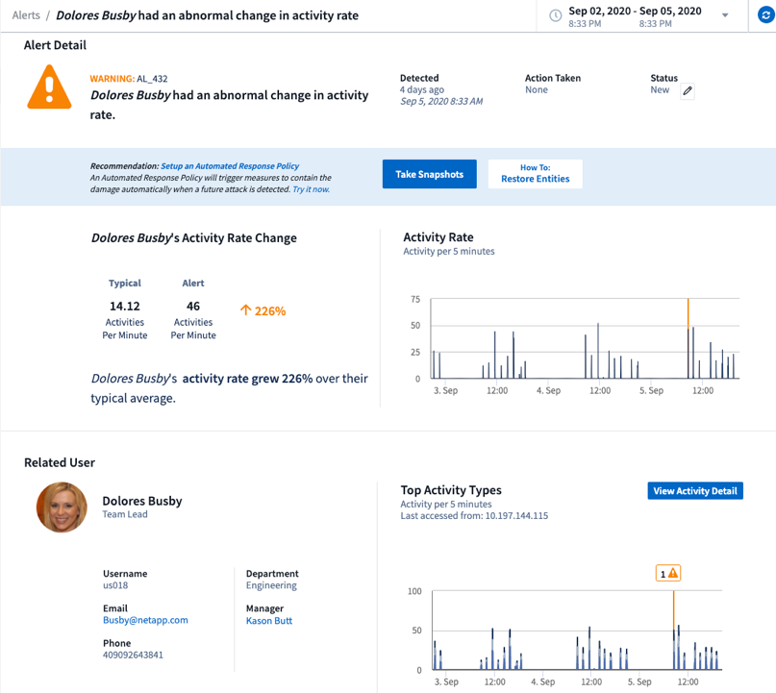
Security
– Cloud Secure: Intelligent Threat and Impact Analysis
Identify
  What (risk): Potential Attack
  Who: User and Source IP
  When: Real time detection
  Impact: Affected volumes and files
Rich graphical interface for analysis
  View user profile and activity information
  Compare user activity during alert and with historical information
Abnormal user activity
P

Slide 39
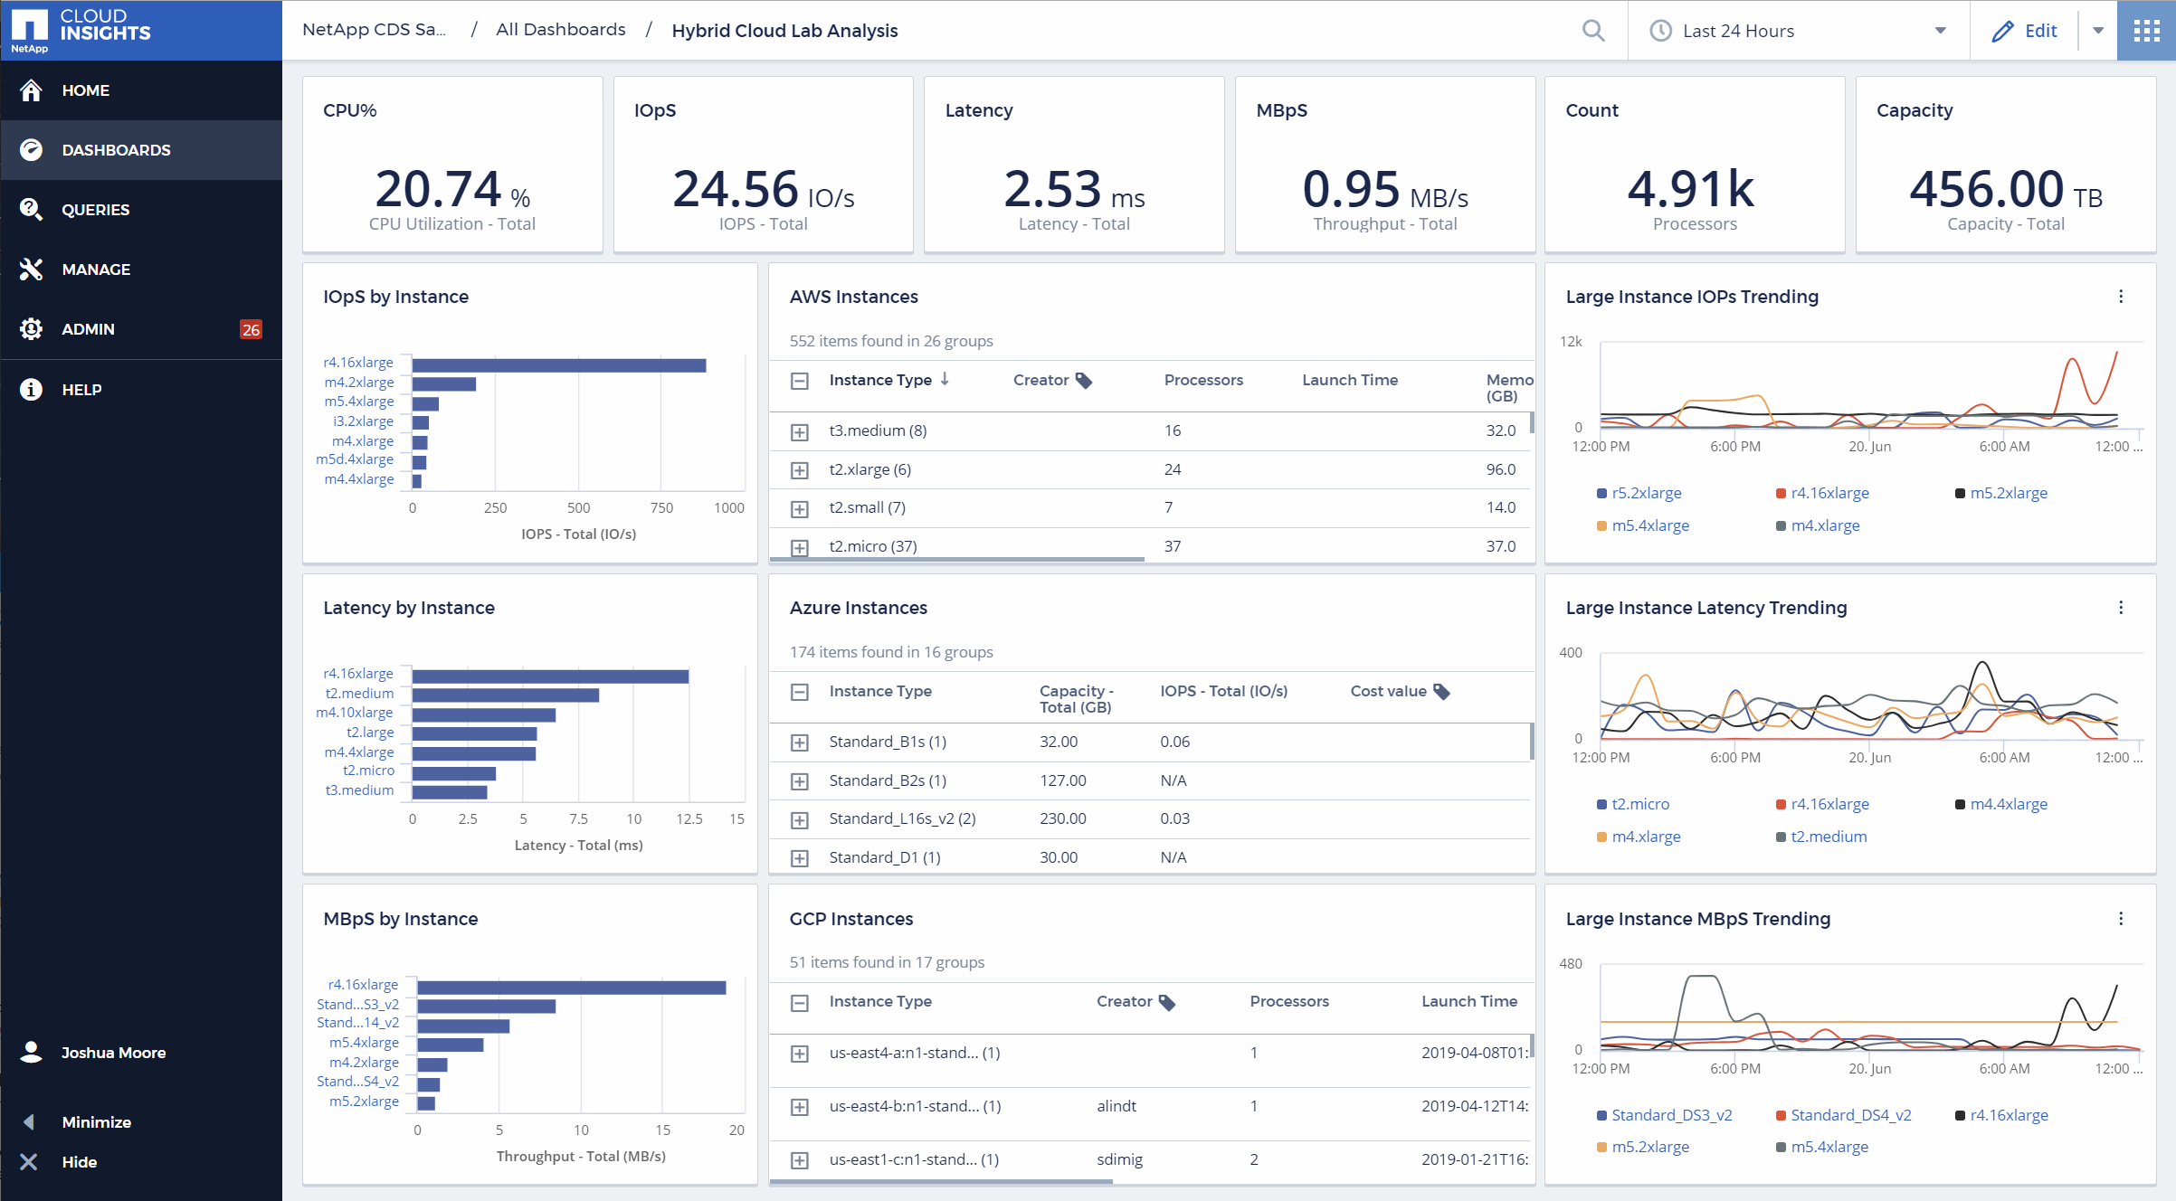
Cloud Insights Monitoring
P

Slide 40
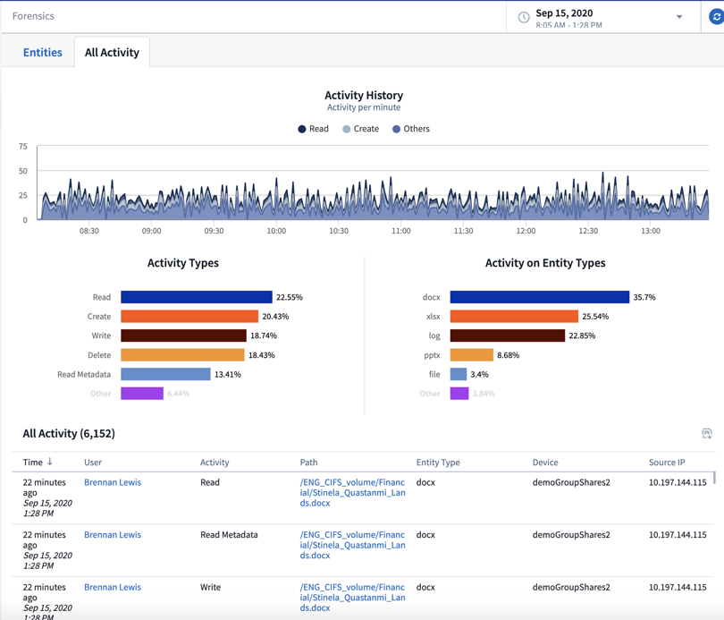
Security
– Cloud Secure: Forensic for Data Breach and Audits
  Select file activity data by user, time, activity type and file attributes
  Generate User Data Access Audit reporting
  Conduct data breach and security incident investigations
  Retain historical data for 13 month
Event time, user, file and activity information
P

Slide 41
Action Plans and Next Steps
Monitor the health of your cloud environment
Correlate storage utilization to workloads
Optimize your cloud spend by understanding unused infrastructure and overprovisioned workloads
Monitor all your IT infrastructure on-premises and in the cloud
D

Slide 42



Why Cloud Insights?
Control the performance and usage of your workloads
When you have issues find the problems before they effect customer satisfaction
Optimize your growing cloud spend by understanding unused infrastructure and overprovisioned workloads
Monitor all your IT infrastructure on-premises and in the cloud
P

Slide 43
What are Cloud Management Tools and platforms?
Cloud management tools and platforms enable organizations to manage multi-cloud (i.e., on-premises, public cloud and edge) services and resources.
This includes providing governance, life cycle management, brokering and automation for managed cloud infrastructure resources across multiple functional areas.
Source: https://www.gartner.com/reviews/market/cloud-management-tooling

