Slide 1
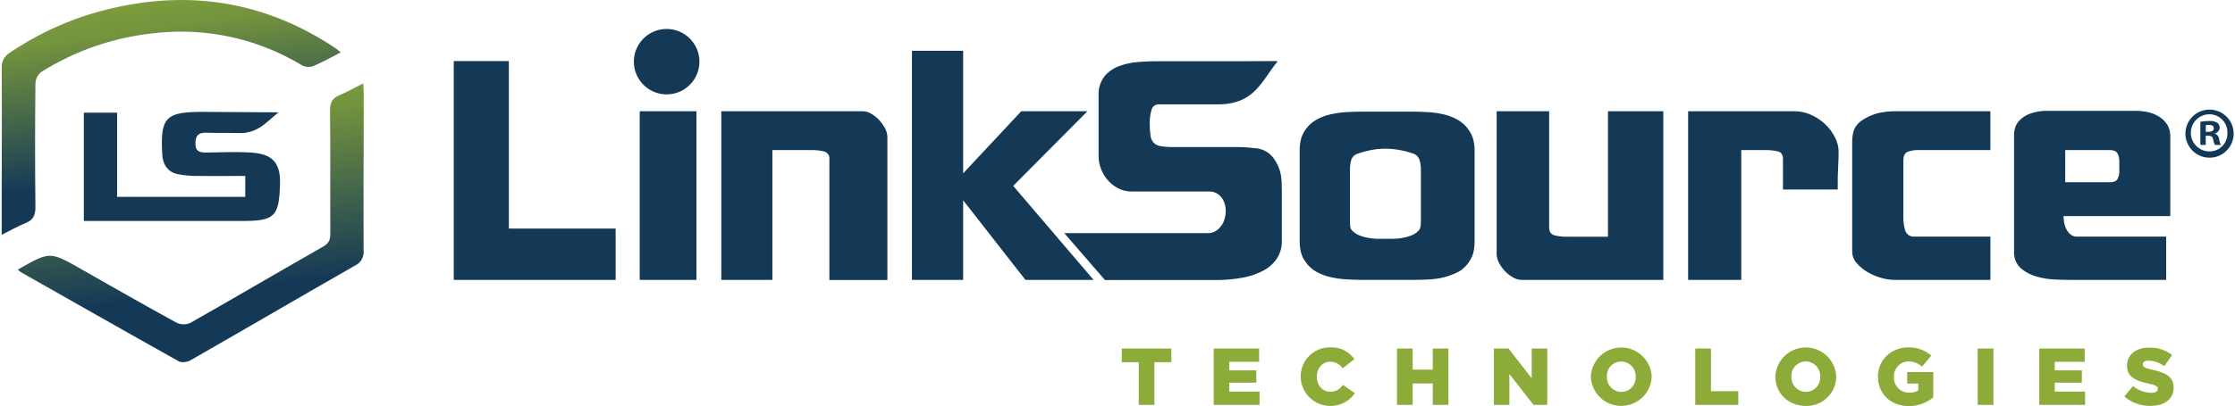
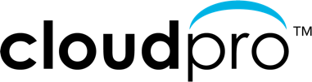
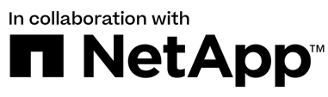
Cloud Optimization Sales Workshop – Part II
Optimize your Cloud
Accelerate your business with
Cloud Insights from NetApp
D

Slide 2

LinkSource Sales Workshop Agenda
Schedule | Topic
9:00 – 9:05 | Welcome Introductions – CloudPro & NetApp Sales Workshop Objectives
9:05 – 9:15 | Why optimize your cloud? Performance, cost savings & security
9:15 – 9:40 | Taking control of your cloud NetApp Cloud Insights Monitoring & Optimization
9:40 – 9:50 | Selling Cloud Insights Target Customers Cloud Optimization Workshop POCs
9:50 – 9:55 | Nike By You
9:55 – 10:00 | Q & A
M

Slide 3
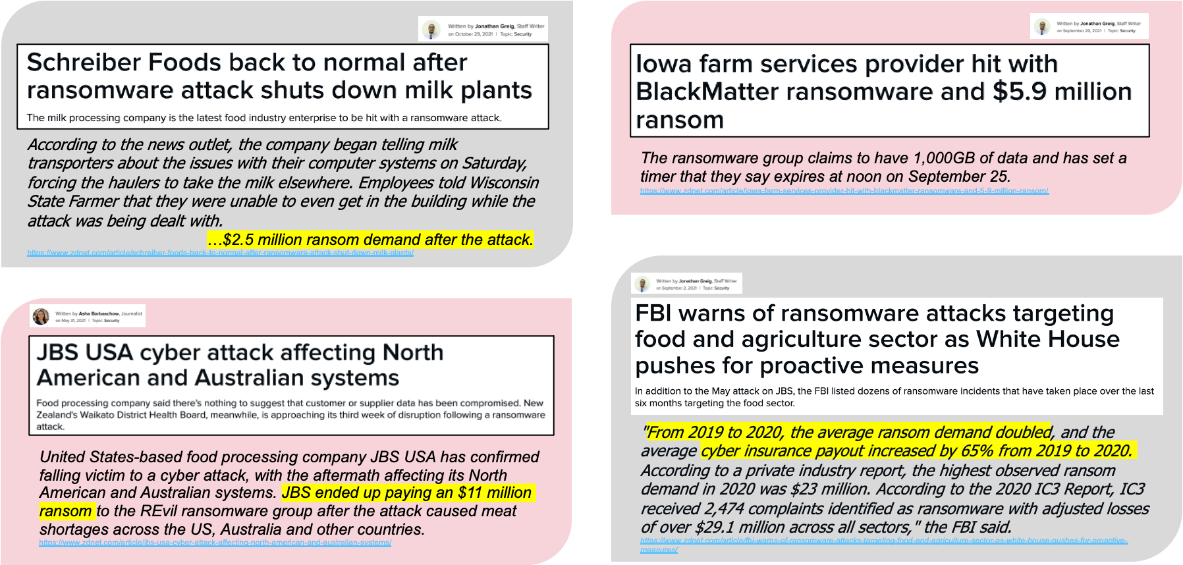
Ransomware in the news...

Slide 4

Ransomware happens.
No one wants to admit it.
“This is the most reliable ransomware protection we’ve found. One of our critical applications looks a lot like ransomware to other tools, and false positives have halted business more than once. Not so with NetApp Cloud Insights, which has been able to distinguish the difference between business as usual and an actual threat.”
– IT Director, Finance
Note: This is an actual quote from a NetApp customer. However, details have not
been included to protect the customer’s anonymity.

Slide 5

Ransomware happens.
No one wants to admit it.
“We had a ransomware attack. The only data we could recover was on NetApp.”
— IT Director, Energy Company
Note: This is an actual quote from a NetApp customer. However, details have not
been included to protect the customer’s anonymity.

Slide 6

Ransomware happens.
No one wants to admit it.
“Our company had a widespread ransomware attack, NetApp Cloud Insights alone stopped it for us and kept us out of the press.”
– CISO, Consumer Company
Note: This is an actual quote from a NetApp customer. However, details have not
been included to protect the customer’s anonymity.

Slide 7
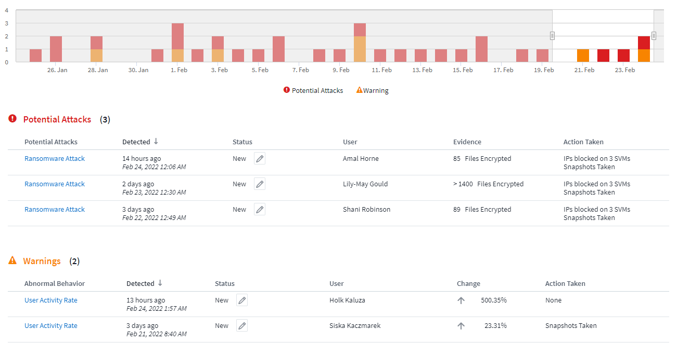

Security
– Cloud Secure: A feature of Cloud Insights
Detect anomalies & identify potential attacks
  Advanced machine learning algorithms uncover unusual data activity and detect a potential attack
Monitor User Activity
  All user activity across on-premises and hybrid cloud environments is captured and analyzed
Automated Response Policies
  Alerting and automatic data snapshot response make sure you are notified, data is backed-up and you can recover quickly
Forensics and User Audit Reporting
  Graphical interface for activity data analysis, data breach investigations and User Data Access Audit reporting generating
P

Slide 8
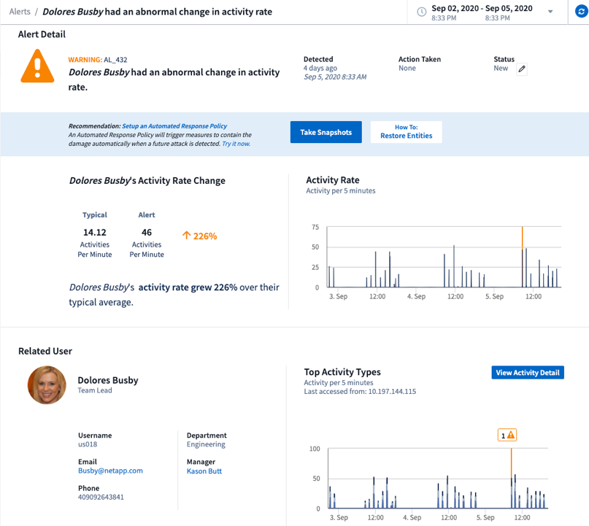
Security
– Cloud Secure: Intelligent Threat and Impact Analysis
Identify
  What (risk): Potential Attack
  Who: User and Source IP
  When: Real time detection
  Impact: Affected volumes and files
Rich graphical interface for analysis
  View user profile and activity information
  Compare user activity during alert and with historical information
Abnormal user activity
P

Slide 9

Secure your data – Cloud Insights and Cloud Secure
User anomaly and threat detection
Detect ransomware attacks before it’s too late.
Minimize the impact of an attack with automatic Snapshot data recovery point.
Gain visibility into malicious user activity and identify potential policy risks.
Easily satisfy audit reporting requirements, saving time and money.
Simple SaaS solution, rapid time to value, no upgrades, scalable from single departments to global enterprises.
“We recently experienced a ransomware event, and when we saw what Cloud Insights’ Ransomware Detection provides, we were sold.”
—Director of IT, Transportation Company
© 2022 CloudPro™ Corporation. © 2022 NetApp™. All Rights Reserved.

Slide 10
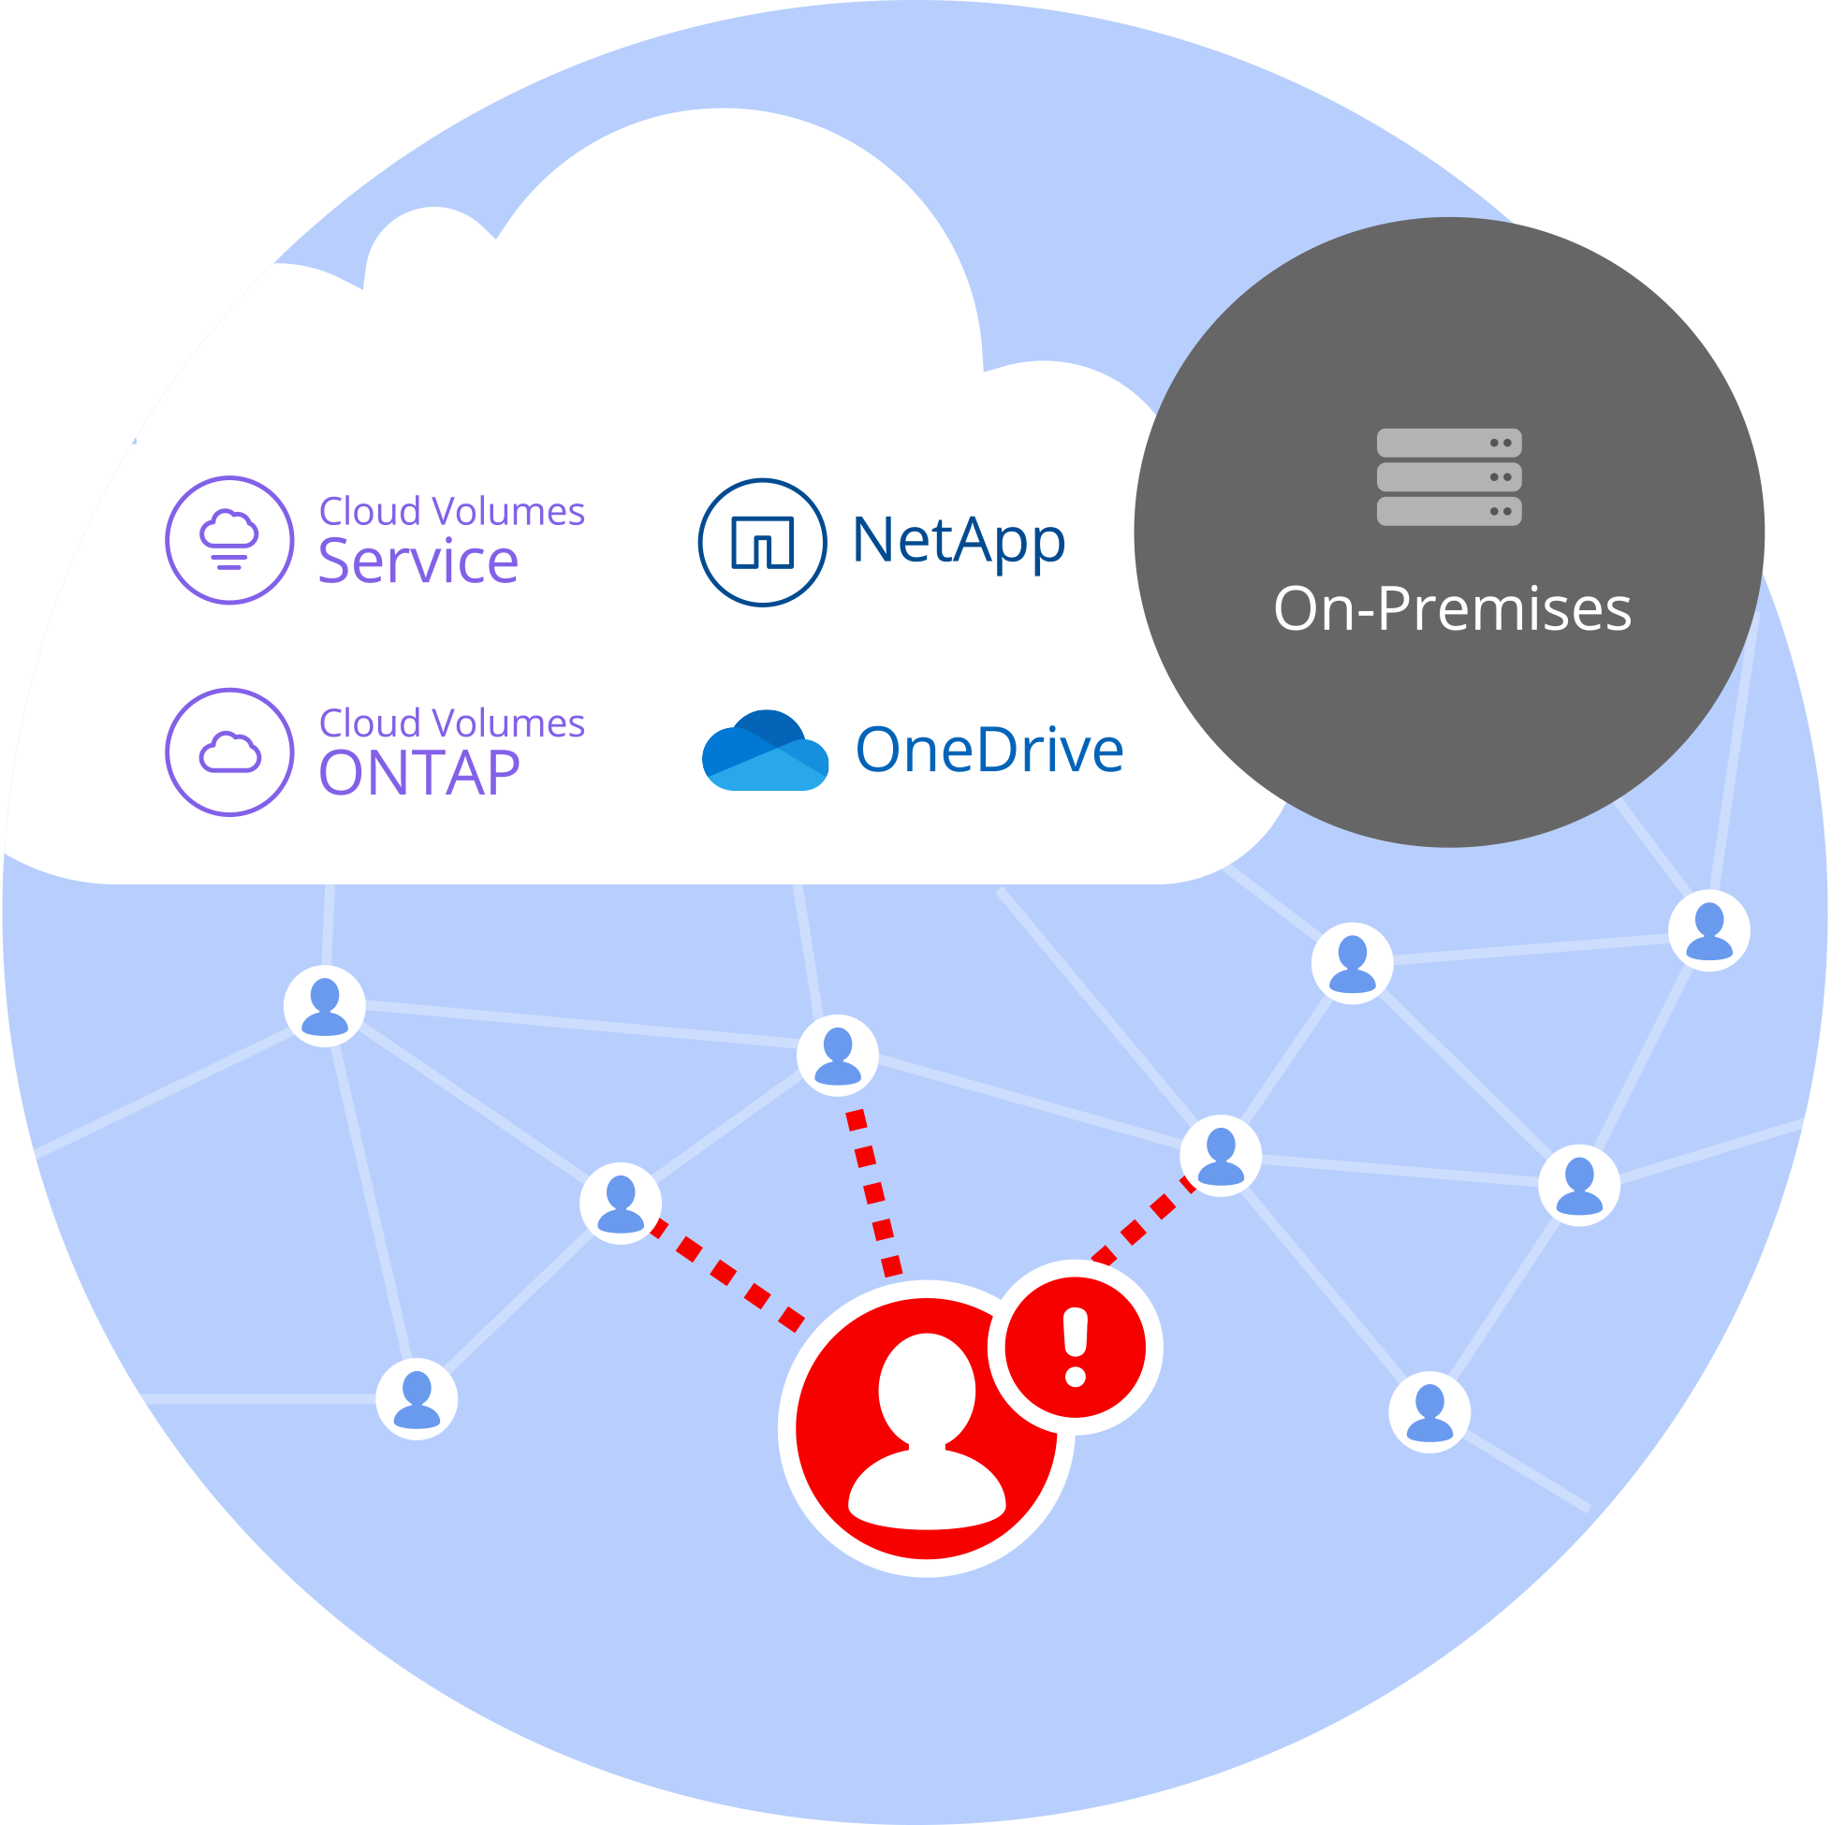
Data Protection, Governance and Legal Compliance Are Challenging To Organizations
Operational teams, across organizations, managing data using tools and manual processes that are time-consuming, inaccurate, unscalable and limited, are
Failing to gain visibility and control across cloud services and on-premises storage systems
Vulnerable to gaps in compliance with relevant regulations and standards such as audit, secure usage, actions taken, and alerts
Risking in organization’s data being misused by malicious or compromised users
© 2022 CloudPro™ Corporation. © 2022 NetApp™. All Rights Reserved.
Notes:
Examples:
Risking in organization’s data being misused by malicious or compromised users
It’s estimated that a company is infected with ransomware every 40 seconds.
The malware, the best known examples of which include WannaCry and Petya, encrypts files. Affected companies are asked for a ransom. If ransomware is not detected very quickly, data can be lost. Worst of all: Just one click by an employee is enough to infect the network. It’s not only files on the local computer that are harmed, but also those on authorized network drives. The flood of ransomware goes on. And some only notice when it’s too late. Just a single click on a malicious link or e-mail attachment can install malware in the background which can run unnoticed for months. There is then a risk that, over time, the backup media will only be holding encrypted files, and the originals can no longer be restored.
Vulnerable to gaps in compliance with relevant regulations and standards such as audit, secure usage, actions taken, and alerts
Imagine an M&A (Merger and acquisition) department storing documents and analytical data around an upcoming merger
Employees delivering additional information must have access to their documents
Cloud Secure will detect as soon as any user accesses files he has never accessed before or copies/reads files in an abnormal amount (like copying all of ‘em to a separated flash drive or so)
You will be alerted in real-time on this thread and can take counter measures immediately
Failing to gain visibility and control across cloud services and on-premises storage systems
For sure you have a valid security tool in place – even audits will be processed regularly – but for each location / solution you own a different product to ensure data integrity.
It is hard to give you a complete overview and transparency into your organization
Cloud Secure will enable you to exactly do this for
All your NetApp

Slide 11
Why Cloud Secure?
63% of all data breaches are caused by insider threats
Conventional security models operate on the outdated assumption that everything on the inside of an organization’s network can be trusted. Inside Threats are left invisible, uninspected, and free to extract sensitive, valuable business data.
Cloud Secure doesn’t assume a trusted internal network; instead, it trusts no one. It inspects and analyzes all data access activity in real time to detect malicious behaviors.
Source: https://breachlevelindex.com/
© 2022 CloudPro™ Corporation. © 2022 NetApp™. All Rights Reserved.
Notes:
63% of all data breaches are caused by insider threats
Conventional security models operate on the outdated assumption that everything on the inside of an organization’s network can be trusted. Inside Threats are left invisible, uninspected, and free to extract sensitive, valuable business data.
Cloud Secure doesn’t assume a trusted internal network; instead, it trusts no one. It inspects and analyzes all data access activity in real time to detect malicious behaviors.

Slide 12
Key Features
Gain centralized visibility and control of user access to your critical corporate data stored on-premises or in the cloud
Replace tools and manual processes that fail to provide timely and accurate visibility into data access and control. Cloud Secure uniquely operates on both cloud and on-premises storage systems to give you real-time alerts of malicious user behavior.
Protect organizational data from being misused by malicious or compromised users.
Alerts you to any abnormal data access through advanced machine learning and anomaly detection of user behavior.
Ensure corporate compliance
Audit user data access in real-time and automatically update protection policies to adopt dynamic access rights
© 2022 CloudPro™ Corporation. © 2022 NetApp™. All Rights Reserved.

Slide 13
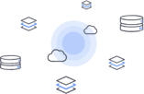

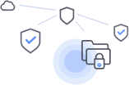
How Cloud Secure works
1. Monitor User Activity
  To accurately identify breaches, every user activity, across on-premises and hybrid cloud environments, is captured and analyzed.
2. Discover Communities
  To understand risky user behavior, it’s important to identify the user’s true 'virtual' working communities. Cloud Secure forms communities of users based on common file access patterns and establishes a baseline of a community’s typical user.
3. Detect Anomalies & Take Action
  Cloud Secure uses advanced machine learning algorithms to automatically uncover unusual data activity. Alerting on a potential threat before they become breaches.
© 2022 CloudPro™ Corporation. © 2022 NetApp™. All Rights Reserved.

Slide 14
A Simple SaaS Solution
Simple turn key solution to organizational data with minimal effort
Time to value:
  Quick deployment
  No manual rules configuration
  No professional services
Automatic anomaly detection based on AI/ML
SaaS:
  No upgrades
  No maintenance
  Feature of Cloud Insights
Scalable from single departments to global enterprises
© 2022 CloudPro™ Corporation. © 2022 NetApp™. All Rights Reserved.

Slide 15





Cloud Insights Benefits Across the Organization
What inefficient use of resources means to:
CEO
CFO
CTO
IT MANAGER
PROCUREMENT MGR
Lower profit
Reduced cash flow
Inefficient use of resources
Fewer projects and smaller team
Best pricing, expense visibility
D
Notes:
Danny

Slide 16
Selling to the CEO
Focus
Revenues
Profitability
Growth
Brand Stability
Motivations
Sales Generation
Time to Market
Competitive Advantage
Triggers
Lagging Sales
Cost Overruns
Market Shifts/Demands
Setting the Stage – Make IT a Business Generator Not a Cost Center
Is your IT organization a key contributor to your overall business strategy?
How dependent are your revenues and profits on the success/failure of your technology initiatives?
Are your technology cost/benefit ratios in line with your revenue and profit projections?
Do have “time to market constraints” that you are having trouble making due to technology short falls?

Slide 17


Target Customers
Dev / Ops Director
Kubernetes Admin
Network Analyst
Head of Solution Delivery
IT Administrator
Cloud Operations Manager
Cloud Architect
Security Operations Director
Infrastructure and Security
Technical
CEOs, CFOs COOs
VP IT Operations
Development / Enterprise Architecture
Chief Security Officer (CSO)
SVP or Director
Infrastructure / Operations Directors
Department Managers
Business
D

Slide 18
Survey Results
What we learned
Business Challenges
  Runaway cloud costs
  Inability to measure SLAs and usage for chargeback
  High cost of maintaining multiple tools
  Poor performance effecting customer satisfaction
  High cost of system outages
Technical Challenges
  Inability to right-size workloads that are over provisioned
  Find and fix problems faster
  Lack of a single effective monitoring tool that covers the full stack and can be used by the entire DevOps team
  Meet SLOs & SLAs during and after cloud migration
  Visibility into infrastructure and applications
D

Slide 19
Qualifying Opportunities
Are you able to control the performance and usage of your workloads?
Can you identify and resolve problems before they effect customer satisfaction?
Are you able to optimize your growing cloud spend by understanding unused infrastructure and overprovisioned workloads?
Are you able to monitor all your IT infrastructure on-premises and in the cloud?
Do you have actionable intelligence on insider threats?

Slide 20
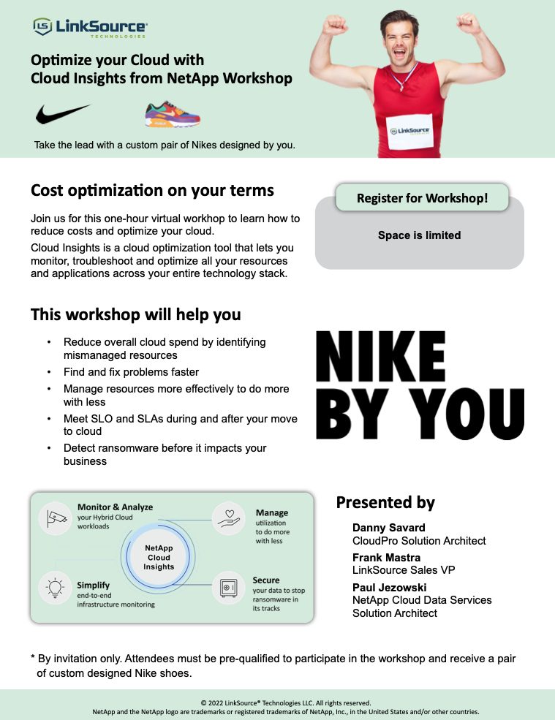
Cloud Insights Optimization Workshop

Slide 21
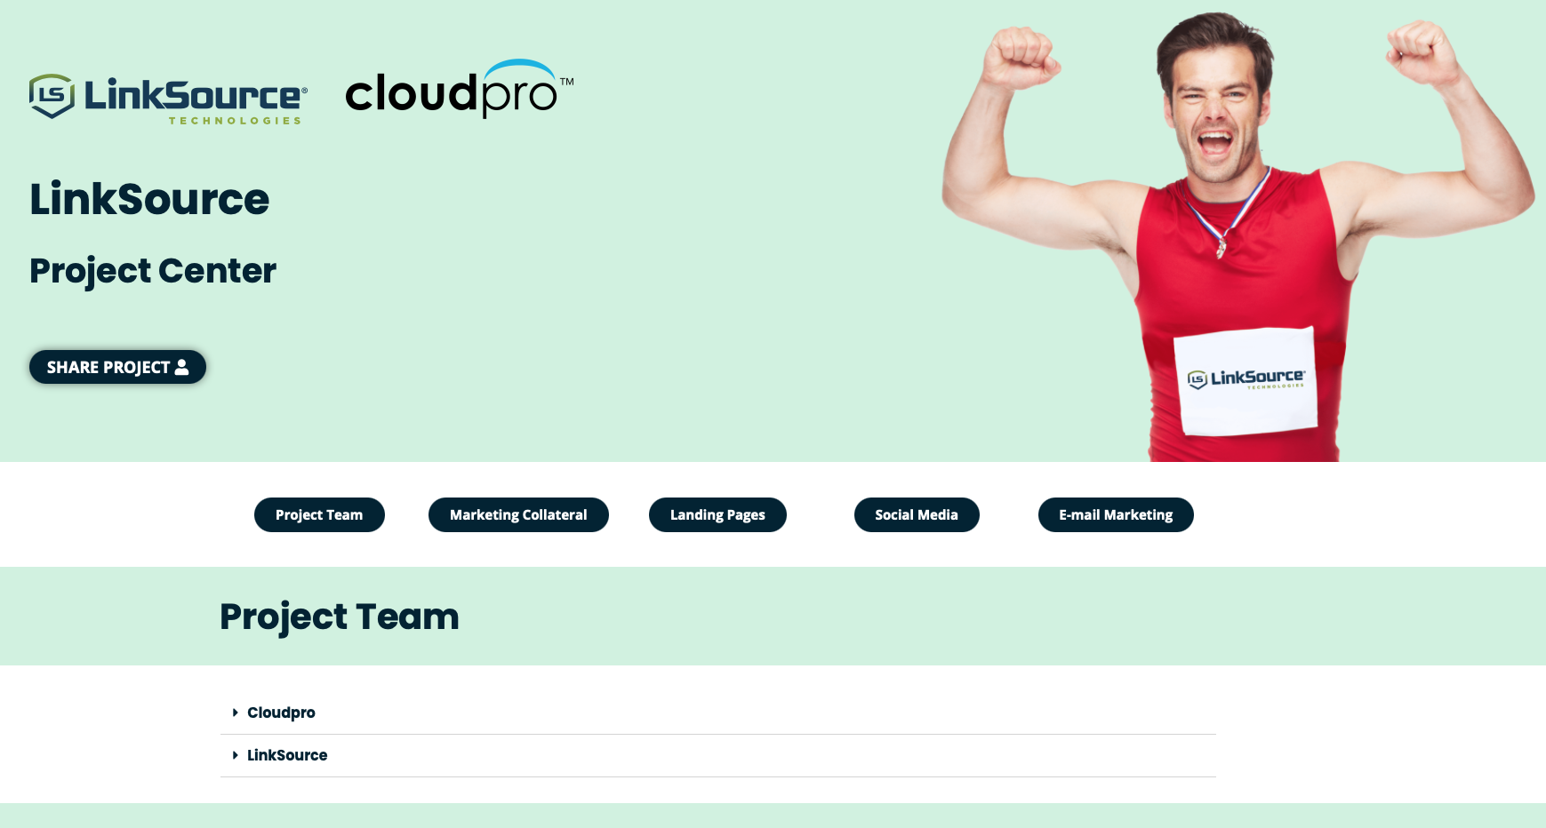
LinkSource Cloud Insights Resource Center

Slide 22



Custom Nikes
for LinkSource SR
for each
Cloud Insights POC
https://www.nike.com/nike-by-you
M

Slide 23

Q&A Discussion
Any Questions?
M

Slide 24

Next Step
Meet with Mike Plan client-specific CI sales campaign for target target accounts (30 mins)
Mike Garcia - VP of Sales
Email: mike.garcia@cloudpro.services
Mobile: (408) 590-6949
Calendly: https://calendly.com/mike-garcia-cloudpro
M

Slide 25
Mike Garcia - VP of Sales
Email: mike.garcia@cloudpro.services
Mobile: (408) 590-6949
Calendly: https://calendly.com/mike-garcia-cloudpro
Doug Kryzan - CEO
Email: doug.kryzan@cloudpro.services
Mobile: (650) 714-3882
M

Slide 26
M

Slide 27
Backup

Slide 28

Special thanks to
Paul Jezowski NetApp Cloud Data Services Solution Architect
Mike Garcia CloudPro VP of Sales
M

Slide 29



Your Business Accelerated
Comprehensive portfolio of cloud consulting and engineering services
Full spectrum of cloud expertise, skills, and certifications to quickly fill knowledge and resource gaps
High-quality cloud best practices and methodologies for your cloud optimization, integration, migration and assessment projects
D

Slide 30
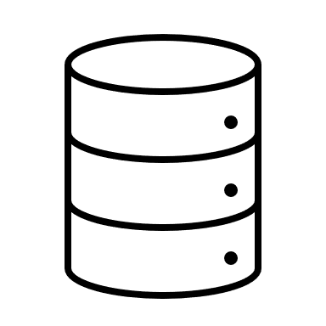



Industry-leading cloud services
NetApp is a global cloud-led, data-centric software company that gives organizations everywhere the freedom to put data to work in the applications that elevate their business.
Global cloud-led, data-centric software company
Industry-leading software, systems, and cloud services
Founded in 1992, headquartered in San Jose, California
$5.74B FY21 revenue
11,000+ employees and 4,000+ partners helping organizations thrive in a hybrid multi-cloud world
Fortune 500 company (NASDAQ: NTAP)
Cloud
Storage
Compute
Operations
Cloud
Controls
Cloud Services
and Analytics
D

Slide 31



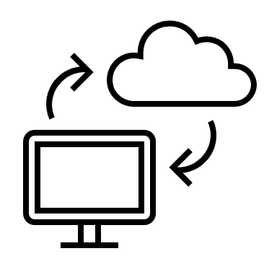
Why Cloud Insights?
Control the performance and usage of your workloads
When you have issues find the problems before they effect customer satisfaction
Optimize your growing cloud spend by understanding unused infrastructure and overprovisioned workloads
Monitor all your IT infrastructure on-premises and in the cloud
P

Slide 32

Control the performance and cost of your cloud workloads
Find performance issues faster and optimize cloud usage to do more with your limited budget.
NetApp Cloud Insights is a SaaS based monitoring tool that helps you quickly find performance problems and optimize usage of your cloud workloads.
P
Notes:
Paul

Slide 33



Outcomes Delivered
– Why Do You Need Cloud Insights
Monitor shared resources across any infrastructure;
On-premised, Cloud and Kubernetes
Analyze relationships between shared resources and how they impact each other
Modernize and Analyze
Optimize and Control Usage
Optimize by identifying waste, increasing utilization and density of compute and storage
Control usage with Show-back / Chargeback showing who is using what and how much
Guarantee Availability
Determine the available headroom to prevent infrastructure saturation
Right size application resources to prevent performance problems and downtime
Key Differentiators
Multi-Vendor Infrastructure
Shared Infrastructure
Full Stack Visibility
Ransomware Protection
P

Slide 34
Operational Challenges
– Reasons to invest in Infrastructure Monitoring
  Business Challenges
  Poor performance effecting customer satisfaction
  Runaway cloud costs
  High cost of maintaining multiple tools
  High cost of system outages
  Inability to measure SLAs and usage for optimization
  Protection against Ransomware
  Technical Challenges
  Difficulty isolating problems and outages in complex hybrid infrastructure in a timely manner
  Lacking a single effective view of the full-service path
  Difficulty identifying workloads for right-sizing or optimization
  Inability to report on SLAs and SLOs
  Accurately provisioning cloud resources for cloud migrations
P

Slide 35
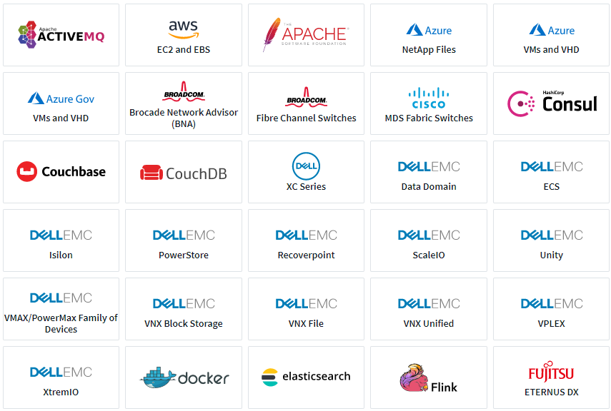
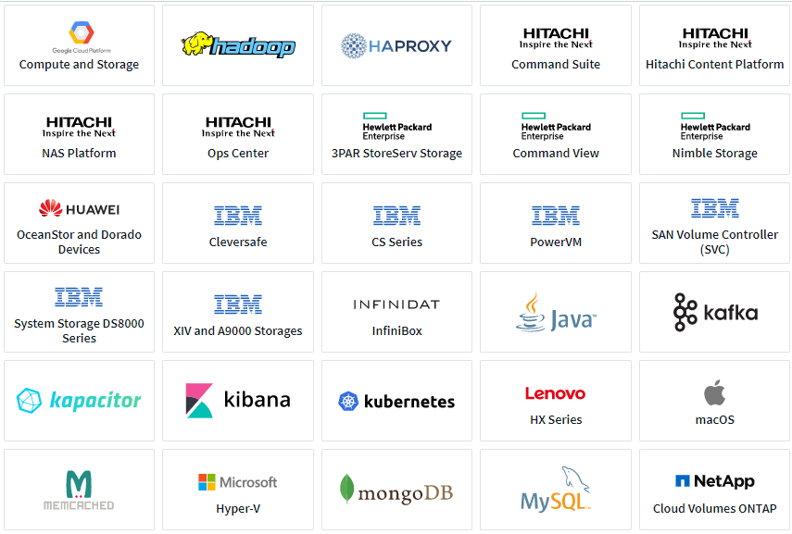
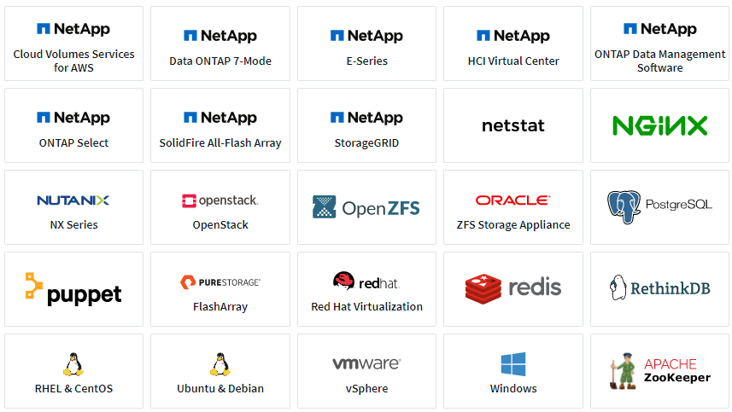
Heterogeneous Support
– Operating systems, infrastructure devices, and services
P

Slide 36

Cloud Insights
Common Use Cases
Cloud Visibility / Cloud Migration
Troubleshooting and Operational Efficiency
Forecasting and Trend Analysis
Security
P

Slide 37


Summary
– Value and Benefits
Make intelligent decisions before, during, and after hybrid cloud migrations
Avoid potentially costly initial over-provisioning of cloud resources before migrating.
Analyze and control cloud costs before they get out of hand.
End-to-end visibility of application infrastructure resources, whether they’re in the cloud or on-prem
Reduce the time to find and resolve infrastructure issues and identify areas of potential risk before they become an issue.
Improve application availability and application user / owner satisfaction.
Integrate optimization and cost management into a daily process
REST APIs for CMDB integration enables true cost of infrastructure or application ownership analysis with chargeback reporting.
Provide infrastructure or application owners with performance and capacity information to make intelligent requirements decisions.
P

Slide 38

Summary
– Value and Benefits
Optimize usage and achieve more with a limited budget
Avoid over-provisioning hybrid cloud infrastructure resources.
Forecast infrastructure requirements based on historical trend analysis.
Protect organizational data from ransomware or being misused by malicious/compromised users
Limit critical data loss by detecting and stopping malicious activities.
Ensure corporate compliance by auditing user data access to NetApp data stored on-prem or in the cloud.
Avoid loss of business, damage to brand, loss of trust, fines, etc…
P

Slide 39





Cloud Insights Clients
Major healthcare insurer and managed care provider
Heterogeneous infrastructure monitoring, existing and via acquisitions
Ransomware and malicious activity detection
Global computer security company
Cloud migration
Cloud-based application chargeback
Global mortgage lending company
Monitor and administer their cloud-based VDI and database environment to ensure content creators have the necessary resources
Global provider of outsourced services to the pharmaceutical, biotechnology, and medical device industries
Heterogeneous infrastructure monitoring, capacity planning, and ransomware detection on a 20PB sprawling storage estate
Globally-known companies in the consumer electronics, entertainment, pharmaceutical oil & gas industries
Heterogeneous infrastructure monitoring
Cloud infrastructure monitoring: AWS, Google Cloud, Azure
P

Slide 40
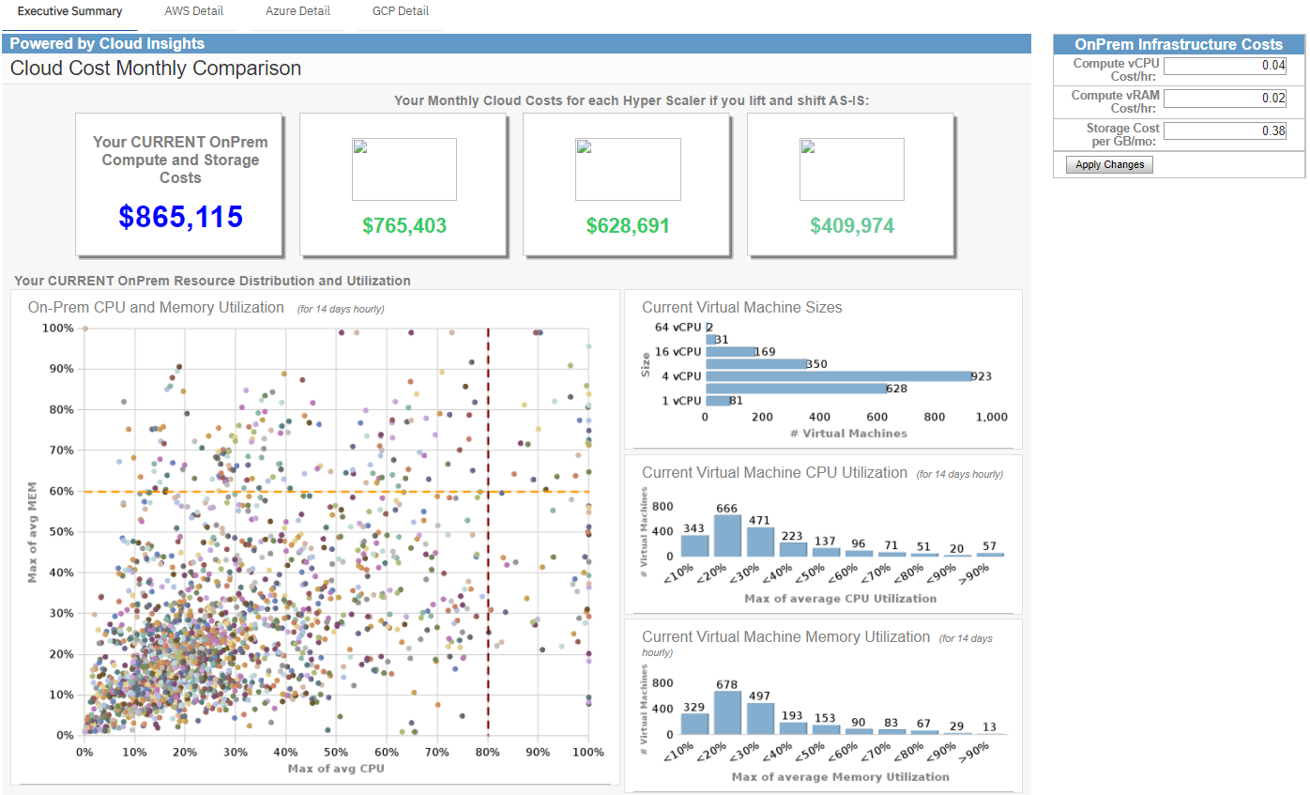
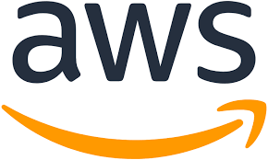
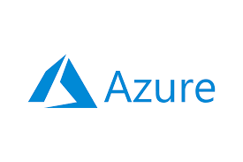
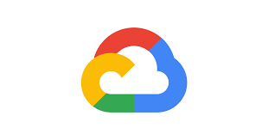
Cloud Visibility / Cloud Migration
– Optimize costs and run efficiently
Model on-prem versus cloud costs (these are fictitious values)
P

Slide 41
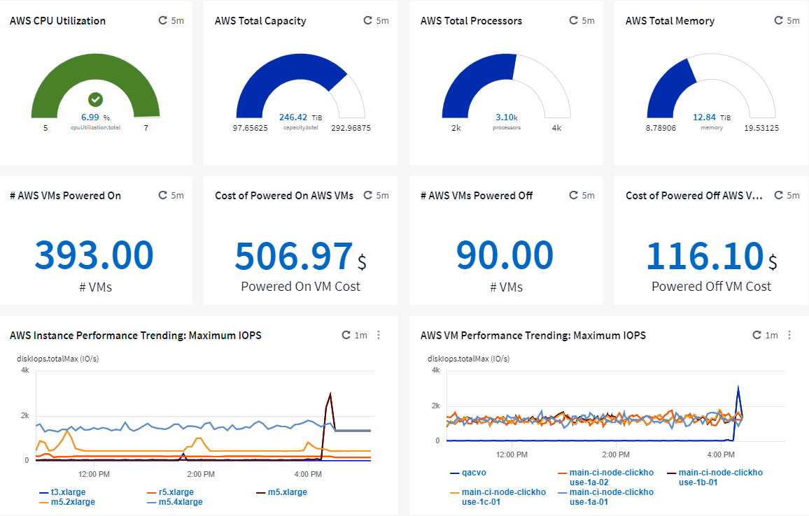
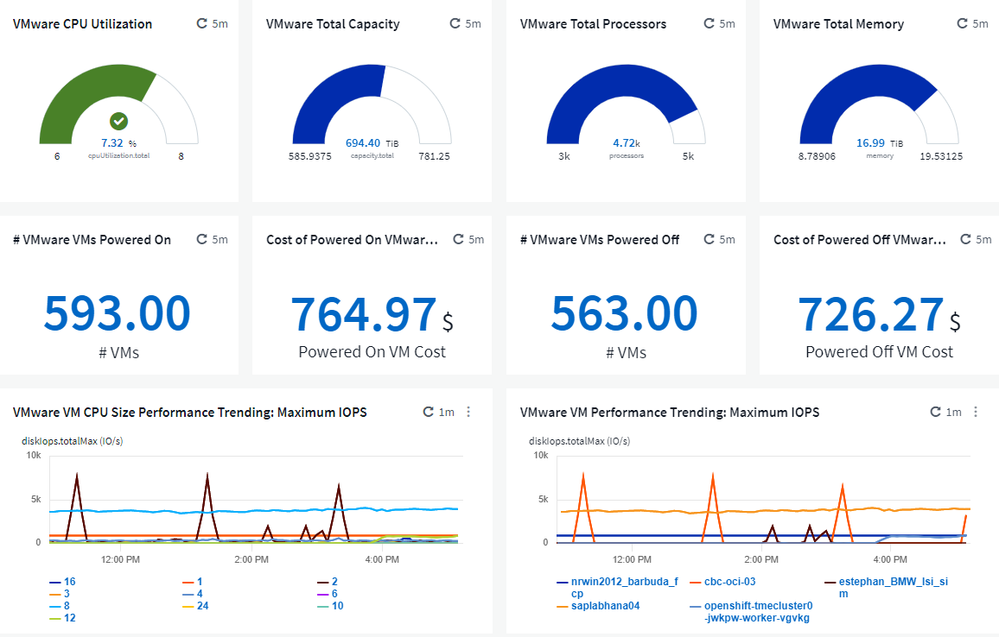
Cloud Visibility / Cloud Migration
– Managing hybrid-cloud assets: Side-by-side utilization and cost comparison
Cloud resources
On-prem resources
P

Slide 42
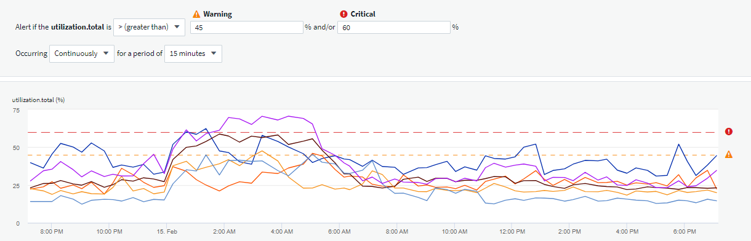
Troubleshooting and Operational Efficiency
– Reduce potential future application outages with proactive alerting
Thresholds determined by application owners, IT staff, etc…
Storage nodes consistently over-utilized, potentially leading to application interruption or outage
P

Slide 43
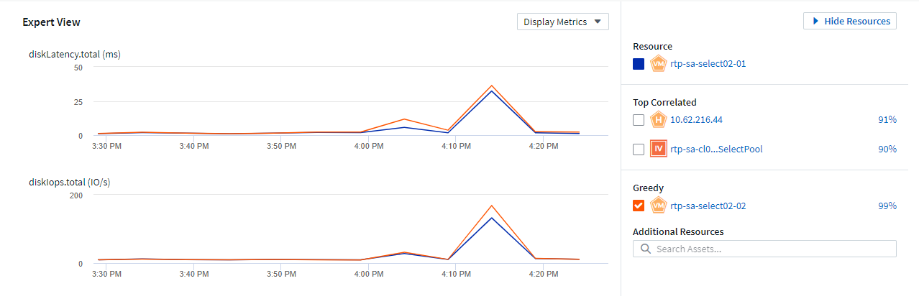
Troubleshooting and Operational Efficiency
– End-to-end visibility of application infrastructure resources, whether they’re in the cloud or on-prem
Identify resources having an impact on the base resource
IOPs of greedy resource (orange) impacts latency of base resource (blue)
Identify greedy or degraded workloads
P

Slide 44
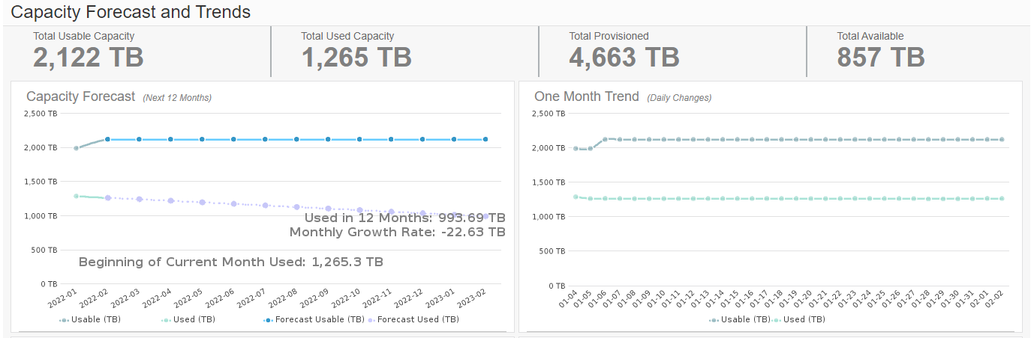
Forecasting and Trending Analysis
– Optimize usage and achieve more with a limited budget
Forecasted used capacity on a downward trend
P

Slide 45
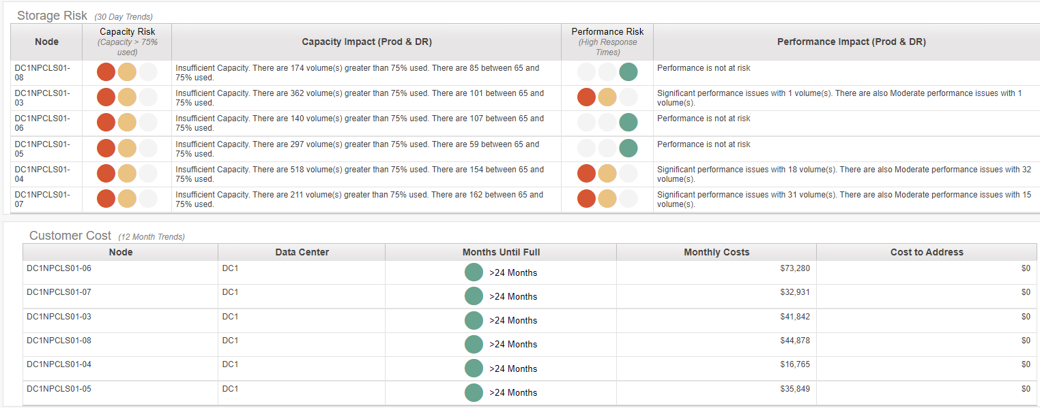

Forecasting & Trending Analysis
– Understand where storage capacity and performance may be at risk
Volume-level capacity and performance risk with easy-to-understand red, yellow, and green indicators
Anticipated capacity full timeframe based on current consumption
P

Slide 46
Workshop Poll Questions
Poll 1
  Q: Are you able to quickly identify runaway costs in your cloud infrastructure?
  A1:Yes A2: No A3: Not sure
Poll 2
  Q: Are you able to identify unused or orphaned infrastructure in your cloud environment?
  A1:Yes A2: No A3: Not sure
Poll 3
  Q: Are you able to monitor all your IT infrastructure on-premises and in the cloud?
  A1:Yes A2: No A3: Not sure
Poll 4
  Q: Are you able to detect ransomware attacks before they impact your business?
  A1:Yes A2: No A3: Not sure
P

Slide 47
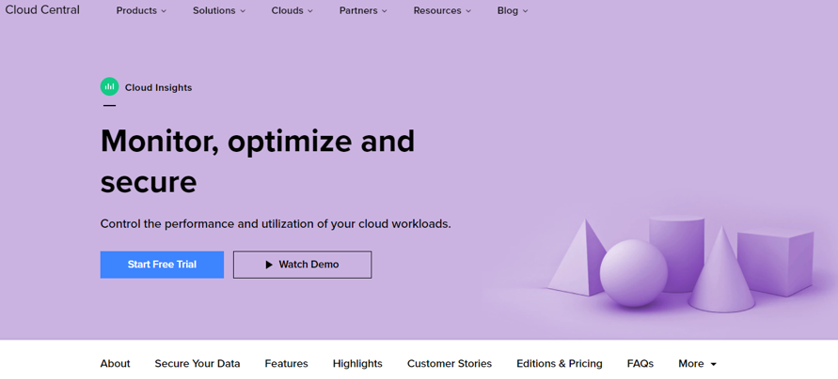
Cloud Insights
– Heterogeneous hybrid-cloud SaaS monitoring platform
Visibility into your infrastructure and applications
Find and fix problems faster
Manage resources more effectively
Meet SLOs & SLAs during and after cloud migration
Stop ransomware with actionable intelligence
https://cloud.netapp.com/cloud-insights
P

Slide 48



Cloud Insights Use Case Categories
Monitoring
Cost Control & Optimization
Secure
Centralize Monitoring Across Your Growing Hybrid IT Infrastructure
Reduce Cost Across Your Hybrid Environment
Reduce Exposure to Insider Threats
Reduce mean time to resolution by 90% and prevent 80% of cloud issues from impacting end users
Reduce cloud infrastructure costs by an average of 33%
Reduce your exposure to insider threats by protecting your data with actionable intelligence.
P

Slide 49
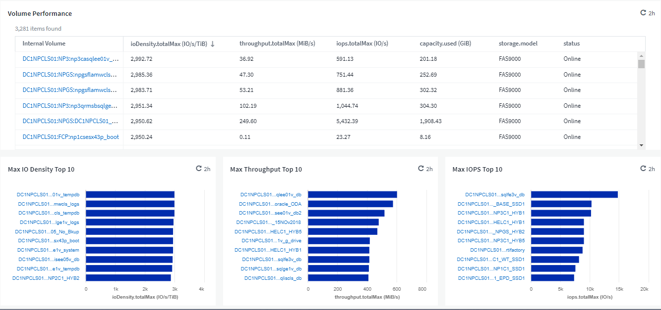
Cloud Visibility / Cloud Migration
– Make intelligent decisions before, during, and after hybrid cloud migrations
Provision cloud storage based on metrics used by cloud providers
P

Slide 50
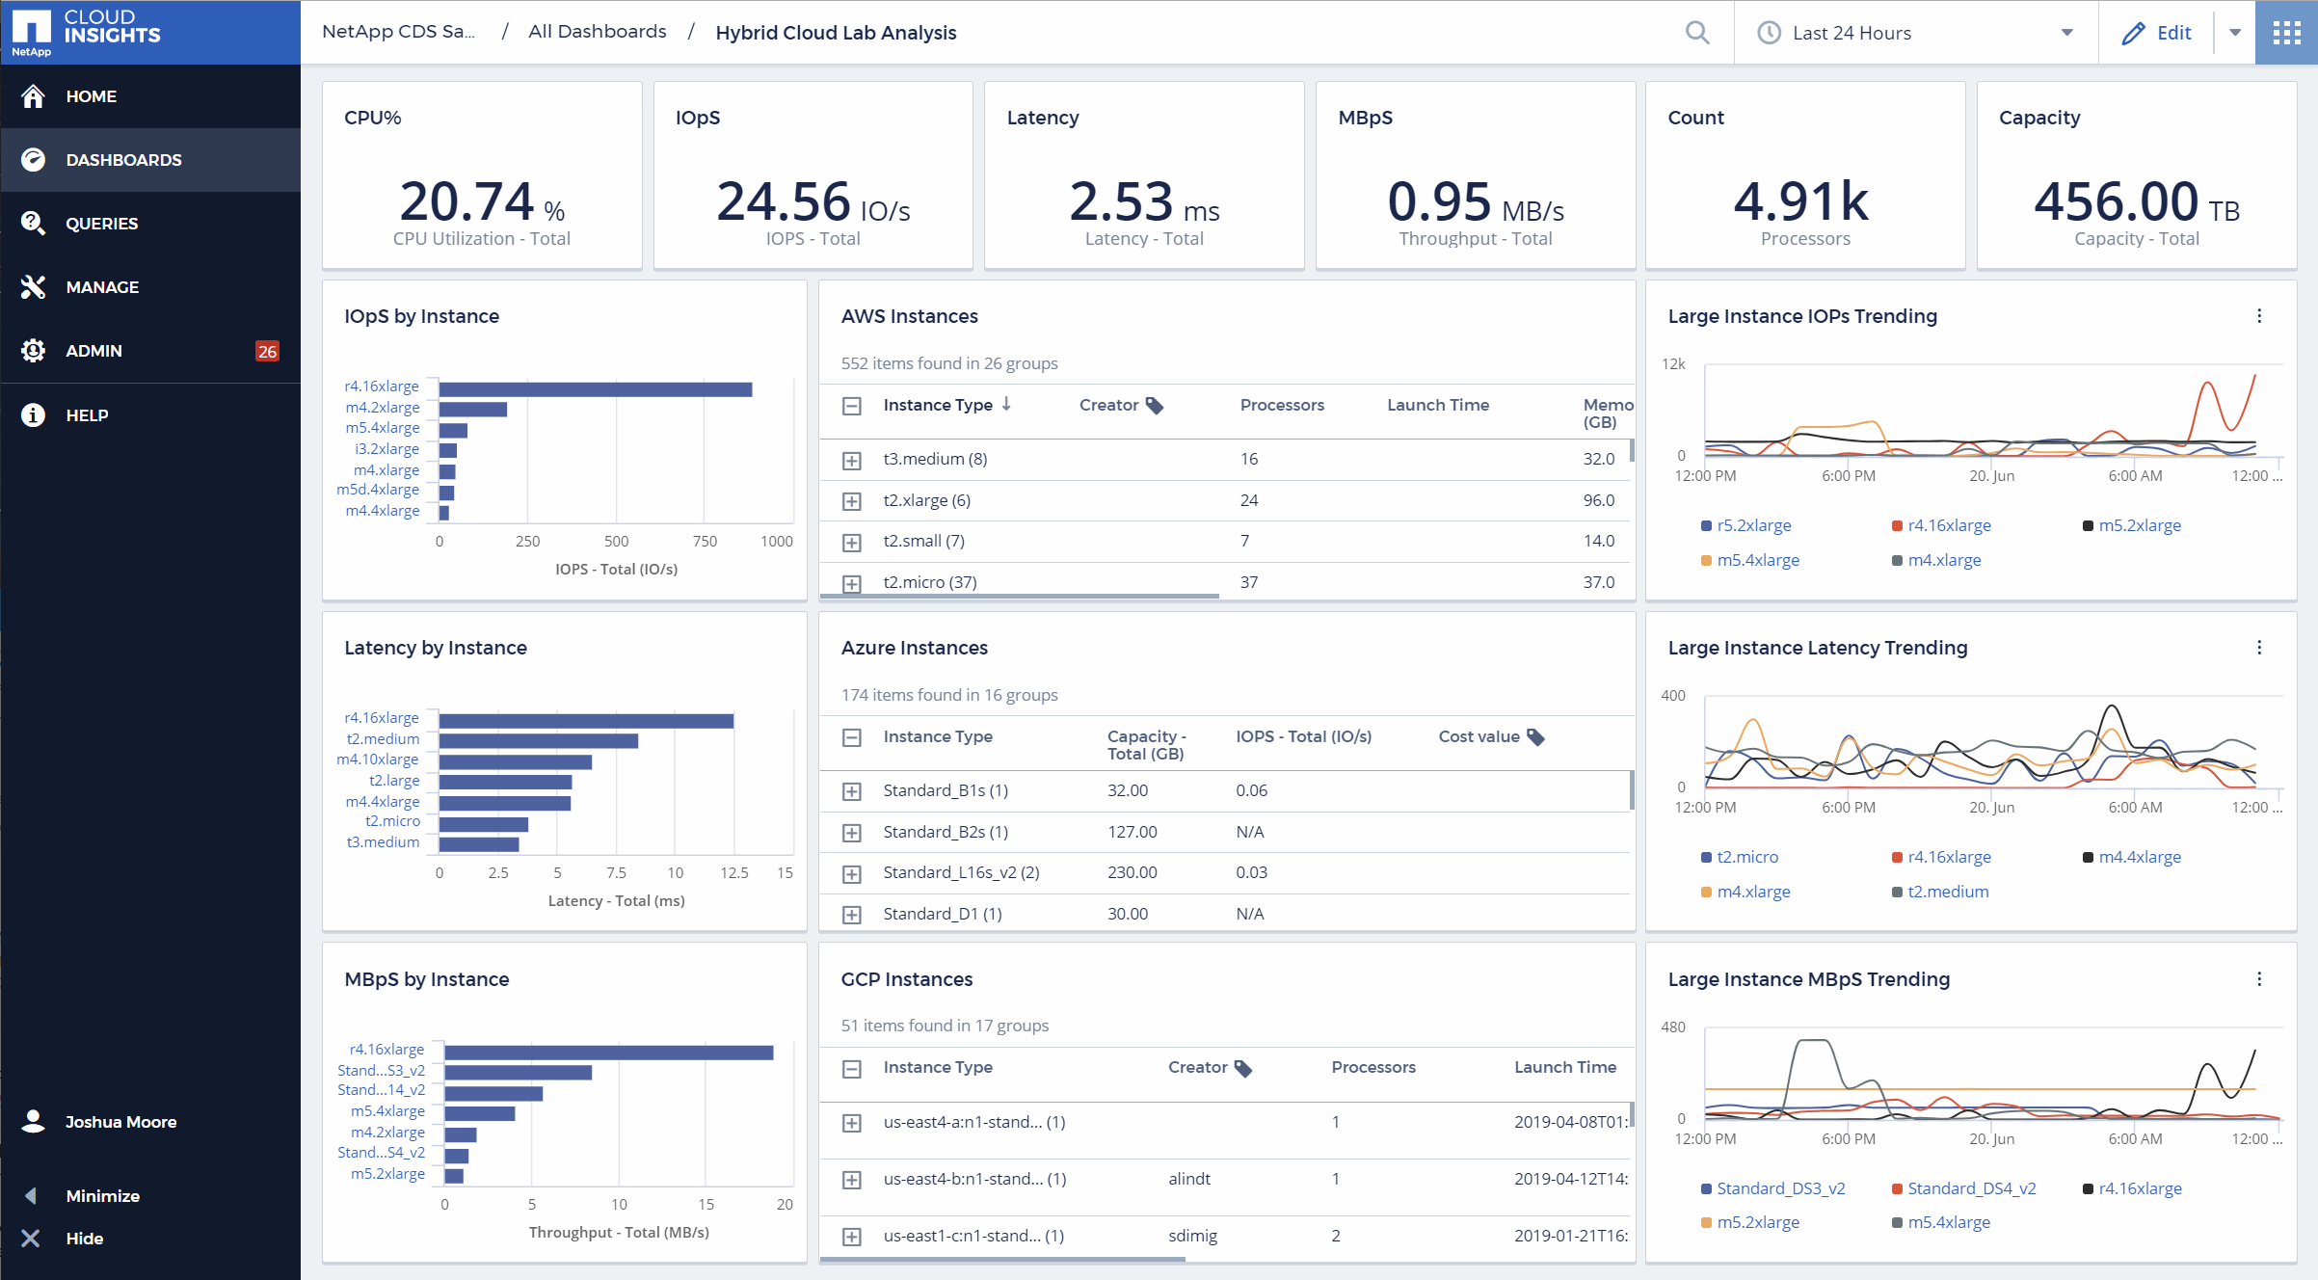
Cloud Insights Monitoring
P

Slide 51
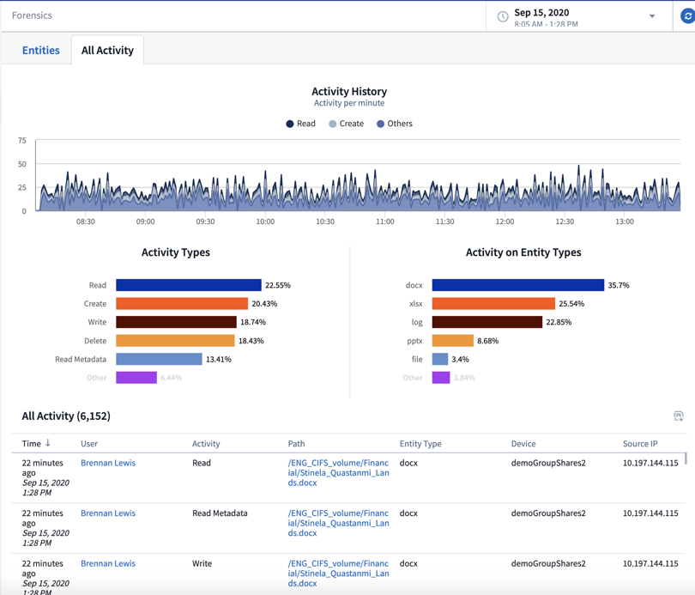
Security
– Cloud Secure: Forensic for Data Breach and Audits
  Select file activity data by user, time, activity type and file attributes
  Generate User Data Access Audit reporting
  Conduct data breach and security incident investigations
  Retain historical data for 13 month
Event time, user, file and activity information
P

Slide 52

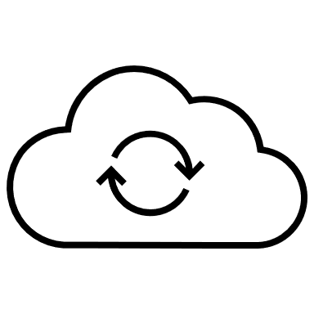

Action Plans and Next Steps
Monitor the health of your cloud environment
Correlate storage utilization to workloads
Optimize your cloud spend by understanding unused infrastructure and overprovisioned workloads
Monitor all your IT infrastructure on-premises and in the cloud
D

Slide 53
What are Cloud Management Tools and platforms?
Cloud management tools and platforms enable organizations to manage multi-cloud (i.e., on-premises, public cloud and edge) services and resources.
This includes providing governance, life cycle management, brokering and automation for managed cloud infrastructure resources across multiple functional areas.
Source: https://www.gartner.com/reviews/market/cloud-management-tooling

Slide 54
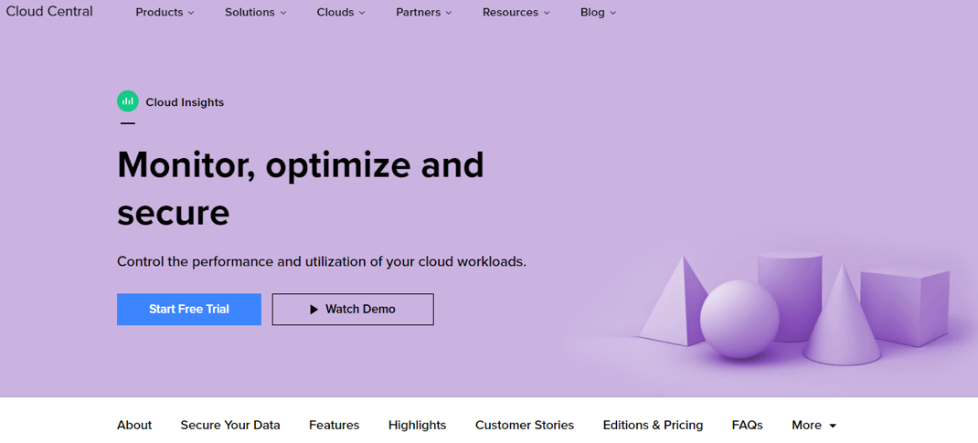
Next Steps
– Trials and POCs
  Start a free Cloud Insights trial or conduct a POC in your customer’s environment!
P

