Slide 1
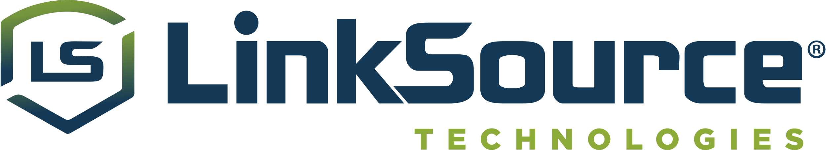
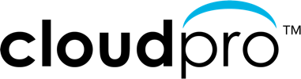

Cloud Optimization Sales Workshop – Part I
Optimize your Cloud
Accelerate your business with
Cloud Insights from NetApp
D

Slide 2

Special thanks to
Paul Jezowski NetApp Cloud Data Services Solution Architect
Mike Garcia CloudPro VP of Sales
M

Slide 3

LinkSource Sales Workshop Agenda
Schedule | Topic
9:00 – 9:05 | Welcome Introductions – CloudPro & NetApp Sales Workshop Objectives
9:05 – 9:15 | Why optimize your cloud? Performance, cost savings & security
9:15 – 9:40 | Taking control of your cloud NetApp Cloud Insights Monitoring & Optimization
9:40 – 9:50 | Selling Cloud Insights Target Customers Cloud Optimization Workshop POCs
9:50 – 9:55 | Nike By You
9:55 – 10:00 | Q & A
M

Slide 4



Your Business Accelerated
Comprehensive portfolio of cloud consulting and engineering services
Full spectrum of cloud expertise, skills, and certifications to quickly fill knowledge and resource gaps
High-quality cloud best practices and methodologies for your cloud optimization, integration, migration and assessment projects
D

Slide 5




Industry-leading cloud services
NetApp is a global cloud-led, data-centric software company that gives organizations everywhere the freedom to put data to work in the applications that elevate their business.
Global cloud-led, data-centric software company
Industry-leading software, systems, and cloud services
Founded in 1992, headquartered in San Jose, California
$5.74B FY21 revenue
11,000+ employees and 4,000+ partners helping organizations thrive in a hybrid multi-cloud world
Fortune 500 company (NASDAQ: NTAP)
Cloud
Storage
Compute
Operations
Cloud
Controls
Cloud Services
and Analytics
D

Slide 6



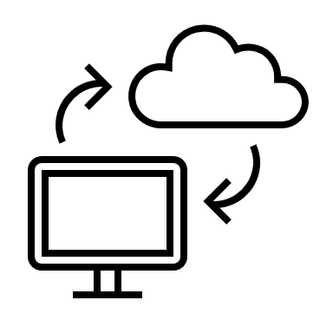

Why Cloud Insights?
Control the performance and usage of your workloads
When you have issues find the problems before they effect customer satisfaction
Optimize your growing cloud spend by understanding unused infrastructure and overprovisioned workloads
Monitor all your IT infrastructure on-premises and in the cloud
P

Slide 7





Cloud Insights Benefits Across the Organization
What inefficient use of resources means to:
CEO
CFO
CTO
IT MANAGER
PROCUREMENT MGR
Lower profit
Reduced cash flow
Inefficient use of resources
Fewer projects and smaller team
Best pricing, expense visibility
D
Notes:
Danny

Slide 8

Control the performance and cost of your cloud workloads
Find performance issues faster and optimize cloud usage to do more with your limited budget.
NetApp Cloud Insights is a SaaS based monitoring tool that helps you quickly find performance problems and optimize usage of your cloud workloads.
P
Notes:
Paul

Slide 9



Outcomes Delivered
– Why Do You Need Cloud Insights
Monitor shared resources across any infrastructure;
On-premised, Cloud and Kubernetes
Analyze relationships between shared resources and how they impact each other
Modernize and Analyze
Optimize and Control Usage
Optimize by identifying waste, increasing utilization and density of compute and storage
Control usage with Show-back / Chargeback showing who is using what and how much
Guarantee Availability
Determine the available headroom to prevent infrastructure saturation
Right size application resources to prevent performance problems and downtime
Key Differentiators
Multi-Vendor Infrastructure
Shared Infrastructure
Full Stack Visibility
Ransomware Protection
P

Slide 10


Operational Challenges
– Reasons to invest in Infrastructure Monitoring
  Business Challenges
  Poor performance effecting customer satisfaction
  Runaway cloud costs
  High cost of maintaining multiple tools
  High cost of system outages
  Inability to measure SLAs and usage for optimization
  Protection against Ransomware
  Technical Challenges
  Difficulty isolating problems and outages in complex hybrid infrastructure in a timely manner
  Lacking a single effective view of the full-service path
  Difficulty identifying workloads for right-sizing or optimization
  Inability to report on SLAs and SLOs
  Accurately provisioning cloud resources for cloud migrations
P

Slide 11
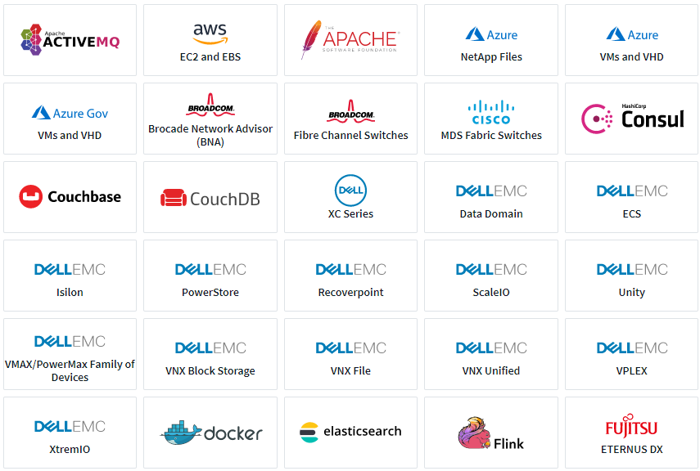
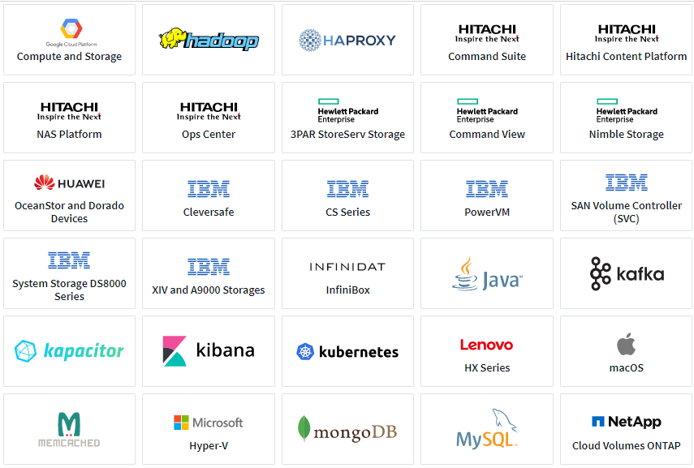
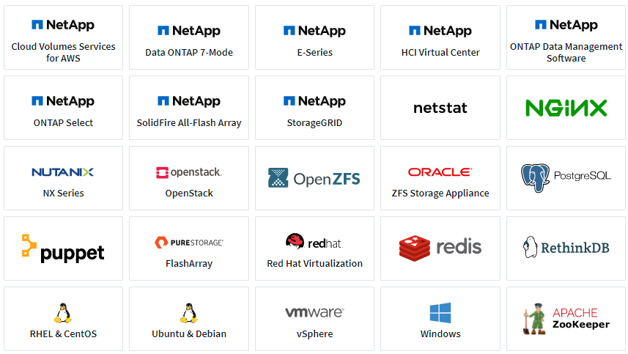
Heterogeneous Support
– Operating systems, infrastructure devices, and services
P

Slide 12

Cloud Insights
Common Use Cases
Cloud Visibility / Cloud Migration
Troubleshooting and Operational Efficiency
Forecasting and Trend Analysis
Security
P

Slide 13
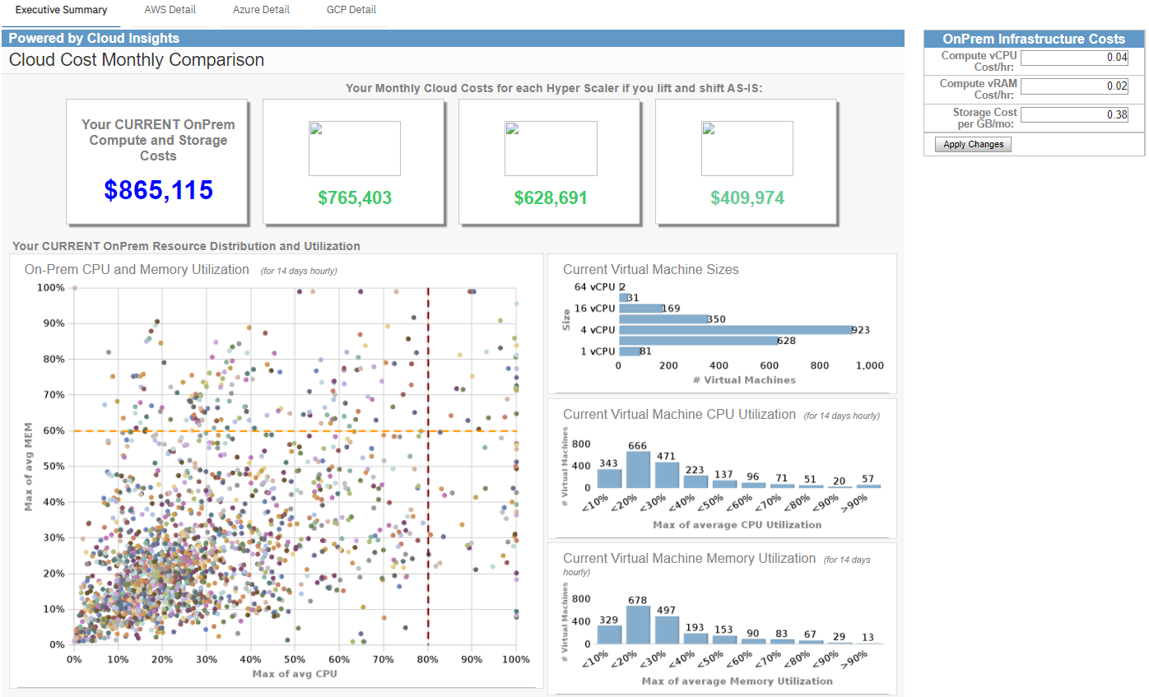

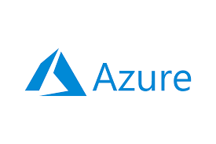
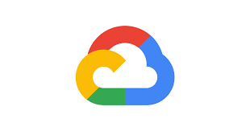
Cloud Visibility / Cloud Migration
– Optimize costs and run efficiently
Model on-prem versus cloud costs (these are fictitious values)
P

Slide 14
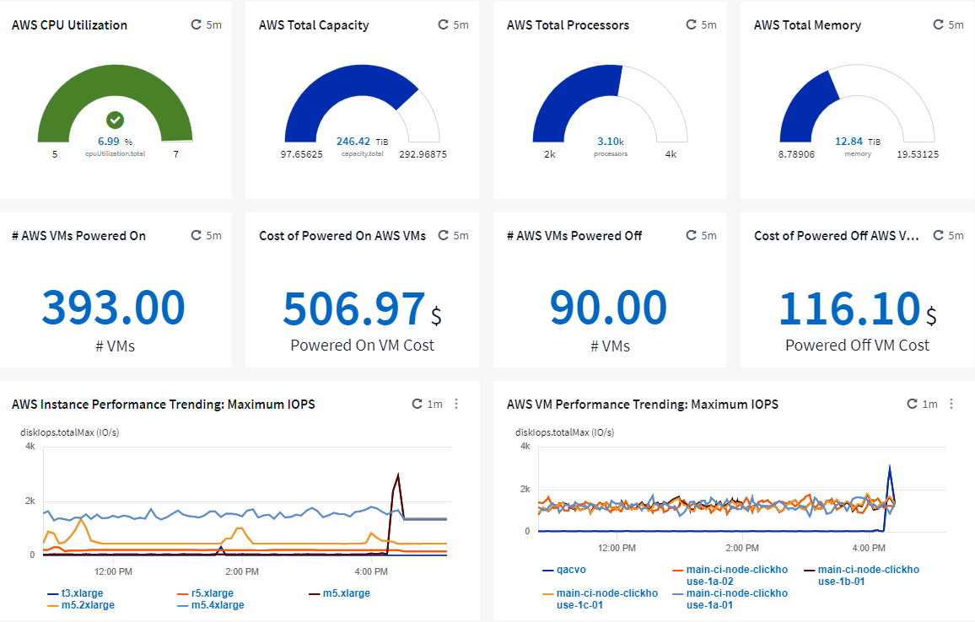
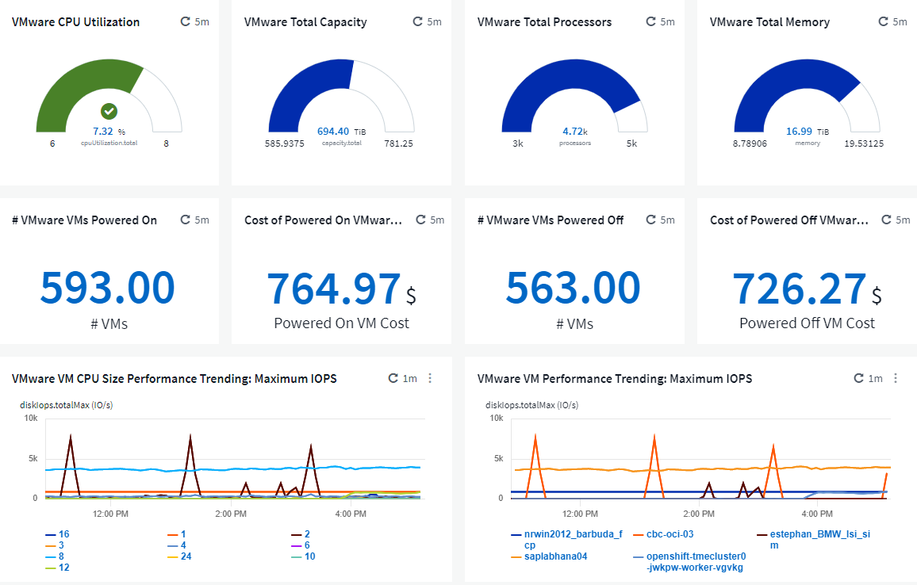
Cloud Visibility / Cloud Migration
– Managing hybrid-cloud assets: Side-by-side utilization and cost comparison
Cloud resources
On-prem resources
P

Slide 15
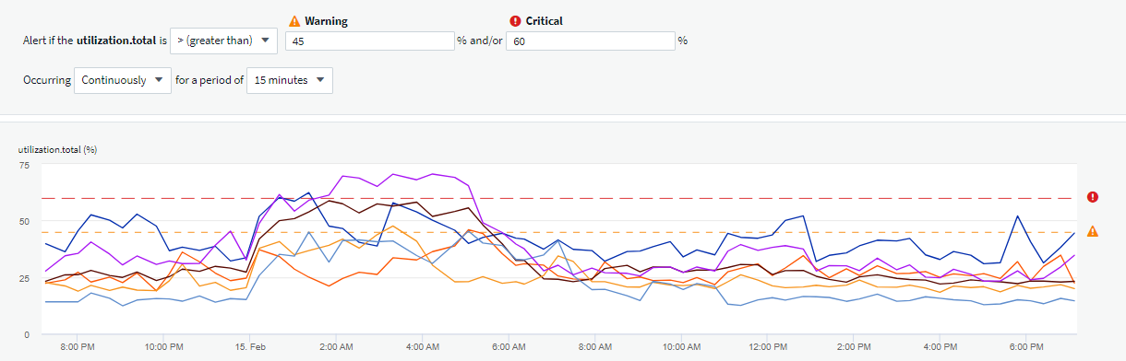
Troubleshooting and Operational Efficiency
– Reduce potential future application outages with proactive alerting
Thresholds determined by application owners, IT staff, etc…
Storage nodes consistently over-utilized, potentially leading to application interruption or outage
P

Slide 16
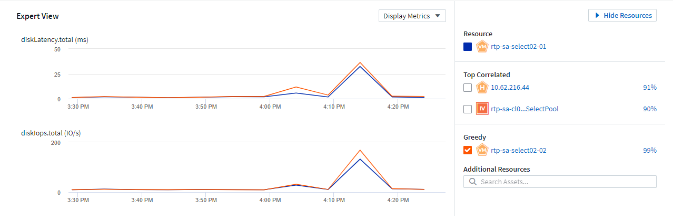
Troubleshooting and Operational Efficiency
– End-to-end visibility of application infrastructure resources, whether they’re in the cloud or on-prem
Identify resources having an impact on the base resource
IOPs of greedy resource (orange) impacts latency of base resource (blue)
Identify greedy or degraded workloads
P

Slide 17
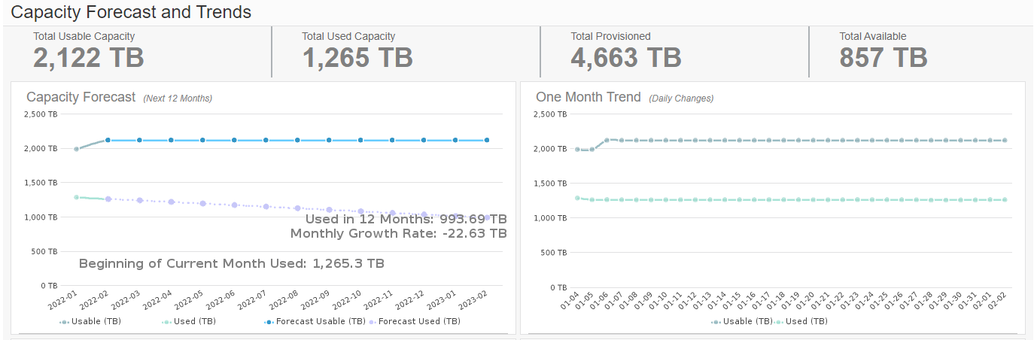
Forecasting and Trending Analysis
– Optimize usage and achieve more with a limited budget
Forecasted used capacity on a downward trend
P

Slide 18
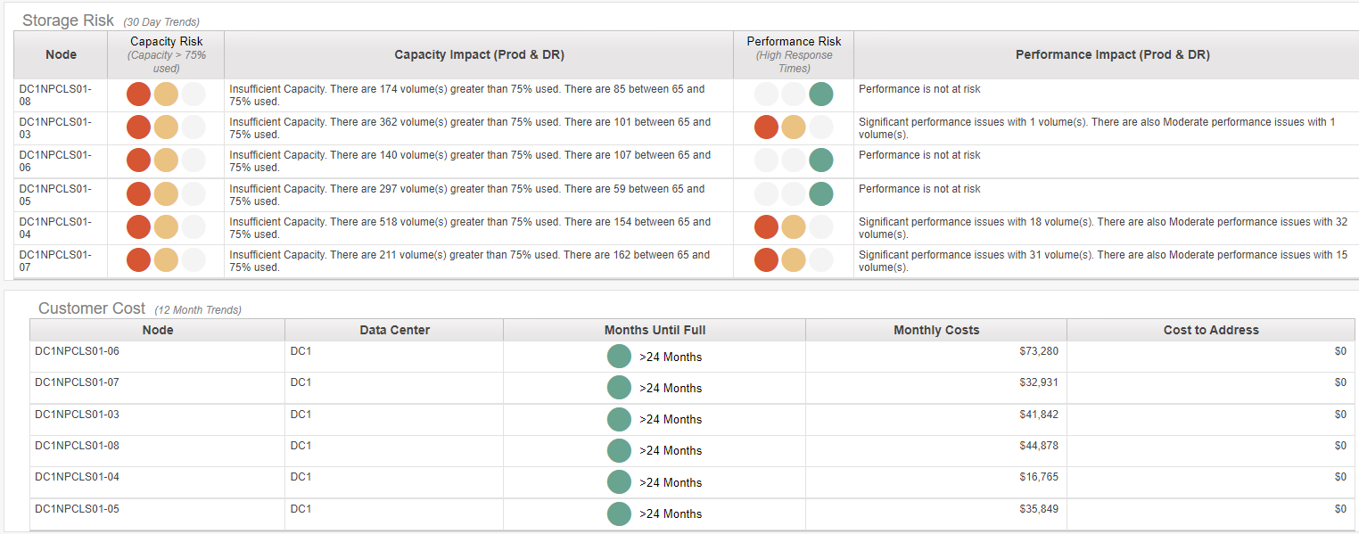

Forecasting & Trending Analysis
– Understand where storage capacity and performance may be at risk
Volume-level capacity and performance risk with easy-to-understand red, yellow, and green indicators
Anticipated capacity full timeframe based on current consumption
P

Slide 19
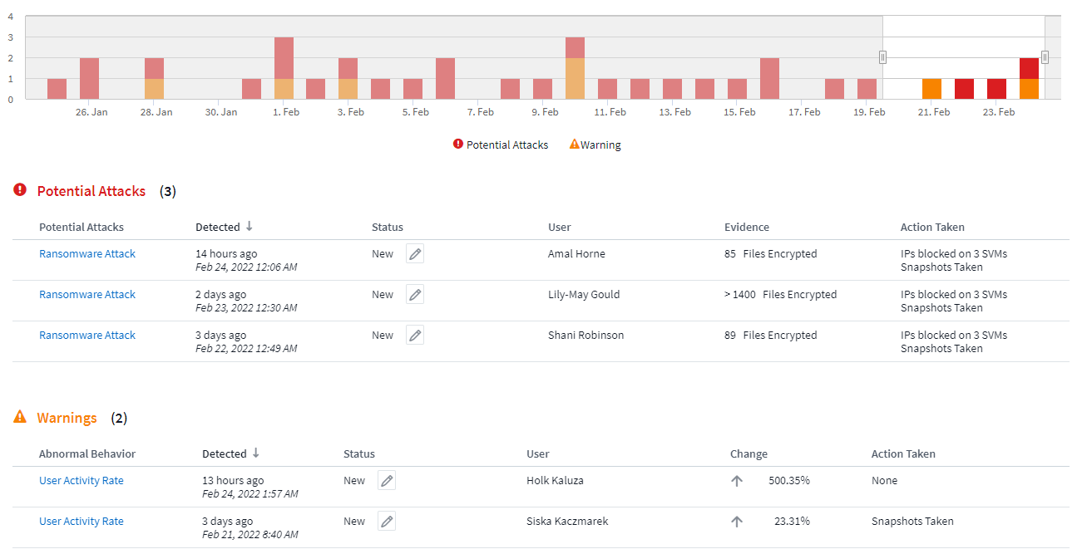
Security
– Cloud Secure: A feature of Cloud Insights
Detect anomalies & identify potential attacks
  Advanced machine learning algorithms uncover unusual data activity and detect a potential attack
Monitor User Activity
  All user activity across on-premises and hybrid cloud environments is captured and analyzed
Automated Response Policies
  Alerting and automatic data snapshot response make sure you are notified, data is backed-up and you can recover quickly
Forensics and User Audit Reporting
  Graphical interface for activity data analysis, data breach investigations and User Data Access Audit reporting generating
P

Slide 20


Summary
– Value and Benefits
Make intelligent decisions before, during, and after hybrid cloud migrations
Avoid potentially costly initial over-provisioning of cloud resources before migrating.
Analyze and control cloud costs before they get out of hand.
End-to-end visibility of application infrastructure resources, whether they’re in the cloud or on-prem
Reduce the time to find and resolve infrastructure issues and identify areas of potential risk before they become an issue.
Improve application availability and application user / owner satisfaction.
Integrate optimization and cost management into a daily process
REST APIs for CMDB integration enables true cost of infrastructure or application ownership analysis with chargeback reporting.
Provide infrastructure or application owners with performance and capacity information to make intelligent requirements decisions.
P

Slide 21

Summary
– Value and Benefits
Optimize usage and achieve more with a limited budget
Avoid over-provisioning hybrid cloud infrastructure resources.
Forecast infrastructure requirements based on historical trend analysis.
Protect organizational data from ransomware or being misused by malicious/compromised users
Limit critical data loss by detecting and stopping malicious activities.
Ensure corporate compliance by auditing user data access to NetApp data stored on-prem or in the cloud.
Avoid loss of business, damage to brand, loss of trust, fines, etc…
P

Slide 22





Cloud Insights Clients
Major healthcare insurer and managed care provider
Heterogeneous infrastructure monitoring, existing and via acquisitions
Ransomware and malicious activity detection
Global computer security company
Cloud migration
Cloud-based application chargeback
Global mortgage lending company
Monitor and administer their cloud-based VDI and database environment to ensure content creators have the necessary resources
Global provider of outsourced services to the pharmaceutical, biotechnology, and medical device industries
Heterogeneous infrastructure monitoring, capacity planning, and ransomware detection on a 20PB sprawling storage estate
Globally-known companies in the consumer electronics, entertainment, pharmaceutical oil & gas industries
Heterogeneous infrastructure monitoring
Cloud infrastructure monitoring: AWS, Google Cloud, Azure
P

Slide 23
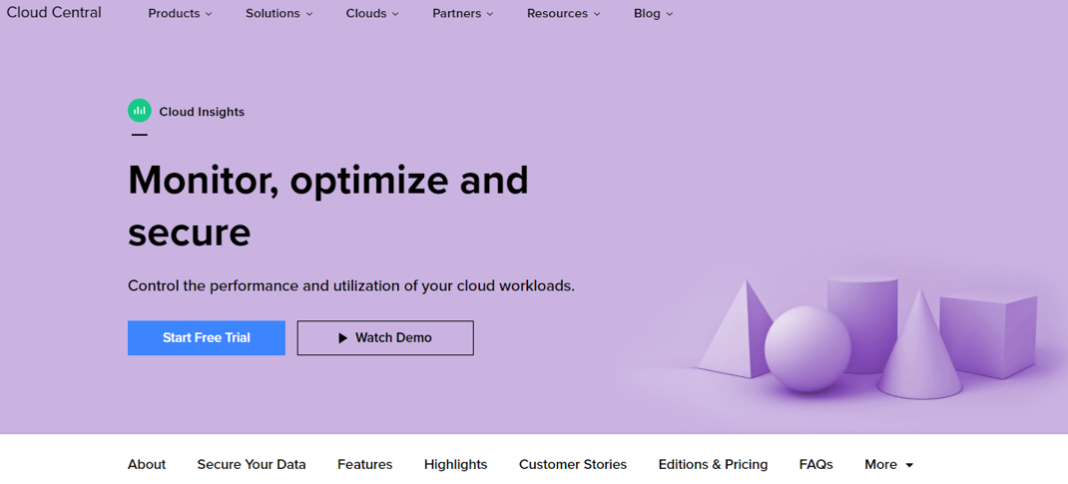
Next Steps
– Trials and POCs
  Start a free Cloud Insights trial or conduct a POC in your customer’s environment!
P

Slide 24
Target Customers
Dev / Ops Director
Kubernetes Admin
Network Analyst
Head of Solution Delivery
IT Administrator
Cloud Operations Manager
Cloud Architect
Security Operations Director
Infrastructure and Security
Technical
CEOs, CFOs COOs
VP IT Operations
Development / Enterprise Architecture
Chief Security Officer (CSO)
SVP or Director
Infrastructure / Operations Directors
Department Managers
Business
D

Slide 25
Selling to the CEO
Focus
Revenues
Profitability
Growth
Brand Stability
Motivations
Sales Generation
Time to Market
Competitive Advantage
Triggers
Lagging Sales
Cost Overruns
Market Shifts/Demands
Setting the Stage – Make IT a Business Generator Not a Cost Center
Is your IT organization a key contributor to your overall business strategy?
How dependent are your revenues and profits on the success/failure of your technology initiatives?
Are your technology cost/benefit ratios in line with your revenue and profit projections?
Do have “time to market constraints” that you are having trouble making due to technology short falls?

Slide 26
Survey Results
What we learned
Business Challenges
  Runaway cloud costs
  Inability to measure SLAs and usage for chargeback
  High cost of maintaining multiple tools
  Poor performance effecting customer satisfaction
  High cost of system outages
Technical Challenges
  Inability to right-size workloads that are over provisioned
  Find and fix problems faster
  Lack of a single effective monitoring tool that covers the full stack and can be used by the entire DevOps team
  Meet SLOs & SLAs during and after cloud migration
  Visibility into infrastructure and applications
D

Slide 27
Qualifying Opportunities
Are you able to control the performance and usage of your workloads?
Can you identify and resolve problems before they effect customer satisfaction?
Are you able to optimize your growing cloud spend by understanding unused infrastructure and overprovisioned workloads?
Are you able to monitor all your IT infrastructure on-premises and in the cloud?
Do you have actionable intelligence on insider threats?

Slide 28
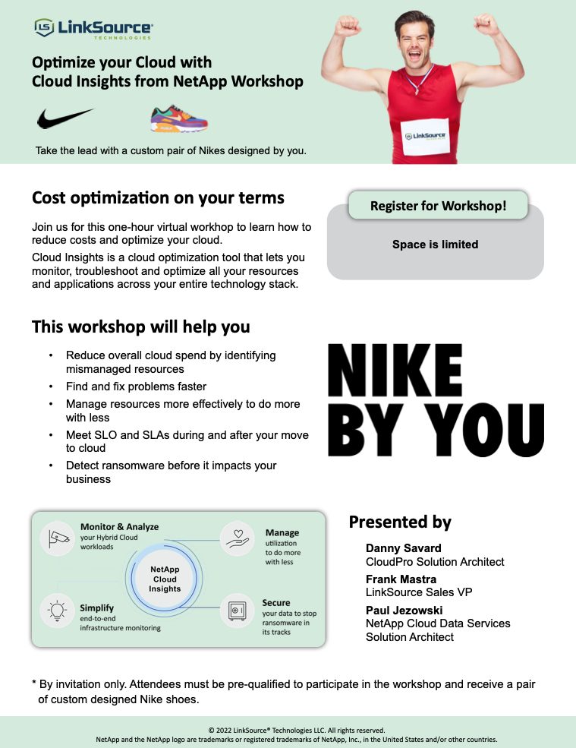
Cloud Insights Optimization Workshop

Slide 29
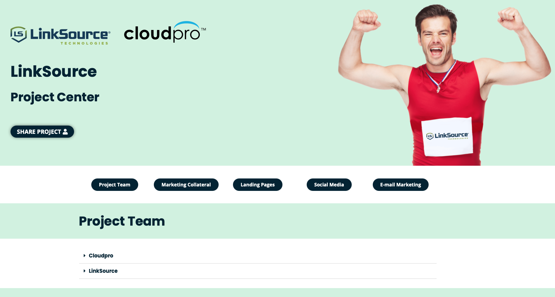
LinkSource Cloud Insights Resource Center

Slide 30



Custom Nikes
for LinkSource SR
for each
Cloud Insights POC
https://www.nike.com/nike-by-you
M

Slide 31

Q&A Discussion
Any Questions?
M

Slide 32

Next Step
Meet with Mike Plan client-specific CI sales campaign for target target accounts (30 mins)
Mike Garcia - VP of Sales
Email: mike.garcia@cloudpro.services
Mobile: (408) 590-6949
Calendly: https://calendly.com/mike-garcia-cloudpro
M

Slide 33
Mike Garcia - VP of Sales
Email: mike.garcia@cloudpro.services
Mobile: (408) 590-6949
Calendly: https://calendly.com/mike-garcia-cloudpro
Doug Kryzan - CEO
Email: doug.kryzan@cloudpro.services
Mobile: (650) 714-3882
M

Slide 34
M

