Slide 1
Cloud Insights
Hybrid Infrastructure Resource Management and Monitoring
Messaging and Content Toolkit

Slide 2
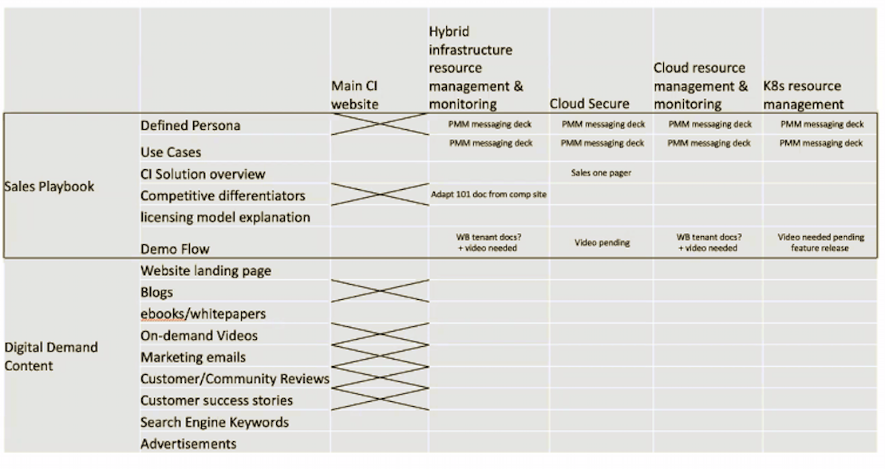
Cloud Insights Digital Campaigns and Playbooks

Slide 3
Key Personas and Workloads
Technical Personas
Infrastructure Manager
IT Operations Manager
Storage / Compute Admins
Developer / Engineer
Architect
Business Personas
VP IT Operations
SVP Application Development/Enterprise Architecture
Director Technology Shared Services
SVP or Director Infrastructure/Operations
Department Heads – i.e. ISP, Healthcare, Finance
Use Cases
Storage Management
Move to cloud

Slide 4
Outcomes Delivered
Why Do You Need Cloud Insights
Modernize and Analyze
Optimize and Control Usage
Guarantee Availability
Monitor shared resources across any infrastructure; On-premised, Cloud and Kubernetes
Analyze relationships between shared resources and how they impact each other
Optimize by identifying waste, increasing utilization and density of compute and storage
Control usage with Show-back / Chargeback showing who is using what and how much
Determine the available headroom to prevent infrastructure saturation
Right size application resources to prevent performance problems and downtime
Key Differentiators
  Multi-vendor infrastructure
  Shared Infrastructure
  Full Stack visibility

Slide 5
Storage Management
Persona – Titles
  Storage Admin
  Operations Managers
Jobs to be done
  Monitor and analyze multi-vendor storage
    Performance
    Optimize allocation and utilization
Pain Points
  No easy way to monitor NetApp and other vendor storage systems using element managers
    Eg. Jump-hosts, lots of credentials, apples to oranges comparisons, inconsistent terminology and metrics
  Inability to quickly get to MTTI
  Difficulty in collaborating cross silos
Promise
  Simple, Easy to use, maintenance free tool to cover all your infrastructure
  Visualize the full stack and see how resources are related helping you find problems faster
  Open API to easily consume metrics
  Integrate head-room management and waste identification into daily processes
  Balance allocation of capacity and performance effectively
Bold claims
  Find problems faster and be a hero
  Optimize usage, defer spend and do more with your limited budget
Opportunity timeline
  New storage sales
  Multi-vendor environment

Slide 6
Move to Cloud
Persona – Titles
  DevOps (Dev, SRE, Ops)
  Infrastructure Operations Manager
  Storage Admin
  Cloud Architect
Jobs to be done
  Plan and execute move to cloud mandate
  Ability to ensure visibility into cloud migrations to immediately recognize issues
  Monitor and optimize new modernized cloud applications
Pain Points
  Migration to the cloud involves re-tooling when there are many other changes to manage
  Difficulty in managing cross-platform (hybrid cloud) applications
Promise
  Comprehensive coverage all your infrastructure in the cloud and on-premises
  Single consistent way to monition head-room before, during and after migration to cloud
  Open API to easily consume metrics
  Integrate optimization and cost management into daily processes
Bold claims
  Meet SLOs and SLAs during and after move to cloud
  Implement pro-active waste management and do more with your limited budget
Opportunity timeline
  Projects moving workloads to cloud
  Mandates to move to cloud

Slide 7
Business Persona
Executives and line of business owners - budget holder & business decision maker
TITLES / ROLES INCLUDE
VP of IT/Operations, reporting to CIO/CTO
SVP Application Development/Enterprise Architecture
Director Technology Shared Services
SVP or Director Infrastructure/Operations
Department Heads – i.e. ISP, Healthcare, Finance
VALUE PROP
NetApp Cloud insights help you control the performance and cost of your multi-vendor on-premises and cloud workloads
RESPONSIBILITIES
Planning the IT future for the organization, including implementation and maintenance of current systems.
Technology leadership, rallying the troops around the technology plan and path for the company, especially when new training is needed for upgrades and system changes.
Ensure maximum uptime and stability in the company’s computer systems and networks
DEMOGRAPHICS
20+ years experience
MS in computer science or IT and perhaps MBA as well
HOW THEY GATHER THEIR INFORMATION TO BUY
Analyst reports/papers (i.e. vendor reviews, MQ)
Trusted vendors and suppliers – integration is key
“WHAT” ABOUT NETAPP WILL APPEAL TO THEM?
Market leader, proven enterprise technology, customer-proven implementations with in many fortune 500 enterprises
The number one device management software (OCI) (IDC- 2020)

Slide 8
Target Identification
Organizations
  IT departments from small to large enterprises excluding defense departments
  Cloud Insights is globally available
  All verticals are relevant
    Healthcare and Financial services are top verticals
Notable companies using OCI and Cloud Insights
  Apple, Intuit, DreamWorks, RGA, Denver Health, AstraZeneca, Chevron
Installed technology
  On-premises multi-vendor systems
  Cloud infrastructure: AWS, Google Cloud, Azure

Slide 9
Operational challenges
Reasons to invest in Infrastructure monitoring
Business Challenges
  Poor performance effecting customer satisfaction
  Runaway cloud costs
  High cost of maintaining multiple tools
  High cost of system outages
  Inability to measure SLAs and usage for chargeback
Technical Challenges
  Inability to isolate problems and outages in complex hybrid infrastructure
  Lack of a single effective monitoring tool that covers the full stack and can be used by the entire DevOps team
  Inability to right-size workload that are over provisioned
  Inability to report on SLAs and SLOs

Slide 10
Narrative
Operations Managers
Your IT infrastructure is growing increasingly complex, and you are asked to do more with fewer resources. You are responsible for meeting performance goals and reducing MTTR inside ever more aggressive budgetary constraints. You must do this for a multi-vendor and multi-platform infrastructure that spans hybrid cloud and public cloud resources. You are the first in the line of fire if something goes wrong. What if you had a simple, SaaS based, easy to use Infrastructure and application Monitoring tool that could reduce trouble shooting time, encourage proactive optimization, and accurately predict performance needs?
Now there is a cloud-based monitoring tool that provides you actionable knowledge of your infrastructure. NetApp Cloud Insights is simple to use. Because it’s hosted in the cloud, it is easy to be up and running fast; giving you real-time data visualization of the availability, performance, utilization and optimization of your IT applications and infrastructure.
Cloud Insights will quickly inventory what resources you have, discover interdependencies across them, and assemble an easily navigable topology of your environment. This means that you have end-to-end visibility into what infrastructure resources are supporting which applications or business units, regardless of whether the resources are in the cloud or on premises. Along with this visibility, Cloud Insights offers advanced analytics. You will be able to identify which resources are greedy and degraded through correlation analysis, helping you identify the root cause of a problem faster and minimizing finger-pointing between support groups. With Cloud Insights, you can set up advanced conditional policies with alerts, with a sophisticated metadata engine to filter the appropriate alerts to the right application and infrastructure teams.
Whether you’re moving applications to the cloud, or taking them back into your own datacenters, Cloud Insights offers a consistent operational view that enables you and your teams to operate effectively throughout change in the environment.
Available on NetApp Cloud Central https://cloud.netapp.com/cloud-insights, NetApp Cloud Insights, is designed to be simple to set up and easy to use. (need a description of how to demo, try or buy Cloud Insights)

Slide 11
COPY+ CLAIMS + PROOF POINTS | Cloud Insights
Headline: Control the performance and cost of your cloud workloads
Bold Claim: Find performance issues faster and optimize cloud spend to do more with your limited budget
25 words Find problems fast and reduce spend NetApp Cloud Insights is a SaaS based monitoring tool that helps you quickly find performance problems and optimize usage of your cloud workloads. (23 words)
50 words Visualize of your entire IT infrastructure NetApp Cloud Insights is a SaaS based monitoring tool that helps you quickly find performance problems and optimize usage of your cloud workloads. It is easy to be up and running fast, giving you real-time data visualization of the availability, performance, and utilization of your entire IT infrastructure. (48 words)
100 words Advanced analytics across topology, context and time NetApp Cloud Insights is a SaaS based monitoring tool that helps you quickly find performance problems and optimize usage of your cloud workloads. It is easy to be up and running fast, giving you real-time data visualization of the availability, performance, and utilization of your entire IT infrastructure. Cloud Insights will quickly inventory what resources you have, figure out the interdependencies across them, and assemble a topology of your environment. This means that you have end-to-end visibility into what infrastructure resources are supporting which applications or business units, regardless of whether the resources are in the cloud or on premises. (100 words)

Slide 12
Benefits
Top reasons for adopting Cloud Insights
Control the performance and usage of your workloads
When you have issues find the problems before they effect customer satisfaction
Optimize your growing cloud spend by understanding unused infrastructure and overprovisioned workloads
Monitor all your IT infrastructure on-premises and in the cloud
Monitor the health of your Kubernetes clusters including which nodes are in trouble and zoom in when you see a problem
Take advantage of Active IQ integration and directly identify risks and get prescriptive guidance
Protect your data with Cloud Secure. Get actionable intelligence on insider threats through advanced machine learning and anomaly detection

Slide 13
Cloud Insights Headlines
Control your cloud infrastructure
Want to Be a Hero? Prevent IT Problems Now!
Do more with less
Infrastructure Monitoring Software: Can You Afford It?
Integrate optimization into your daily workflows
Maintain sanity before, during and after cloud migration
Something about stopping arguing with other silos/towers when stuff breaks

Slide 14
Pain, Power, Fit and Timeline
Pain
Runaway costs of cloud infrastructure
Unable to quickly diagnose problems
Unable to find unused, orphaned infrastructure
Power
Architect and developer influence
LOB or departmental budget
Cloud first mandate
Fit
When you have issues find the problems before they effect customer satisfaction
Optimize your growing cloud spend and do more with less
Monitor all your IT infrastructure on-premises and in the cloud
Timeline
Refresh with Cloud Integration requirements
Cloud cost reduction projects
Move to cloud projects
New cloud-based application development

Slide 15
Thank you

