Slide 1
Cloud Insights
Cloud Resource Management and Monitoring
Messaging and Content Toolkit
Richard Treadway & Josh Moore
July 2020

Slide 2
Key Personas and Workloads
Technical Personas
DevOps (Dev, SRE, Ops)
Cloud Operations Manager
Cloud Architect
Business Personas
VP IT Operations
SVP Application Development/Enterprise Architecture
Director Technology Shared Services
SVP or Director Infrastructure/Operations
Department Heads – i.e. ISP, Healthcare, Finance
Use Cases
Cloud Monitoring
  EC2 and EBS Monitoring
Personas
  DevOps (Dev, SRE, Ops)
  Operations Manger
  Cloud Architect

Slide 3
Outcomes Delivered
Why Do You Need Cloud Insights
Modernize and Analyze
Optimize and Control Usage
Guarantee Availability
Monitor shared resources across any infrastructure; On-premised, Cloud and Kubernetes
Analyze relationships between shared resources and how they impact each other
Optimize by identifying waste, increasing utilization and density of compute and storage
Control usage with Show-back / Chargeback showing who is using what and how much
Determine the available headroom to prevent infrastructure saturation
Right size application resources to prevent performance problems and downtime
Key Differentiators
  Multi-vendor infrastructure
  Shared Infrastructure
  Full Stack visibility

Slide 4
AWS Cloud Monitoring
Persona – Titles
  DevOps (Dev, SRE, Ops)
  Cloud Operations Manager
  Cloud Architect
Jobs to be done
  Monitor and analyze EC2 and EBS to detect resource contention before it impacts users
  Make optimize allocation and utilization of associated infrastructure into daily workflows
Pain Points
  Difficulty monitoring shared resources with no integration of the many element managers
  Difficulty visualizing end to end application performance
Promise
  Simple, Easy to use tool to cover all your infrastructure
  Visualize the full stack and see how resources are related helping you find problems faster
  Open API to easily consume metrics
  Integrate optimization and cost management into daily processes
Bold claims
  Find problems faster and be a hero
  Optimize usage, defer spend and do more with your limited budget
Opportunity timeline
  DevOps ”go-live” schedule
  Cloud cost reduction projects
  New cloud-based application development

Slide 5
Business Persona
Executives and line of business owners - budget holder & business decision maker
TITLES / ROLES INCLUDE
VP of IT/Operations, reporting to CIO/CTO
SVP Application Development/Enterprise Architecture
Director Technology Shared Services
SVP or Director Infrastructure/Operations
Department Heads – i.e. ISP, Healthcare, Finance
VALUE PROP
NetApp Cloud insights help you control the performance and cost of your multi-vendor on-premises and cloud workloads
RESPONSIBILITIES
Planning the IT future for the organization, including implementation and maintenance of current systems.
Technology leadership, rallying the troops around the technology plan and path for the company, especially when new training is needed for upgrades and system changes.
Ensure maximum uptime and stability in the company’s computer systems and networks
DEMOGRAPHICS
20+ years experience
MS in computer science or IT and perhaps MBA as well
HOW THEY GATHER THEIR INFORMATION TO BUY
Analyst reports/papers (i.e. vendor reviews, MQ)
Trusted vendors and suppliers – integration is key
“WHAT” ABOUT NETAPP WILL APPEAL TO THEM?
Market leader, proven enterprise technology, customer-proven implementations with in many fortune 500 enterprises
The number one device management software (OCI) (IDC- 2020)

Slide 6
Target Identification
Organizations
  IT departments from small to large enterprises excluding defense departments
  Cloud Insights is globally available
  All verticals are relevant
    Healthcare and Financial services are top verticals
Notable companies using OCI and Cloud Insights
  Apple, Intuit, DreamWorks, RGA, Denver Health, AstraZeneca, Chevron
Installed technology
  On-premises multi-vendor systems
  Cloud infrastructure: AWS, Google Cloud, Azure

Slide 7
Operational challenges
Reasons to invest in Infrastructure monitoring
Business Challenges
  Poor performance effecting customer satisfaction
  Runaway cloud costs
  High cost of maintaining multiple tools
  High cost of system outages
  Inability to measure SLAs and usage for optimization
Technical Challenges
  Inability to isolate problems and outages in complex hybrid infrastructure
  Lack of a single effective monitoring tool that covers the full stack and can be used by the entire DevOps team
  Inability to right-size workload that are over provisioned
  Inability to report on SLAs and SLOs

Slide 8
Narrative
Site Reliability Engineers
As an SRE you are charged with developing and supporting modern applications, and a key point of arbitration between Developer and Operation functions. Your goal is to improve operational efficiency and performance. You identify and manage risks involved in the development and deployment of these new applications. Failure of these applications will adversely affect your company’s business.
You need tools covering every aspect of your application that give you real-time insight into the SLIs so that you can be assured that your systems are meeting SLOs and SLAs. When you do experience infrastructure outages you need tools that help you find the problem fast. Bottom line you are the first in the line of fire if something goes wrong. We designed NetApp Cloud insights to give you extensive coverage of your environment, to minimize the number of tools you need to use to troubleshoot critical issues and resolve them as quickly as possible.
NetApp Cloud Insights is a SaaS monitoring tool that provides you actionable knowledge of your infrastructure. NetApp Cloud Insights is simple to use. Because it’s hosted in the cloud, it is easy to be up and running fast; giving you real-time data visualization of the availability, performance, and utilization of your entire environment. Cloud Insights can provide the expert views you need, but additionally is easy to use for the non-expert, so can be used by all your extended team. This is important because ensuring performance, availability and efficiency should be everyone's job.
Cloud Insights will quickly inventory what resources you have, along with interdependencies between them, and assemble a topology of your environment. This means that you have end-to-end visibility into what infrastructure resources are supporting which applications or business units, regardless of whether the resources are in the cloud or on premises – or both. Along with this visibility, Cloud Insights offers advanced analytics. You will be able to identify which resources are greedy and degraded through correlation analysis, helping you identify the root cause of a problem faster. With Cloud Insights, you can set up advanced conditional policies with alerts once, to cover many different environments.
Available on NetApp Cloud Central https://cloud.netapp.com/cloud-insights, NetApp Cloud Insights, is designed to be simple to set up and easy to use.

Slide 9
COPY+ CLAIMS + PROOF POINTS | Cloud Insights
Headline: Control the performance and cost of your cloud workloads
Bold Claim: Find performance issues faster and optimize cloud usage to do more with your limited budget
25 words Find problems fast and reduce spend NetApp Cloud Insights is a SaaS based monitoring tool that helps you quickly find performance problems and optimize usage of your cloud workloads. (23 words)
50 words Visualize of your entire IT infrastructure NetApp Cloud Insights is a SaaS based monitoring tool that helps you quickly find performance problems and optimize usage of your cloud workloads. It is easy to be up and running fast, giving you real-time data visualization of the availability, performance, and utilization of your entire IT infrastructure. (48 words)
100 words Advanced analytics across topology, context and time NetApp Cloud Insights is a SaaS based monitoring tool that helps you quickly find performance problems and optimize usage of your cloud workloads. It is easy to be up and running fast, giving you real-time data visualization of the availability, performance, and utilization of your entire IT infrastructure. Cloud Insights will quickly inventory what resources you have, figure out the interdependencies across them, and assemble a topology of your environment. This means that you have end-to-end visibility into what infrastructure resources are supporting which applications or business units, regardless of whether the resources are in the cloud or on premises. (100 words)

Slide 10
Benefits
Top reasons For Adopting Cloud Insights
Control the performance and usage of your workloads
When you have issues find the problems before they effect customer satisfaction
Optimize your growing cloud spend by understanding unused infrastructure and overprovisioned workloads
Monitor all your IT infrastructure on-premises and in the cloud

Slide 11
Cloud Insights Headlines
Control your cloud infrastructure
Want to Be a Hero? Prevent IT Problems Now!
Do more with less
Infrastructure Monitoring Software: Can You Afford It?
Integrate optimization into your daily workflows
Maintain sanity before, during and after cloud migration
Stop arguing with other silos/towers when stuff breaks

Slide 12
Pain, Power, Fit and Timeline
Pain
Runaway costs of cloud infrastructure
Unable to quickly diagnose problems
Unable to find unused, orphaned infrastructure
Power
Architect and developer influence
LOB or departmental budget
Cloud first mandate
Fit
When you have issues find the problems before they effect customer satisfaction
Optimize your growing cloud spend and do more with less
Monitor all your IT infrastructure on-premises and in the cloud
Timeline
DevOps ”go-live” schedule
Cloud cost reduction projects
New cloud-based application development

Slide 13
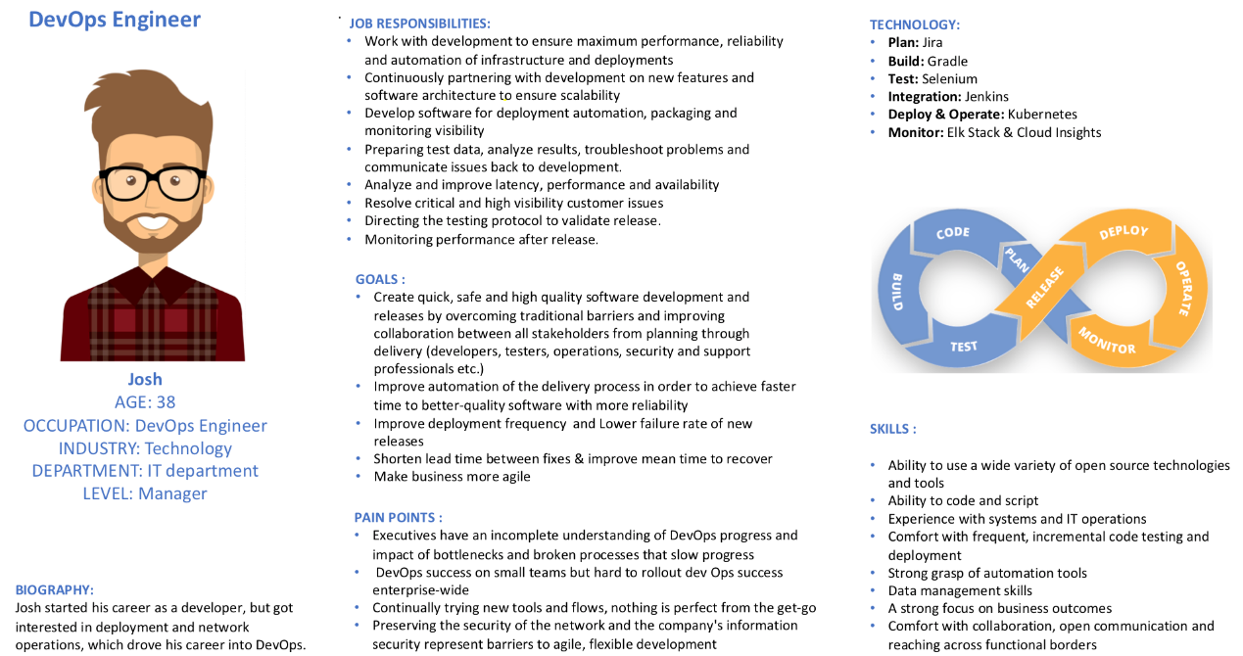
DevOps Persona – SRE/Engineer

Slide 14
Thank you

